Slide 1
The 1,2,3 of CKD
W.A. Wilmer, MD
Kidney Specialists, Inc.
National Kidney Foundation of Central Ohio
Board of Advisors
Medical Advisory Board

Slide 2
Goals of this talk:
Teach providers how to evaluate CKD patients in their office, to start the diagnostic and treatment plan
Teach strategies for treating all stages of CKD, especially CKD stage IIIA.

Slide 3
The Final Phase of CKD –
Dialysis and Its Financial Burden:
750,000 people in the US have ESRD – US Renal Data Service 2020
$80,000 / year all costs for ESRD care (Medicare and commercial insurance)
1% of Medicare patients have ESRD, but 7% of the Medicare budget for ESRD.
Medicare ESRD budget almost exceeds NIH research budget
Transplantation is the answer but 100,000 on the list and 21,000 transplants available / year.

Slide 4
Kidney Disease: Improving
Global Outcomes (KDIGO)
NKF (United States) initiative to develop guidelines / structure for CKD management
Universally accepted standards for the care of CKD
CKD definition: “GFR < 60 ml/min stable for 3 months, or proteinuria”

Slide 5
KDIGO spotlight on the CKD management crisis
>20 million adult Americans with CKD
only
10,000 practicing nephrologists and advanced practitioners
KDIGO: PCPs are expected to screen and manage at early stage CKD with minimal proteinuria (albuminuria),
without nephrology referral
S. Thavarajah, et al. CKD for primary care practitioners: can we cut to the chase without too many shortcuts?, AJKD, 2016: 67(6):P826-829.

Slide 6
Not all diabetics need an endocrinologist…….not all CKD patients need a nephrologist.

Slide 7
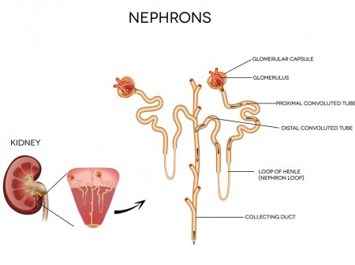
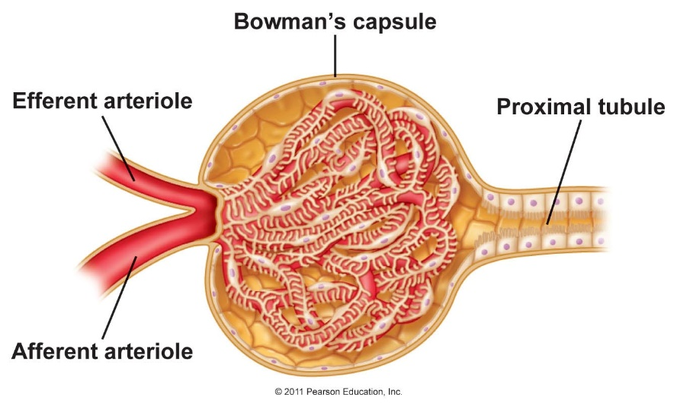
Glomeruli at
the outer cortex
Glomerular filtering:
Normally 1 million glomeruli per kidney
Prematurity results in incomplete
development of glomeruli
Aging reduces functioning glomeruli

Slide 8
The 1,2,3 of CKD
Step 1:
Glomerular Filtering Rate measurement

Slide 9
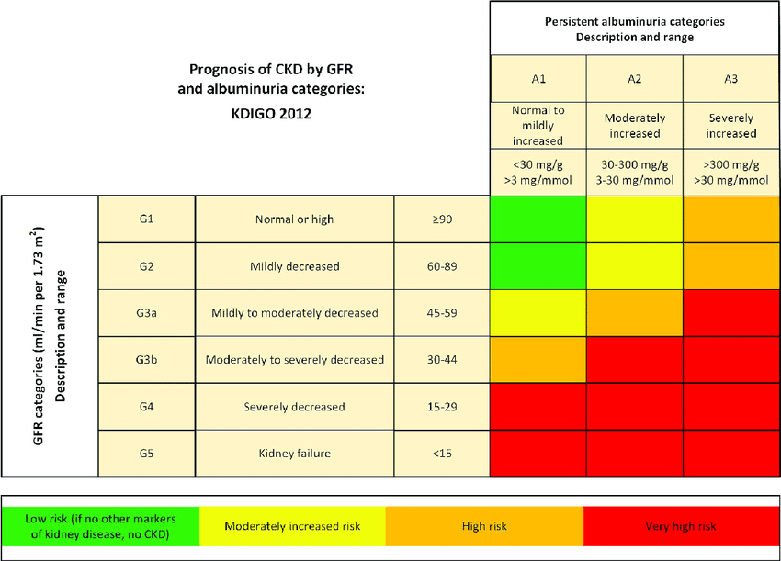
CKD staging criteria using glomerular filtering rate (GFR)
NIH/ NKF Work Group consensus
Risk of GFR decline

Slide 10
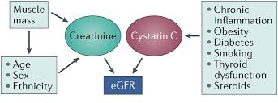
GFR: What to Measure:
Creatinine: Generated by skeletal muscle
- Muscle mass varies between patients and with age / health of same patient
Cystatin C : Generated by all nucleated cells
In theory superior to creatinine
Altered by health issues
Order when creatinine-measured eGFR is low in someone with large muscle mass
Affected by:
Affected by:

Slide 11
eGFR: How to Measure:
All equations use: Cr or Cystatin C, age, gender, +/- race
MDRD equation:
Logarithmic equation based on the 1990s Modification of Diet in Renal Disease Trial
African-American creatinine generation higher than other races, pound for pound
AA and non-AA results provided
Less accurate when GFR > 60 ml/minute
CKD-EPI equation :
2021 version is currently the recommended equation
Race neutral equation: overestimates non-AA, underestimates AA GFR

Slide 12
Chronic kidney disease is NOT a “disease” – it is a spectrum of health and injury:
CKD is the result of a specific process(es) that is/ are a disease:
For example, diabetic kidney disease, polycystic kidney disease, lupus nephritis, kidney transplant rejection, etc.
Loss of GFR also occurs with aging – usually 1 ml/min of GFR decline each year after age 40. (A 90 year old GFR is ~ 50 ml/minute). So is that chronic kidney disease?
The most common cause of GFR loss you will see in the office is aging!

Slide 13
eGFR should be EGFR
The eGFR measurements are ESTIMATES only – indirect measurements
Muscle mass of patients varies
This is a screening tool
To accurately measure creatinine production and excretion – 24 hour urine collections – a direct measurement.

Slide 14
Bell shaped curve: eGFR identifies the mean GFR.
But patients exist above and below that mean value!

Slide 15
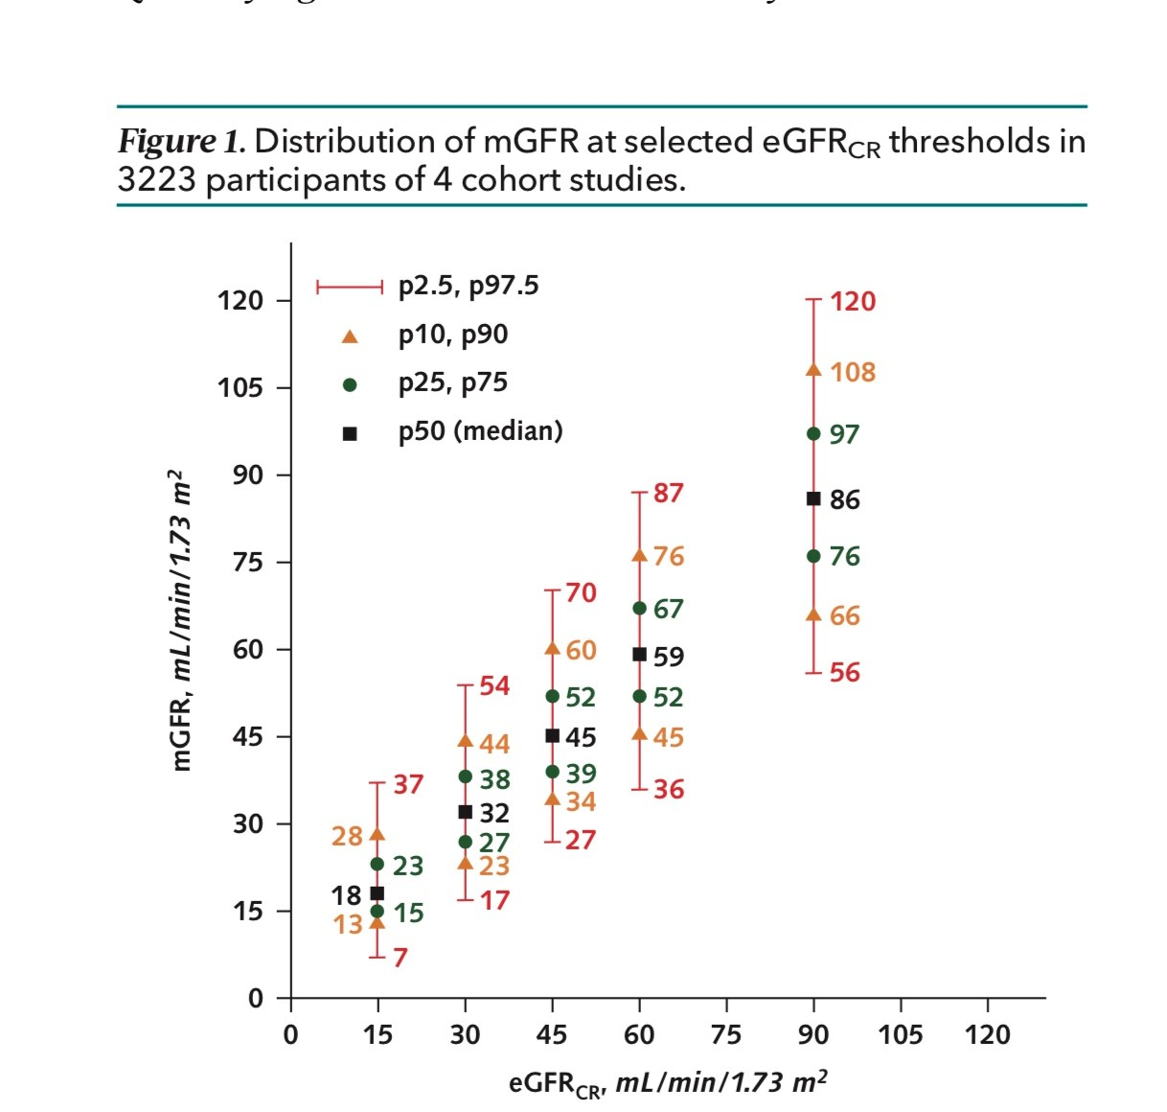
Shafi, T., Quantifying individual –level inaccuracy in glomerular filtration rate estimation. Annals of Internal Medicine, 2022

Slide 16
eGFR is accurate when body habitus is “normal” for gender and age.
When a patient has muscle mass greater or lesser than “normal”, the eGFR is not accurate. In these cases -> 24 hour urine for creatinine clearance.
Trends in eGFR are helpful.
Medications: Fenofibrate – increases muscle production of creatinine without harming kidney function. The “fenofibrate effect” is a low eGFR due to elevation of serum Cr, with normal 24 hour urine creatinine clearances.

Slide 17
EXAMPLES:
eGFR underestimates GFR:
A 55 year old male, construction worker was told he needs to prepare for
dialysis. He is 6’ 4’’, 255 pounds, BSA 2.5 m2; takes lisinopril-HCT, atorvastatin,
fenofibrate, and omeprazole.
Serum creatinine 3.5 mg/dL, eGFR 19 ml/minute.
You ask him to collect a 24 hour urine. His creatinine clearance is
37 ml/minute/1.73 m2.
eGFR overestimates GFR:
A 78 year old female s/p breast cancer treatment has routine labwork that
She is 5’ 2’’, 96 pounds, BSA 1.38 m2.
Serum creatinine 2.0 mg/dL, eGFR 25 ml/minute.
A 24 hour urine is 15 ml/minute/1.73 m2.

Slide 18
The 1,2,3 of CKD
Step 2:
Urine Studies:
Urinalysis
Urine albumin:creatinine ratio (UACR)

Slide 19
Urinalysis
Hematuria – identifies possible glomerulonephritis and possibly faster loss of GFR
Hematuria should be independent of infection.
Recurrent – so test more than once and perform C & S.
Imaging – is this associated with stones or tumor?
CT w/contrast if GFR allows .

Slide 20
Hematuria:
Urology referral:
  Normal GFR
  Gross hematuria
  Microhematuria with normal GFR
  Smoking Hx, occupational risk (factory dyes)
  > 40 years old
  Previous radiation therapy to bladder
  When Nephrology workup is normal
Nephrology referral:
  Low GFR especially declining GFR (check BMP every few weeks!)
  Microhematuria w/ proteinuria
  Age < 40
  Associated w/URI within past few weeks (IgAN, post-strept GN),
  When Urology workup is normal
FYI: Urine cytology for malignancy of limited value as screening.

Slide 21
Urinalysis
Proteinuria (Albuminuria):
Anatomical barriers to blood albumin leak through the glomerulus
Albuminuria represents a breakdown of these barriers
Indicates glomerular disease
Protein leak causes inflammation of tubules and support structures leading to kidney failure ! (The more albuminuria, the faster the kidney decline.)

Slide 22
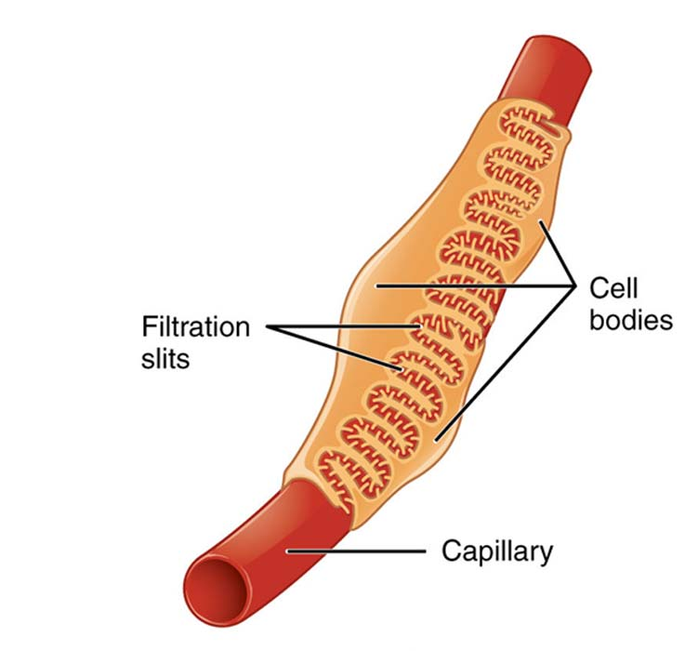
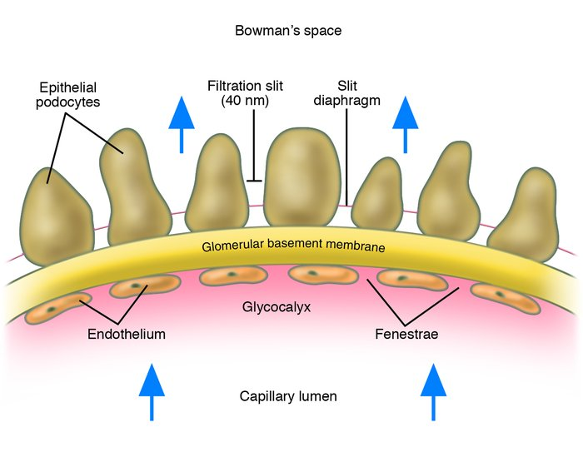
Cross section of a glomerular capillary
MR
MR
MR
MR
MR = mineralocorticoid receptor
I

Slide 23
Urinalysis
Albuminuria:
UA dipstick most sensitive to albumin, least sensitive to LMW proteins.
Sensitivity to albumin excretion ~ 20 mg/dL (~ 300 mg/day).
UA is not standardized for how diluted or concentrated urine sample is (other than S.G).
False positive –
  Concentrated urines. If low grade proteinuria and SG > 1.020 repeat after hydration
  radiocontrast dye
  pyridium
  pH > 8.0.

Slide 24
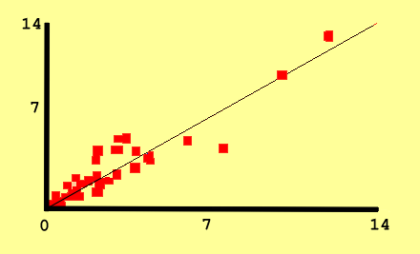
Standardizing proteinuria by urine creatinine
Creatinine excretion is
constant.
If urine creatinine excretion is ~ 1000 mg /day:
Urine Protein: Cr Ratio (UPCR) or Urine Albumin: Cr Ratio (UACR) corresponds to daily proteinuria
Urine P/C ratio
Proteinuria, g/day/1.73 m²
Adapted from Ginsberg et al., NEJM, 309:1543 1983.
(For ex, a UPCR of 1.0 = 1 gram / day, 4.5 = 4.5 grams / day, 0.600 = 600 mg / day)
For patients of large or small body habitus, a 24-hour urine will determine daily
creatinine generation / excretion -> can use to calculate a patient’s U PCR.

Slide 25
Measuring Albuminuria via Urine Albumin: Creatinine Ratio (UACR)
(in many labs = microalbuminuria)
“Microalbuminuria” – low levels of albumin not sensitive via UA. Standardized to creatinine in urine as creatinine excretion is fairly constant (i.e tells if sample is dilute or concentrated):
< 30 mcg / mg creatinine excreted - is normal.
> 30 mcg / mg creatinine excreted - high and represents glomerular leak.
> 300 mcg / mg creatinine excreted - very high and is called macroalbuminuria.
“Macroalbuminuria” – > 300 mcg/mg creatinine excreted.
If persistent represents glomerular pathology and needs nephrology evaluation.

Slide 26
Measuring Albuminuria
Determine if PERMANENT or TRANSIENT -> repeat to confirm.
Conditions that cause transiently elevated albuminuria
Very elevated blood pressures
Very elevated glucose
Infections / inflammation (including vaccinations)
Don’t measure until these issues are improved

Slide 27
Nephrotic-range proteinuria
> 3 grams / day (3 grams/gram Cr)
Often associated with the Nephrotic Syndrome
  > 3 grams proteinuria
  Hypoalbuminemia
  Hyperlipidemia -> higher CVD rate, so follow lipids, start statins
  Hypercoagulability
  Hypercoagulability – need to start preventative therapy
  Serum Albumin < 2 gram/dL
  UPCR 10 grams/day
  BMI > 35
  Prolonged Immobilization
  Genetic risk of coagulopathy
  Heart failure: NYHA III – IV
  Recent orthopedic interventions

Slide 28
Ordering for albuminuria or proteinuria?
Early glomerular damage:
Albuminuria should be followed (urine albumin: Cr ratio, or U ACR)
Measuring total proteinuria results in more LMW protein measurement than albumin
Macroalbuminuria:
Sometimes difficult to quantitate – in some labs albuminuria cut-off values
prevent accurate levels (e.g. “ > 1500 mcg/mg Cr”)
LMW protein interference less of a concern –> can use total
proteinuria (urine protein: Cr ratio, or U PCR)

Slide 29
Proteinuria as a risk for
CKD progression

Slide 30
For 30+ years we have known proteinuria = rapid GFR decline
GFR falls from
60% to < 15% in
6 years
Modification of Diet in Renal Disease study: 1989 – 1993.
Ramipril Efficacy in Nephropathy (REIN) study : 1997.

Slide 31
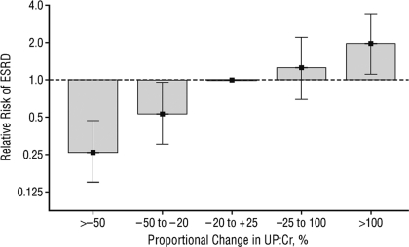
Reducing proteinuria improves
GFR loss /risk of dialysis (ESRD)
(A relative risk = 2 is a doubling of risk)
Change in proteinuria, %
Lea J, Greene T, Hebert L, Lipkowitz M, Massry S, Middleton J, Rostand SG, Miller E, Smith W, Bakris GL: The relationship between magnitude of proteinuria reduction and risk of end-stage renal disease: Results of the African American Study of Kidney Disease and hypertension. Arch Intern Med 165 :947– 953,2005

Slide 32
Prognosis of CKD progression by GFR and albuminuria
Kidney Disease Improving Global Outcomes (KDIGO) - 2012

Slide 33
Step 3:
Imaging:
Kidney ultrasound
CT/MRI

Slide 34
Kidney Imaging:
US preferred as it provides longitudinal dimensions of the kidneys:
< 10 cm, usually = atrophy
Cortical thinning – usually due to hypertension and analgesic use
Screening for polycystic kindey disease (PKD) – needs nephrology referral at any GFR
Identifies urology versus nephrology referral:
Obstructing stones
Kidney masses
Hydronephrosis / obstruction (even mild obstruction) – caveat is prior obstruction – appearance may never return to normal
Second step: CT /MRI:
Abnormal cysts on US (anything other than simple cysts)
Masses workup
Stone workup (CT stone protocol)
Nephrocalcinosis
Urology referral

Slide 35
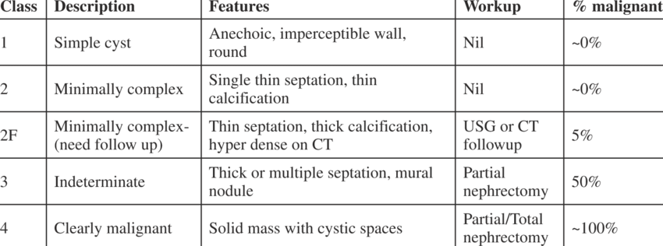
Bosniak classification of kidney cysts
Simple cysts are common and increase in prevalence with age

Slide 36
The 1,2,3 of CKD – partial summary
PCP management (KDIGO recommendations):
eGFR at CKD IIIA (eGFR to 45 ml/minute) with minimal albuminuria (< 300 mcg/mg Cr) and acceptable kidney imaging, especially over age 45, absence of hematuria
Nephrology referral and PCP co-management:
eGFR stage IIIA if young patient (< 45 years old) – personal opinion, not KDIGO
eGFR CKD IIIB – IV - V (eGFR < 45 ml/minute)
eGFR decline > 25% in 2 years
Albuminuria > 300 mcg/mg Cr
Hematuria not answered by urology risks/ workup
Solitary kidney
Polycystic kidney disease
(refer to supplementary handout of hypothetical cases)

Slide 37
Patient: “How close am I to needing dialysis…?”

Slide 38
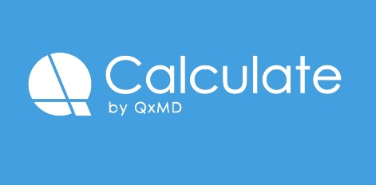
Kidney Failure Risk Estimate (KFRE)
Four-variable Equation: Age, Gender, eGFR, UACR
(Tangri et al, A predictive model for progression of chronic kidney disease to kidney failure,
JAMA, 2011;305(15):1553-1559)
A 75 year old female with a creatinine of 1.6 and eGFR 45 ml/minute,
albuminuria 55 mg/gram Cr.
Kidney failure risk: 2 years = 0.77 %, 5 years 2.39%
A 45 year old male with creatinine 2.5, eGFR 35 ml/minute, albuminuria 1995 mg/gram Cr
Kidney failure risk: 2 years = 15.6%, 5 years 41%
Available on many medical apps:

Slide 39
CKD as a risk for
Cardiovascular disease

Slide 40
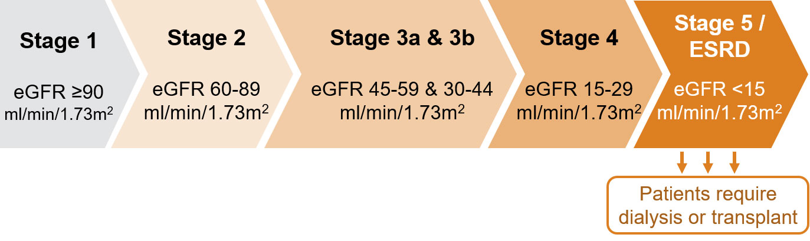
Affected U.S.: 15 million -> 1.5 million -> 750,000
Where did they go? :
Annual CVD risk is 5 X that
of CKD progression

Slide 41
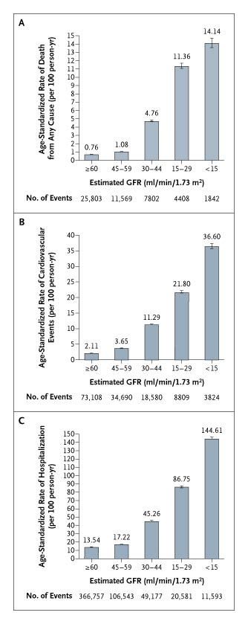

Age-Standardized Rates of Cardiovascular Events
(according to the eGFR of 1,120,295 ambulatory adults)
Go, A. S. et al. N Engl J Med 2004;351:1296-1305
Notes:
Figure 1. Age-Standardized Rates of Death from Any Cause (Panel A), Cardiovascular Events (Panel B), and Hospitalization (Panel C), According to the Estimated GFR among 1,120,295 Ambulatory Adults. A cardiovascular event was defined as hospitalization for coronary heart disease, heart failure, ischemic stroke, and peripheral arterial disease. Error bars represent 95 percent confidence intervals. The rate of events is listed above each bar.

Slide 42
Proteinuria as a risk for
Cardiovascular disease

Slide 43
The kidney vasculature as a
model for general vascular health

Slide 44
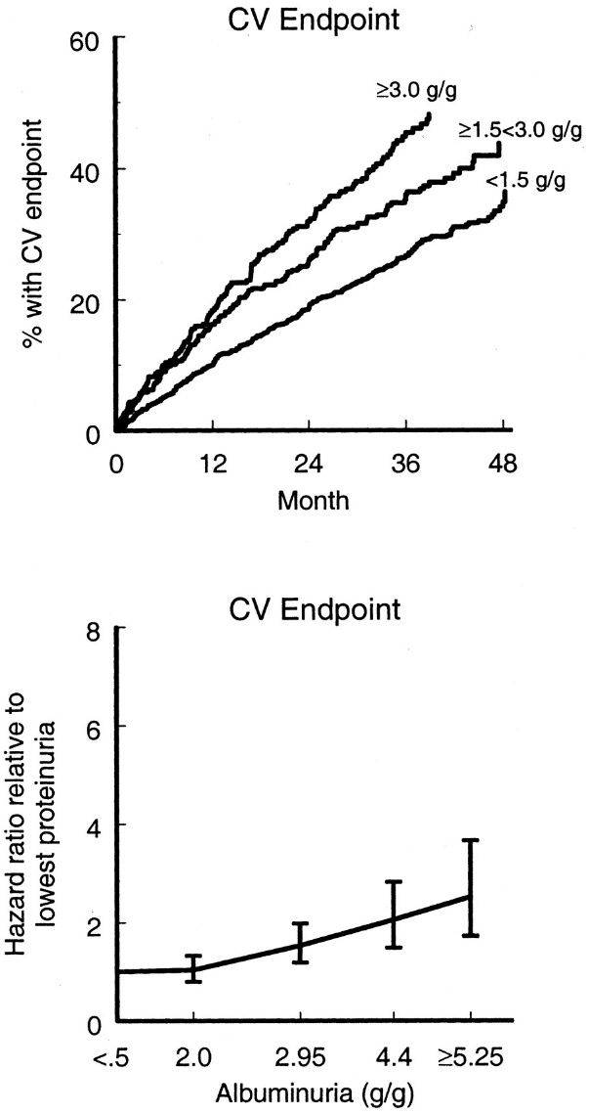
Proteinuria predicts heart disease in Type 2 DM:
Lessons from the RENAAL Trial (Reduction in Endpoints in Non-insulin dependent diabetes mellitus with the Angiotensin II Antagonist Losartan), a double-blind, randomized trial in 1513 type 2 diabetics
Albuminuria, a therapeutic target for cardiovascularprotection in type 2 diabetic patients with nephropathy. Zeeuw D, et al. Circulation. 110(8):921-7. (2004)

Slide 45
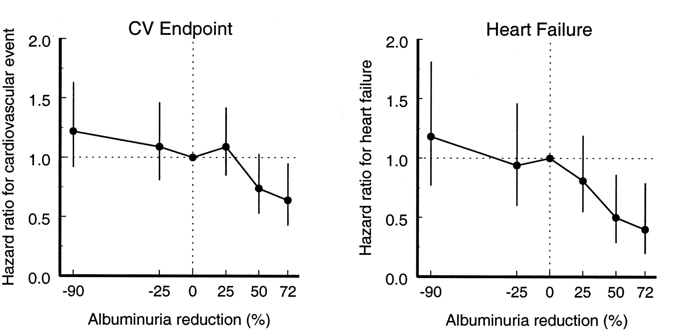
In Type 2 DM - eEvery 50% reduction in proteinuria resulted in an 18% reduction in CV risk, and a 27% reduction in heart failure. Of all variables, proteinuria was the strongest predictor of CV events.

Slide 46
PCP wake-up call:
Proteinuria is a risk factor for chronic kidney disease (CKD) progression and cardiovascular disease:
- The greater the proteinuria, the greater the risk.
- Reducing proteinuria reduces these risks.
- Early and often screening and aggressive control will lower a patient’s risk.
Only 30 % of PCP offices test CKD patients for proteinuria *
*L. Mallika et al. Implementation of a CKD checklist for primary care providers. Clin J Am Soc Nephrol. 2014 Sep 5; 9(9): 1526–1535.

Slide 47
Reducing CVD risk in CKD
CKD in general is a risk of CVD. Proteinuria increases CVD risk - it is an independent variable.
Prevention strategies for all CKD:
Tight blood pressure control: < 130/80 mm Hg,
2021 KDIGO adjustment : SBP < 120 mm Hg (via Sprint Trial).
Aggressive proteinuria reduction –> more to come.
Statins.

Slide 48
Statins in CKD 3+
ACA / AHA recommend statin therapy for CKD
KDIGO guideline (2014)*
> 50 years old: statin
< 50 : statin if DM, Hx CVD, high 10 year risk of CVD.
Pharmacology of statin use:
  Mild GFR loss: low to moderate dose statin
  Lower GFR (stage 4): moderate statin and ezetimibe (Zetia)
  ** Start regardless lipid levels and no titration of dose
  ESRD – no statistical benefits of statins and ezetimibe.
  * KDIGO clinical practice guideline for lipid management in CKD: summary of recommendations statements and clinical approach to the patient. Kidney International, 2014, 85(6)1303-1309.

Slide 49
Screening and Management
of CKD

Slide 50
Screening for albuminuria
KDIGO recommendations (2014):
All CKD 3+ patients annually; if abnormal, then twice annually (commentary in 2015: consider at risk due to age, fam Hx, ethnicity – AA, native Americans, Hispanics- obesity, CVD presence)
Diabetics (even with normal GFR):
Type I DM – 5 years after dx
Type II DM – at time of diagnosis
At least annually thereafter
PCPs are expected to screen and manage at CKD stage
1 -3 patients, without nephrology referral

Slide 51
How to treat albuminuria
Optimal A1C / optimal BMI: weight reduction surgery?
GLP-1 agonists and SGLT2 inhibitors!
Sodium intake < 2 grams / day, tolerate at < 4 grams / day.
Dietary protein 0.8 gm/kg/day preferred, not > 1.2 gm/kg/day.
Blood pressure control: <130/80 mm Hg….maybe SBP < 120 mm Hg (improves CVD rates)

Slide 52
Blood pressure control: <130/80 mm Hg
2021 KDIGO: SBP < 120 mm Hg
Systolic pressure generates the majority of risk.
Anti-proteinuric medications: ACEi, ARB, mineralcorticoid antagonists (MRA), beta blockers, diuretics, a-blockers.
Suggested BP combinations: ACEi/ARB, thiazides, alpha blockers (w/beta blocker), mineralocorticoid blockers
AVOID: Dihydropyridine calcium blockers (amlodipine, nifedipine, etc.), direct vasodilators (minoxidil).

Slide 53
ANGIOTENSINOGEN
BP control and proteinuria reduction: Inhibiting the RAAS system
Renin
ANGIOTENSIN I
AngII type 1:
vasoconstriction
endothelial activation
sodium retention
aldosterone generation
fibrosis
AngII type 2:
inhibit AT1 receptors
Vasodilation
sodium and water retention
disruption of podocytes
fibrosis
ACE
Chymase
in CKD
ANGIOTENSIN II
AT1R
AT2R
ALDOSTERONE

Slide 54
ALDOSTERONE
Epithelial kidney Vascular / other kidney cells cells
Sodium retention Vasoconstriction to
Volume expansion cause glomerular HTN
High BP Inflammation
Potassium excretion Podocyte stress - proteinuria Fibrosis / scar
Common MRAs:
(supplements to ACEi/ARB = potent tools to lower BP, edema, proteinuria, GFR loss)
Spironolactone (Aldactone)
In males, gynecomastia and mastodynia with higher doses
Hyperkalemia
Eplerenone (Inspra)
- Less anti-testosterone effects
Hyperkalemia
Finerenone (Kerendia)
Lesser BP lowering effects
Lesser hyperkalemia
Blocking aldosterone at the mineralocorticoid
receptor prevents many harmful actions.
MRA – mineralocorticoid receptor antagnoists

Slide 55
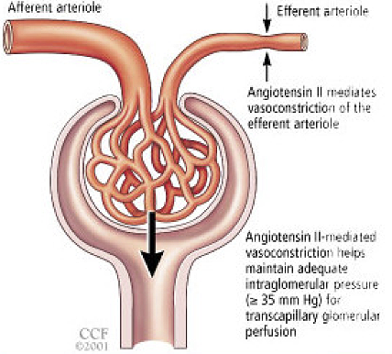
Angiotensin and Aldosterone mediate efferent
vasoconstriction to increase glomerular pressure
Angiotensin II
Aldosterone
If glomerular pressures increase and filtration increases – hyperfiltration - a leaky glomerulus will leak more, and scar from overuse.
Lessening angiotensin and aldosterone
vasoconstriction lessens
proteinuria and
GFR is reduced.

Slide 56
ACEi / ARB to lessen albuminuria
Tricks of the trade:
ACEi or ARB – which one?
African-Americans more often angioedema with ACEi
Chinese -Americans more cough with ACEi
Low salt diets and diuresis – high salt diets negate most effects
Optimize response with MRA (e.g. Aldactone) – reduces albuminuria 30+% more than ACEi or ARB alone.
Diabetics – even with normal GFR and normal BP -> treat with ACEi / ARB (e.g. nighttime dosing of low dose)
DO NOT USE ACEi and ARB TOGETHER – Risk of HYPERKALEMIA.

Slide 57
ACEi / ARB to lessen albuminuria
Tricks of the trade:
BE PATIENT! – proteinuria reduction takes months to achieve.
Renin inhibitors – not superior to ACEi/ARB. Do not add to ACEi / ARB.
Neprilysin inhibitors – no proteinuria reduction (e.g. Entresto not superior to ARB)
Added vitamin D supplementation may reduce renin and be anti-proteinuric.

Slide 58
Creatinine levels increase with treatment – Don’t panic!
Acute hemodynamic GFR loss (creatinine increase) with ACEi / ARB use: A favorable sign
GFR
ACEi / ARB
Cr may increase 25%!
No Rx
TIME
Success = albuminuria reduction of 30% by 6 months
reduces risk of future GFR loss. (Levey,A.L. et al. Am J Kidney Dis
75(1): 84-104, 2019)

Slide 59
SGLT2 Inhibition: A New Tool for Proteinuria Reduction
Diabetes creates a state of kidney hyperfiltration
SGLT2 inhibition reduces hyperfiltration:
  Increases urine glucose and sodium excretion.
  Acts as a diuretic with effects = or better than thiazides.
  Improves kidney health, CVD risk factors and CHF.
  Is being promoted as CHF treatment independent of DM Rx.
  Caveats:
  Sodium and water excretion can be significant: often need reduction of other diuretics AND RAAS inhibition (RAAS inhibition + dehydration -> AKI)
  GFR will decline (creatinine increase) after initiation – not a reason to stop! (Just is reflecting slowing of hyperfiltration).

Slide 60
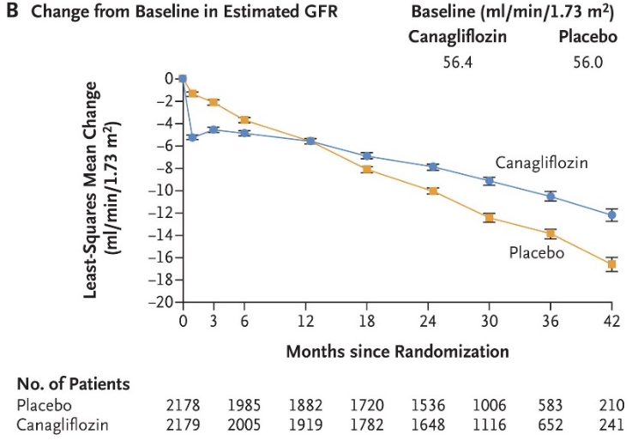
Canagliflozin and Renal Outcomes in Type 2 Diabetes and Nephropathy
for the CREDENCE Trial Investigators
N Engl J Med 2019; 380:2295-2306
Note the acute GFR decline followed by GFR stability

Slide 61
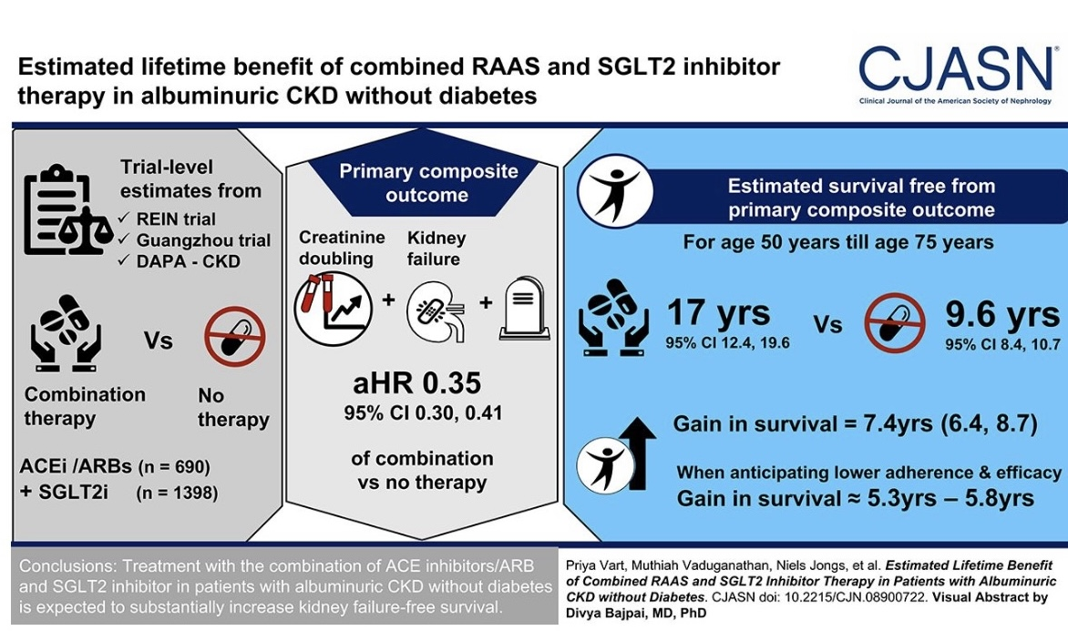

Slide 62
Ending thoughts:
PCPs are the critical first step in identifying and initiating a workup for CKD and proteinuria.
Patients with CKD 3 and greater should have a UA and albuminuria evaluation. Repeat if abnormal.
Kidney imaging necessary to explain low GFR
Manage comorbidities with lifestyle changes, RAAS inhibition, MRA, statins, GLP-1 agonists and/or SGLT2 inhibition.
Understand CVD risks of proteinuria.
Referral for nephrology co-management for:
CKD 3B or greater, CKD 3A in young, macroalbuminuria, significant changes in GFR(25%) even if CKD 3, hematuria,
PKD.

Slide 63
Thank you !

