Slide 1
Hypertension from a nephrologist’s point of view
W.A. Wilmer, MD
Kidney Specialists, Inc.
Board of Advisors, NKF of Central Ohio
Medical Advisory Board, NKF of Central Ohio
* No financial disclosures

Slide 2
Case #1 – When to treat and how to treat
A 52 year old male presents to your office with concerns of fatigue. He is a smoker of 25 years, is treated for hyperlipidemia (total chol 240, LDL 190). His only medication is a statin.
Blood pressures:
138/88 mm Hg left arm sitting
140/90 mm Hg right arm sitting
Pulse 78 bpm, no orthostatic changes to BP.
Followup evaluation in the office one week later confirms similar BP readings.
Out-of-office BPs are the same: SBPs 138 – 140 / DBP 88-90 mm Hg.
Should you treat his elevated blood pressures?

Slide 3
What Hypertension Guideline to Use?
JNC 8
ACC/ AHA
International Hypertension Guidelines
European Hypertension Guidelines
Canadian Hypertension Guidelines
KDIGO guidelines, etc.

Slide 4
What Hypertension Guideline to Use?
JNC 8
60 years or older without DM or CKD the BP goal is <150/90 mm Hg.
18 to 59 years of age without major comorbidities, 60 years or older with DM, CKD, or both conditions, BP <140/90 mm Hg.
2017 ACC/AHA
Normal BP is defined as <120/80 mmHg
Elevated BP as systolic pressure 120 to 129 mmHg and diastolic pressure as <80 mmHg,
Stage 1 hypertension as systolic pressure 130 to 139 mmHg or diastolic pressure 80 to 89 mmHg,
Stage 2 hypertension as systolic pressure ≥140 mmHg or diastolic pressure ≥90 mmHg.

Slide 5
First-line and later-line treatments should now be limited to 4 classes of medications: thiazide-type diuretics, calcium channel blockers (CCBs), ACE inhibitors, and ARBs. Triple therapy with an ACE inhibitor/ARB, CCB, and thiazide-type diuretic would precede use of alpha-blockers, beta-blockers, or any of several other agents.
ACC/ AHA philosophy:
Risk for CVD increases in a log-linear fashion from
SBP levels <115 mm Hg to >180 mm Hg, and from DBP levels <75 mm Hg to >105 mm Hg.
A 20 mm Hg higher SBP and 10 mm Hg higher DBP are each associated with a doubling in the risk of death from stroke, heart disease, or other vascular disease.
SBP has consistently been associated with increased CVD risk. This is not true for DBP.

Slide 6
ACC/AHA Guideline: Assessment of CVD risks:
Use the cvdrisk.com risk evaluator
Using this strategy, this patient has a CVD risk of > 10% in ten years and
BP goals should be < 130/80 mm Hg.
Earlier initiation of pharmacologic therapy is indicated for patients with
hypertension and preexisting CVD, chronic kidney disease (CKD)
or diabetes mellitus (DM), or high estimated 10-year CV risk.
Lifestyle modifications always should be used.
Other risk factors that suggest a BP goal of < 130/80 mm Hg:
CKD, especially if proteinuria.
DM
Patients with mild cognitive impairment.
(SPRINT MIND study: Williamson, JD et al. SPRINT MIND Investigators for the SPRINT Research G:
Effect of intensive vs standard blood pressure control on probable dementia: a randomized clinical trial,
JAMA 321:553-561, 2019)

Slide 7
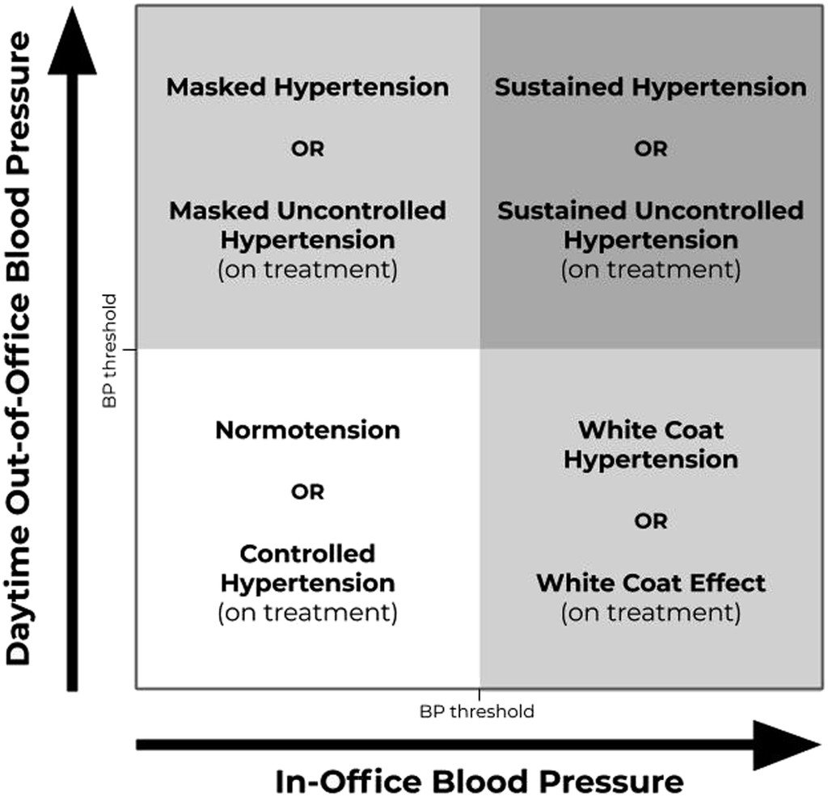
The Emphasis on Out-of-office BP Measurements in
addition to Office BP Measurements
Office BP measurements “White coat effect”
Treatment not as imperative.
>70% will become sustained HTN.
Out-of-office measurements
“Masked HTN”
ABPM: 24 hr. monitor
SMBP: self measured BPs –
ideally twice in AM and twice
PM x 7 days
Kiosk BPs – not as reliable
Wrist / finger BPS – not as
reliable.

Slide 8
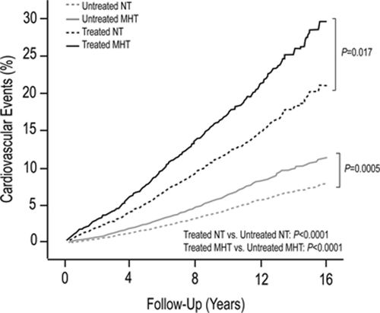
End-organ risks of Masked Hypertension
Stanley S. Franklin. Hypertension. Masked Hypertension, 2015, Hypertension-AHA, Volume: 65,
Issue: 1, Pages: 16-20,

Slide 9
You encourage lifestyle modifications (low salt diet, weight loss, exercise) and decide to also start pharmacotherapy. Which of the following is not an appropriate initial choice ?
Lisinopril
A thiazide diuretic with a potassium sparing diuretic.
Amlodipine.
Losartan.
Atenolol.

Slide 10
You encourage lifestyle modifications (low salt diuretic, weight loss, exercise) and decide to use also start pharmacotherapy. Which of the following is not an appropriate initial choice ?
Lisinopril
A thiazide diuretic with a potassium sparing diuretic.
Amlodipine.
Losartan.
Atenolol.

Slide 11
JNC and ACC/AHA:
First tier medications: ACEi, ARB, CCB, thiazide diuretic.
Guidelines eliminate use of beta-blockers (including nebivolol), alpha-blockers, loop diuretics, alpha 1/beta-blockers, central alpha2/adrenergic agonists, direct vasodilators, aldosterone antagonists, and peripherally acting adrenergic antagonists in patients with newly diagnosed hypertension.
There is an increased risk of cerebrovascular events with beta-blockade monotherapy.
Lifestyle management should always be emphasized, but pharmacotherapy strongly considered initially ….due to slow responses to escalate HTN therapy in many practices.

Slide 12
LEGEND-HTN Study: Large-Scale Evidence Generation and Evaluation Across a Network of Databases for Hypertension.
(Suchard, MA, et al. Lancet 394: 1816-1826, 2019.)
EHR records across four countries, 1 year of data pre-HTN, pharmacy fill rates monitored.
4,893,591 patients
48% ACEi
17% thiazide
16% dihydropyridine CCB
15% ARB
3% non-dihydropyridine CCB
Take home message: MI, hospitalization for heart failure, CVA risks reduced more in the thiazide group. Hyponatremia and hypokalemia more often with thiazides though. (Thiazide potency: indapamide < HCTZ < chlorthalidone.)

Slide 13
Case #2 – Stage 2 HTN
The same patient’s older brother – 56 years old - presents to your office with concerns of elevated BP. He is also treated for hyperlipidemia with a statin, BMI 38, he is a smoker.
Blood pressures:
164/98 mm Hg left arm sitting
166/96 mm Hg right arm sitting
Out-of-office BPs are the same: SBPs 165-168 / upper 90s
How should you treat this elevated BP?

Slide 14
Case #2 – Stage 2 HTN
The same patient’s older brother – 56 years old - presents to your office with concerns of elevated BP. He is also treated for hyperlipidemia with a statin, BMI 38, he is a smoker.
Blood pressures:
164/98 mm Hg left arm sitting
166/96 mm Hg right arm sitting
Out-of-office BPs are the same: SBPs 165-168 / upper 90s
How should you treat this elevated BP?
Combination therapy if BPs are 20 / 10 above BP goals

Slide 15
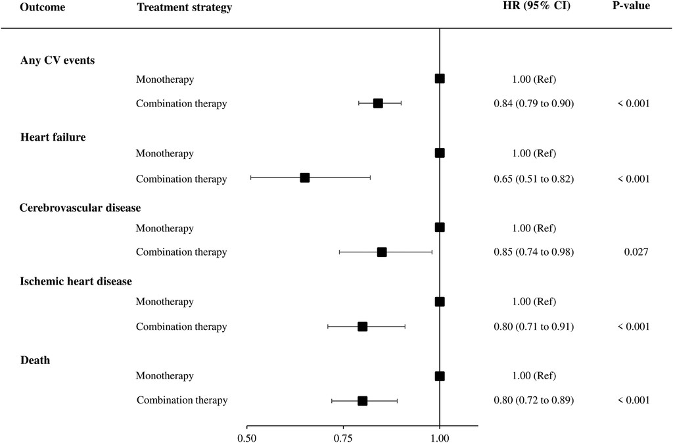
Consider combination therapy from the start
Protective effect of combination therapy over monotherapy in reducing
cardiovascular outcomes. A study of 125,635 patients in Italy.
(Rea F, Corrao G, Merlino L, et al.: Initial Antihypertensive Treatment Strategies
and Therapeutic Inertia. Hypertension 72: 846–853, 2018.)

Slide 16
Case #3 – Resistant HTN
A 45 year old female treated for 2 years for HTN reports home BPs of
154 / 92, never with SBP < 140 / DBP < 85. She reports headaches.
She takes: Lisinopril 40 mg daily, HCTZ 25 mg daily, Nifedipine XL 90 mg daily. She follows a low salt diet and exercises daily. BMI is 25.
What is the appropriate NEXT agent to add to her therapy?”
A beta blocker (bisopropol)
An alpha blocker (doxazocin)
A loop diuretic (furosemide)
A mineralocorticoid blocker (spironolactone) ?

Slide 17
Case #3 – Resistant HTN
A 45 year old female treated for 2 years for HTN reports home BPs of
154 / 92, never with SBP < 140 / DBP < 85. She reports headaches.
She takes: Lisinopril 40 mg daily, HCTZ 25 mg daily, Nifedipine XL 60 mg daily. She follows a low salt diet and exercises daily. BMI is 25.
What is the appropriate NEXT agent to add to her therapy?”
A beta blocker (bisopropol)
An alpha blocker (doxazocin)
A loop diuretic (furosemide)
A mineralocorticoid blocker (spironolactone)

Slide 18
Resistant Hypertension:
Uncontrolled hypertension while using moderate – high doses of three medications one of which is a diuretic
Refractory Hypertension:
Uncontrolled hypertension using moderate-high doses of five medications one of which is a diuretic.

Slide 19
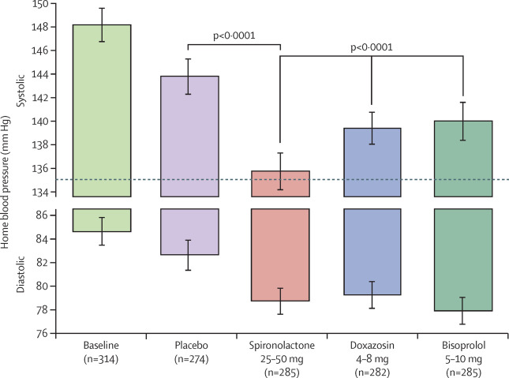
Spironolactone as fourth choice therapy for resistant HTN:
The PATHWAY-2 TRIAL
Williams, B. et al, Lancet. 386:10008, P2059-2068, 2015

Slide 20
ANGIOTENSINOGEN
RAAS system:
aldosterone synthesis can be independent of angiotensin pathway
Renin
ANGIOTENSIN I
ACE
Chymase
in CKD
AT1 receptor:
vasoconstriction
endothelial activation
sodium retention
Sodium and water
retention
Independent of Angiotensin II
ANGIOTENSIN II
ALDOSTERONE
ACTH
K+
adipocytes

Slide 21
Slide from University of North Carolina Medical Center presentation at ASN Renal Week. Referencing: Schjoedt, KJ, et al. Aldosterone escape during blockade of the renin-angiotensin-aldosterone system in diabetic nephropathy is associated with enhanced decline in glomerular filtration rate, Diabetologia 2004: 47(11):1936-9.

Slide 22
Secondary Causes of Hypertension –
Consider when treating resistant HTN
OSA
CKD
Primary hyperaldosteronism
Renal artery strenosis
Medications (NSAIDs, sympathomimetics, cyclosporine, erythropoietin,stimulants) Alcohol Excess
Other Endocrine:
Cushings
Hyperparathyroidism
Thyroid disease
Pheochromocytoma
Coarctation of the Aorta

Slide 23
Hyperaldosteronism
More prevalent than originally thought.
Should be considered in cases of resistant hypertension.
Estimated 20-25% resistant HTN due to aldosterone excess.
In one study, of 4660 patients with resistant HTN, 2% had hyperaldosteronism workup. (Jaffe,G et al.: Screening rates for primary aldosteronism in resistant hypertension: A cohort study. Hypertension 75:650-659, 2020.)

Slide 24
Hyperaldosteronism
Does not require hypokalemia to make the dx (!) – usually hypokalemia with diuretics, but not always.
High serum bicarbonate (due H+ wasting with K+ wasting).
Primary: adrenal hyperplasia, adrenal adenoma, adrenal
carcinoma (CT or MRI adrenal view protocol needed to visualize)
Secondary – atherosclerotic renal vascular disease, FMD
(RA duplex, CT angiogram – use when FMD considered)

Slide 25
Evaluation is not that complicated
HOLD: ACEi/ARB/mineralocorticoid blockers
Early AM sitting: renin activity (test result is rate of conversion) and serum aldosterone:
Plasma renin activity – low in primary (<1 ng/ml/hr), high in secondary (well > 1 ng/ml/hr). Sometimes reported as ‘not measurable’ – so for use in ratio= 0.5 ng/ml/hr).
Serum aldosterone levels: usually > 10 ng/dL.
Primary Hyperaldosteronism Evaluation
Aldo:Renin
30:1
Even if normal K+
Aldo:Renin 20:1
With low K+
Aldo:Renin
10-20:1
Aldo:Renin
< 10:1
Likely Primary Hyperaldosteronism
24 hour urine aldosterone on high salt intake (200 mmol Na+)
Unlikely
Primary
Hyperaldosteronism

Slide 26
Match the renin and aldosterone levels with the following clinical scenarios:
(normal renin 1-4, aldosterone 5-10)
Labs:
Renin <1, aldosterone 5.
Renin 8, aldosterone 22
Renin 30, aldosterone 4
Renin 0.5, aldosterone 25
Scenarios:
A. Renal artery stenosis
B. Primary hyperaldosteronism
C. Volume expanded / fluid overload state (Liddle syndrome)
D. ACEi therapy

Slide 27
Match the renin and aldosterone levels with the following clinical scenarios:
(normal renin 1-4, aldosterone 5-10)
Labs:
Renin <1, aldosterone 5.
Renin 8, aldosterone 22
Renin 30, aldosterone 4
Renin 0.5, aldosterone 25
Scenarios:
A. Renal artery stenosis 2
B. Primary hyperaldosteronism 4
C. Volume expanded / fluid overload state (Liddle syndrome) 1
D. ACEi therapy 3

Slide 28
Summary
A nephrologist's point of view:
Emphasis on home / out-of-office BP monitoring
At risk of CVD / CKD – aggressive control to < 130/80
Diuretic (thiazide) therapy early
Diuretic emphasis, monotherapy early, combination therapy with higher BPs
Resistant HTN – use spironolactone / eplerenone
Look for secondary forms of HTN if resistant HTN
Hyperaldosteronism is more common than previously thought.

Slide 29
Thank you!

