Slide 1

Atrial Fibrillation: From
Diagnosis to Control
Sept. 21, 2023
Michael Reinig, DO, FACC
FHP Cardiology, Electrophysiology

Slide 2
Disclosures
None

Slide 3
Atrial Fibrillation
Definition
&
Epidemiology

Slide 4
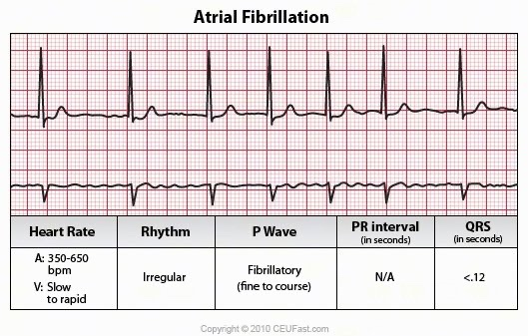

Slide 5
Atrial Fibrillation – What is it?
Atrial fibrillation (Afib) affects about 1% of the population or about 2.3 million people in the United States
Prevalence increases with age — affecting roughly 10% of population age 80 or older
Afib is associated with a 4 to 5x increase in risk of stroke

Slide 6
The AFib Burden
Accounts for 1/3 of hospital admissions for cardiac rhythm disturbances
Highly symptomatic
Affects quality of life
Accounts for 15% of all stroke in US
Over 100,000 strokes in the US alone attributable to AF
Increasing prevalence due to aging population

Slide 7
Proportion of Arrhythmic Diagnoses
  6%
  PSVT
  6%
  PVCs
  18%
  Unspecified
  4%
  Atrial
  Flutter
  9% SSS
  34%
  Atrial
  Fibrillation
  8%
  Conduction
  Disease
  10% VT
  3% SCD
Baily D. J Am Coll Cardiol. 1992;19(3):41A.
  2% VF

Slide 8
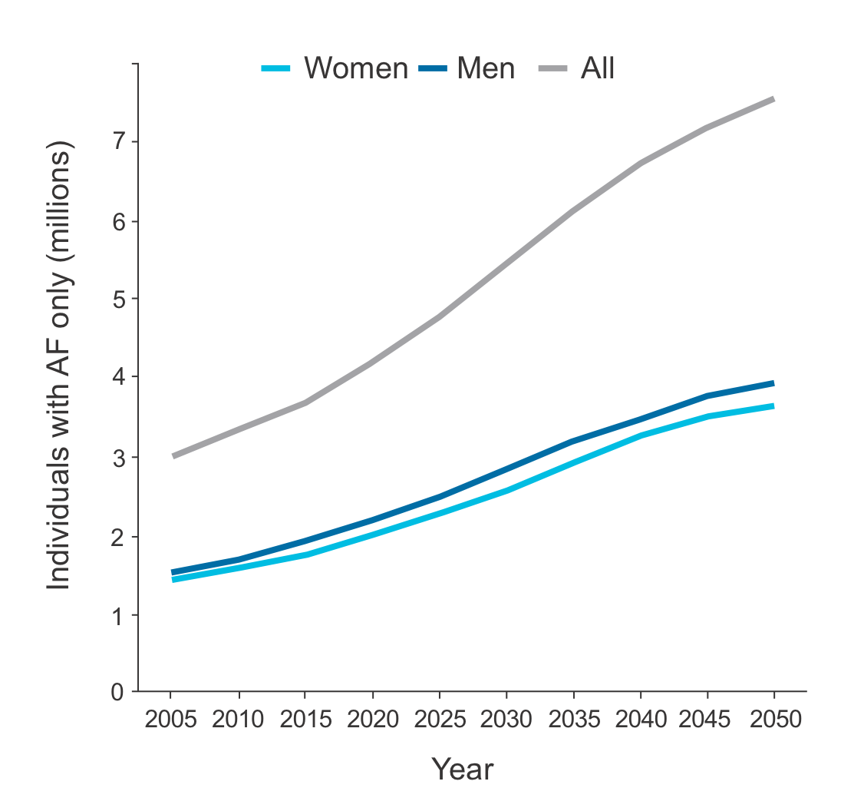
AF Prevalence is Large and Growing
US AF Prevalence
is estimated at > 3.3¹ million people and is predicted to double by 2035¹
Age-adjusted AF incidence is predicted to grow as a result of increased risk factors – obesity, hypertension, diabetes, and cardiovascular disease, ETOH, endurance sport training²
¹Naccarelli GV, et al. Am J Cardiol. December 2009;104(11):1534-1539.
² Miyasaka Y, et al. Circulation. July 2006;114(2):119-125.
Notes:
Key Messages to Deliver:
There are an estimated 3.3 million people in the US suffering from atrial fibrillation.
Due to increased risk factors, such as age, obesity, hypertension, diabetes, cardiovascular disease, the prevalence is expected to double by 2035.
¹ Naccarelli GV, Varker H, Lin J, Schulman KL. Increasing prevalence of atrial fibrillation and flutter in the United States. Am J Cardiol. December 2009;104(11):1534-1539.
² Miyasaka Y, Barnes ME, Gersh BJ, et al. Secular trends in incidence of atrial fibrillation in Olmsted County, Minnesota, 1980 to 2000, and implications on the projections for future prevalence. Circulation. July 2006;114(2):119-125.

Slide 9
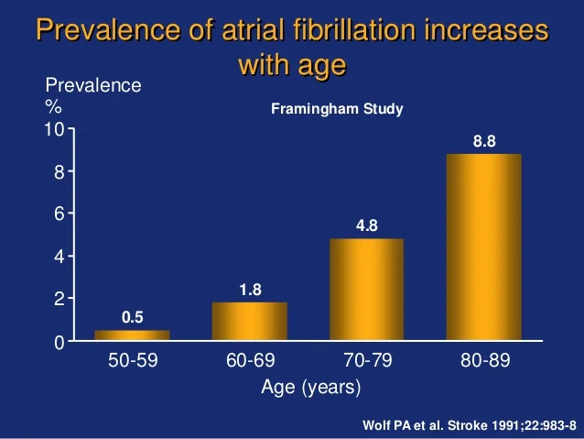

Slide 10
Atrial Fibrillation
Risk Factors

Slide 11
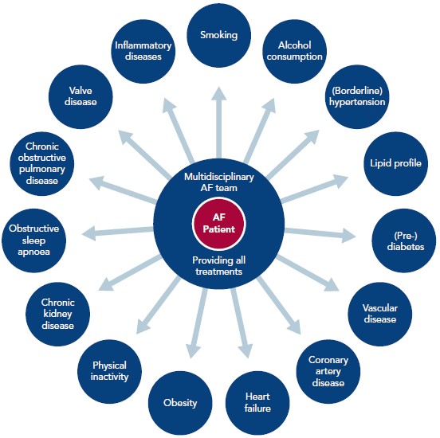
Risk Factors for Afib

Slide 12
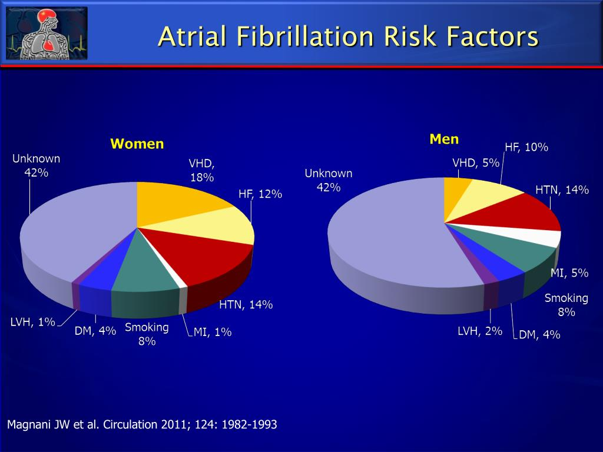
5

Slide 13
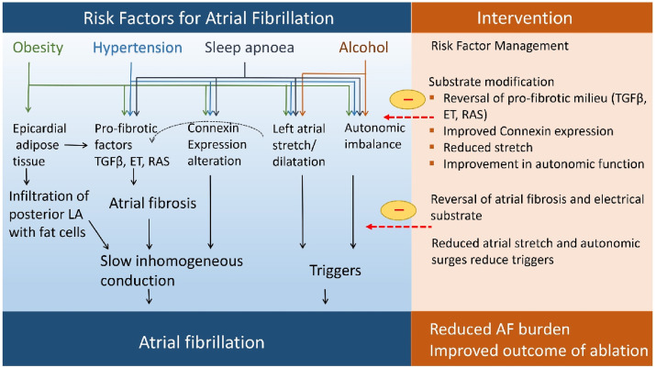

Slide 14
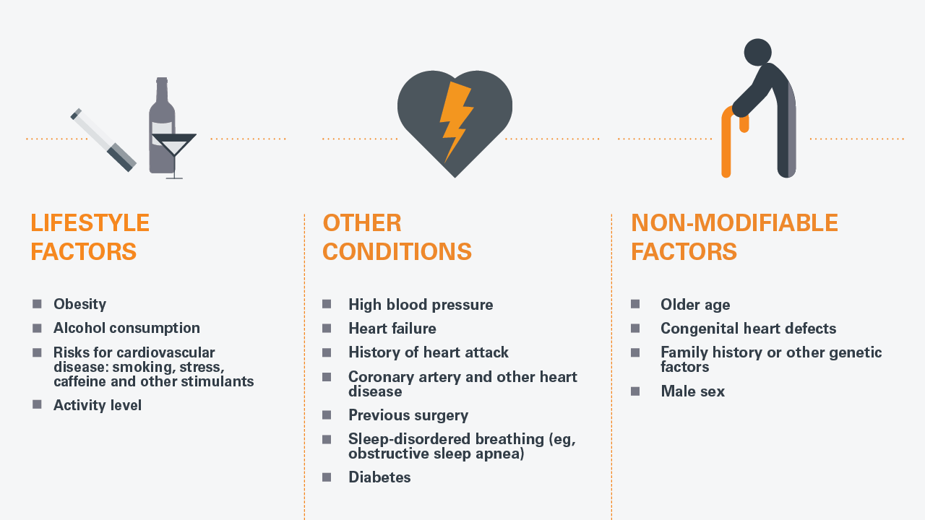

Slide 15
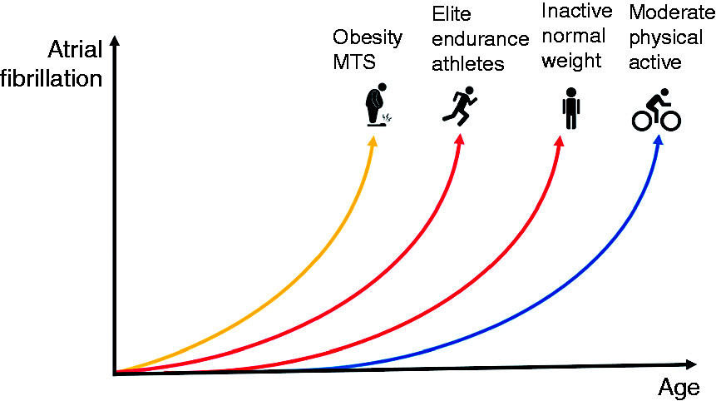
Notes:
Then cardiac remodeling with atrial fibrosis may be induced by volume and pressure overload leading to electrical disturbances of the sinus node and atrial electrical conductance
Increase in PS tone and increase in arrhythmogic substrate

Slide 16
Atrial Fibrillation
Symptoms

Slide 17
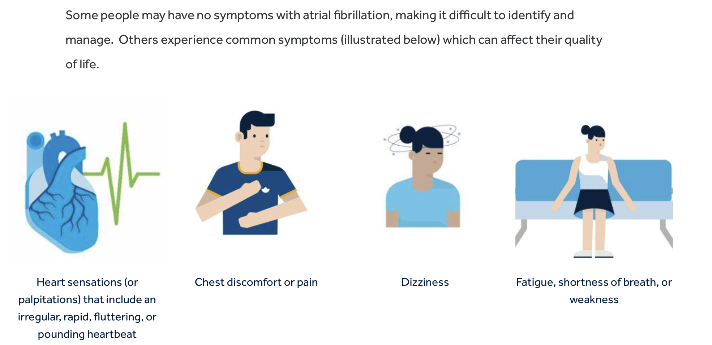
Symptoms of AFib

Slide 18
Atrial Fibrillation
Diagnosis

Slide 19


Notes:
Ring OURA

Slide 20
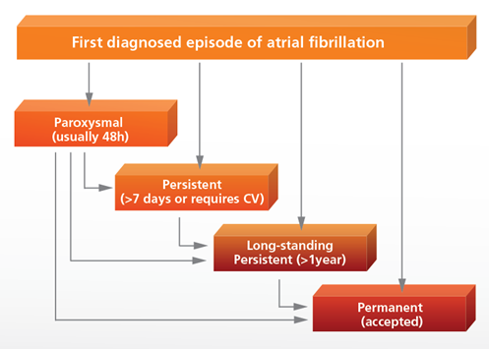
The AFib Continuum
Paroxysmal
  Recurrent AF (≥2 episodes) that terminate
  spontaneously within 7 days
  Episode <48 hrs terminated by CV
Persistent
  AF lasting for 7 days
  or requiring electrical or
  medical intervention
Permanent
  Continuous AF for
  longer than 1 year
Guidelines of the management of AF, Eur Heart J 2010

Slide 21
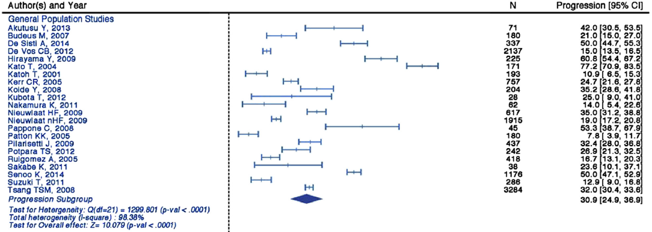

Prevalence of Atrial Fibrillation Progression
~1/3 of patients progress from paroxysmal to more advanced stages of AF
Systematic review evaluating the progression of paroxysmal AF to persistent/permanent AF in general population studies (primarily medical therapy only) compared to catheter ablation studies
The percentage of patients with AF progression in general population studies ranged from 7.8-77.2%, averaging 32.6% across 23 studies
Proietti et al. A systematic review on the progression of paroxysmal to persistent atrial fibrillation: shedding new light on the effects of catheter ablation.
JACC: Clinical Electrophysiology. 2015; 1(3):105-115.

Slide 22
Atrial Fibrillation
Treatment:
CVA Prophylaxis
Rate Control
Rhythm Management

Slide 23
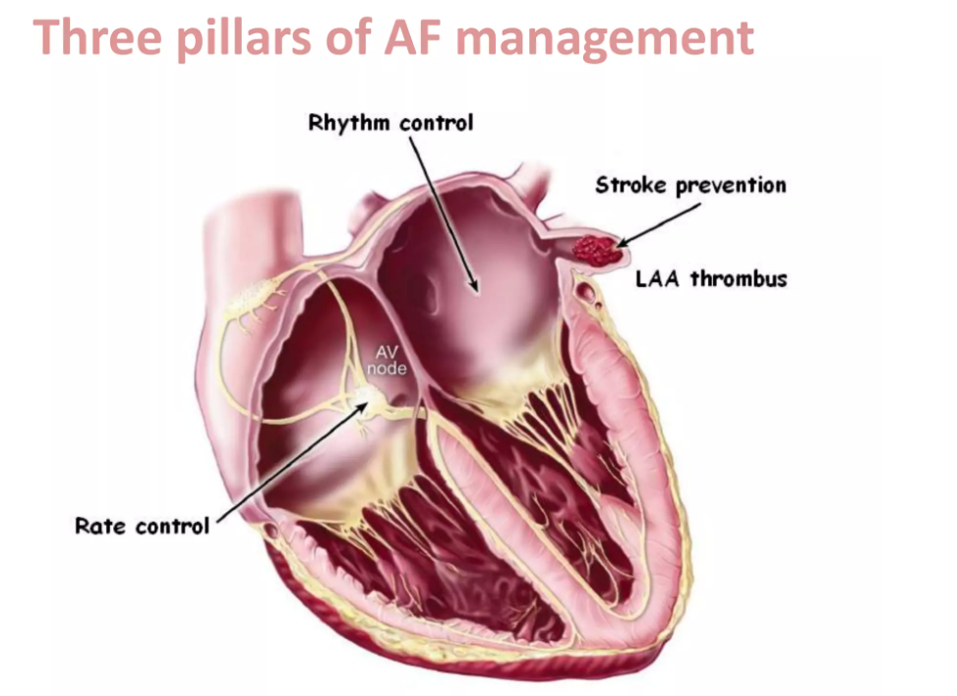

Slide 24
Atrial Fibrillation
Treatment:
CVA Prophylaxis
Rate Control
Rhythm Management

Slide 25
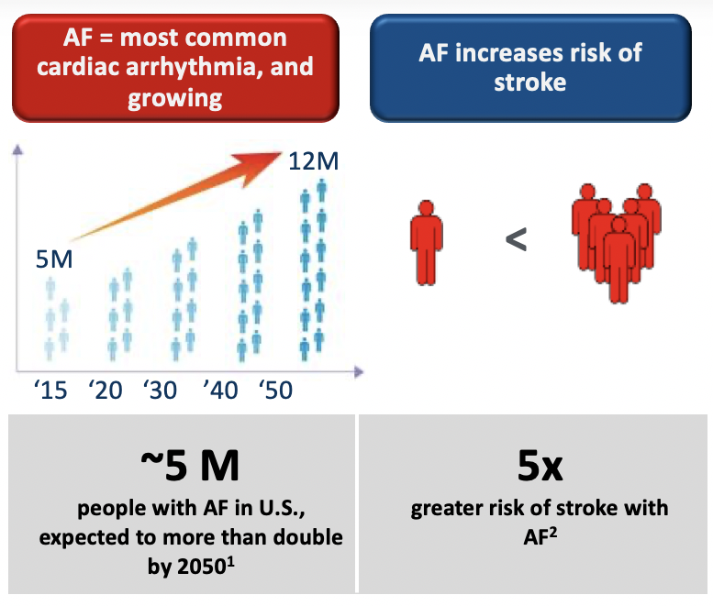
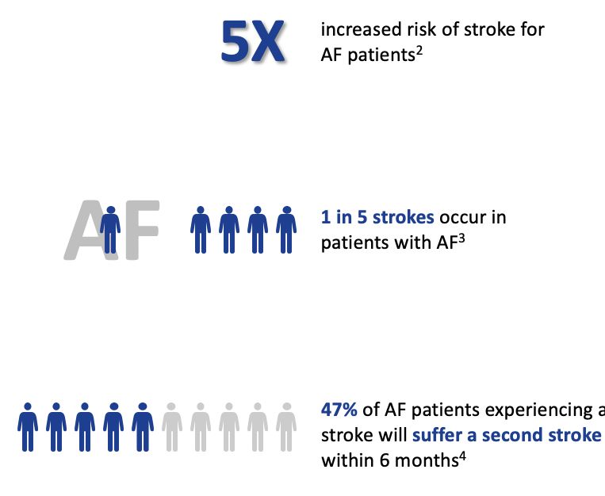
Atrial Fibrillation & CVA

Slide 27
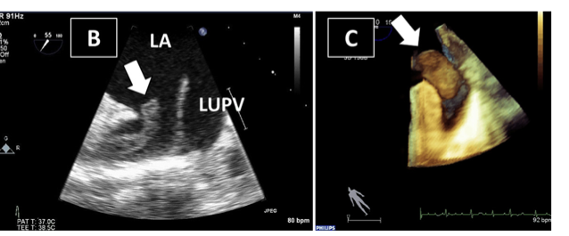
Journal American Society Echo Saric et al. Vol 29

Slide 28
Notes:
Clinical tool for predicting risk of CVA in NR AF

Slide 29
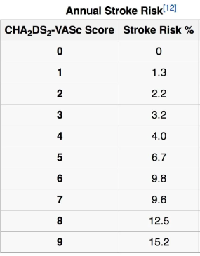
CHF 1
Hypertension 1
Age ≥ 75 2
Diabetes mellitus 1
Stroke/TIA/TE 2
Vascular disease 1
Age 65-74 1
Sex -(female) 1

Slide 31
January CT, Wann LS, Calkins H, et al. 2019 AHA/ACC/HRS Focused Update of the 2014 AHA/ACC/HRS Guideline for the Management of Patients With Atrial Fibrillation: A Report of the American College of Cardiology/American Heart Association Task Force on Clinical Practice Guidelines and the Heart Rhythm Society in Collaboration With the Society of Thoracic Surgeons. Circulation. 2019;140(2):e125-e151.

Slide 35
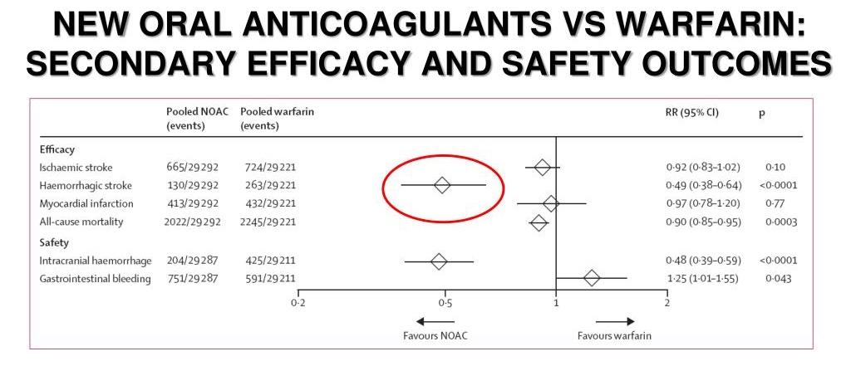

Slide 37
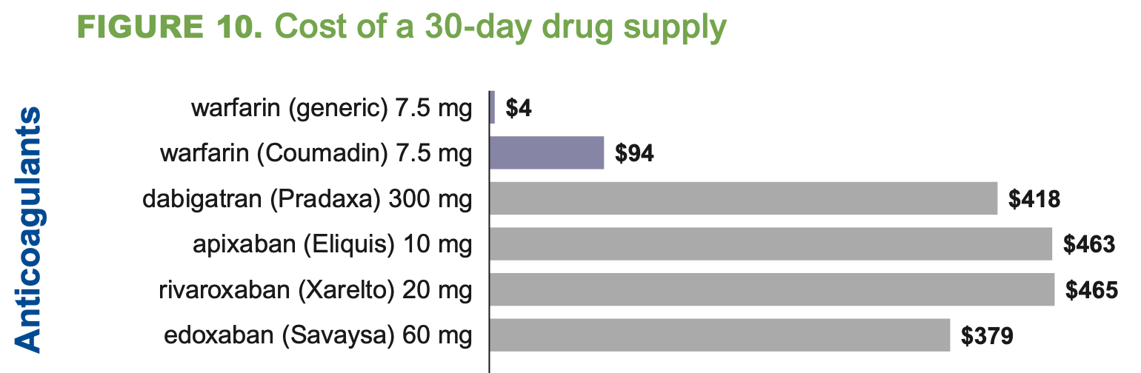
Afib Anticoagulant Agents: Cost

Slide 38
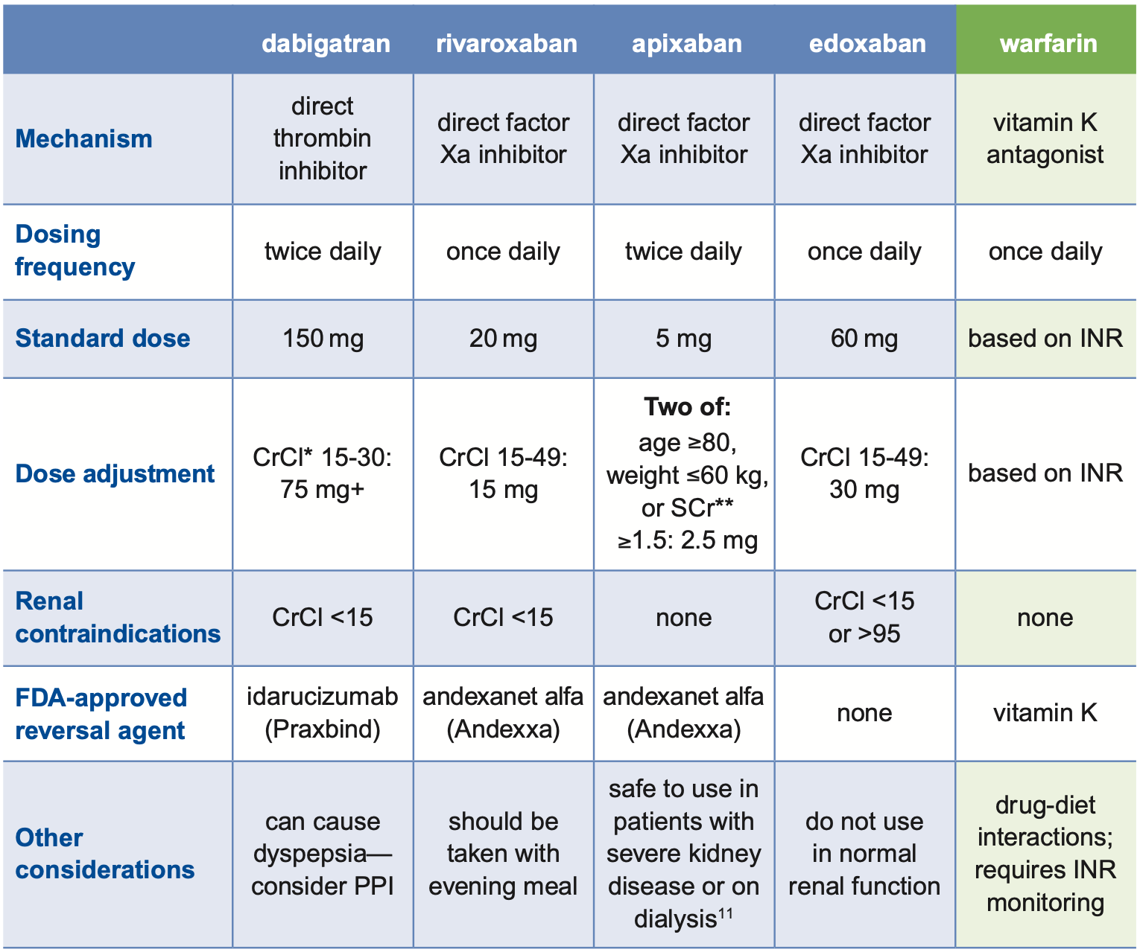
Comparison of Anticoagulants

Slide 39

Afib: Anticoagulation
Stroke Reduction
Bleeding

Slide 40
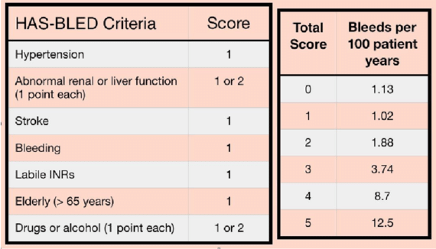
Atrial Fibrillation: HAS-BLED

Slide 41
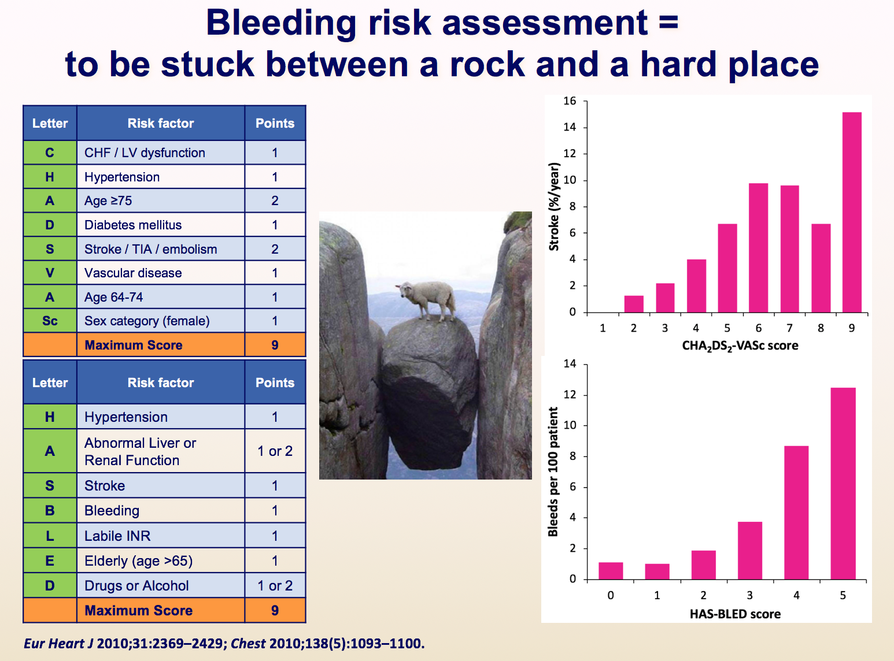

Slide 42
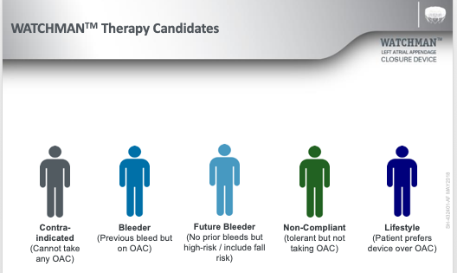

Slide 43
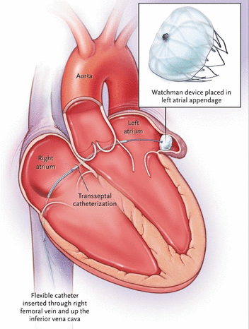

Slide 44
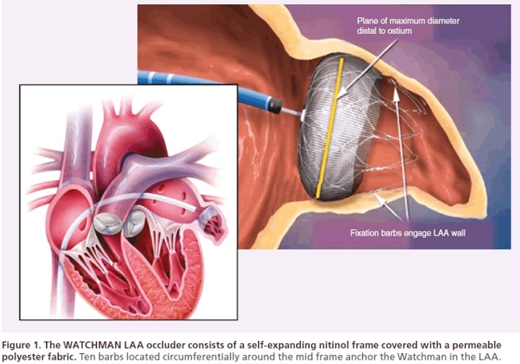
Atrial Fibrillation: LAA Occlusion

Slide 45
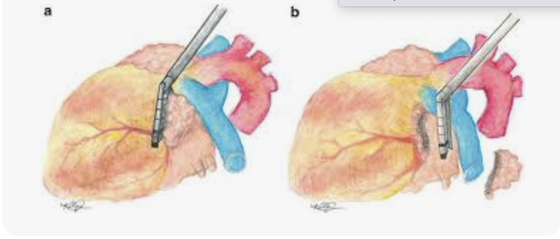
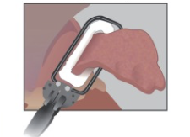
Left Atrial Appendage Clip

Slide 46
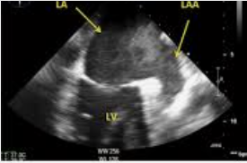
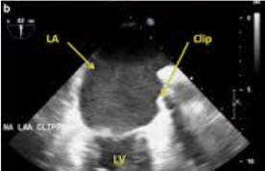
Left Atrial Appendage Clip
Notes:
The AtriClip LAA Exclusion Systems are composed of a single-use, self-closing implantable Clip preloaded onto a sterile, single-use applier. They are designed to completely exclude blood flow between the LAA and the left atrium during cardiac surgery. The Clip is an implant that permanently excludes the LAA.

Slide 47
Atrial Fibrillation
Treatment:
CVA Prophylaxis
Lifestyle Changes
Rate Control
Rhythm Management

Slide 48
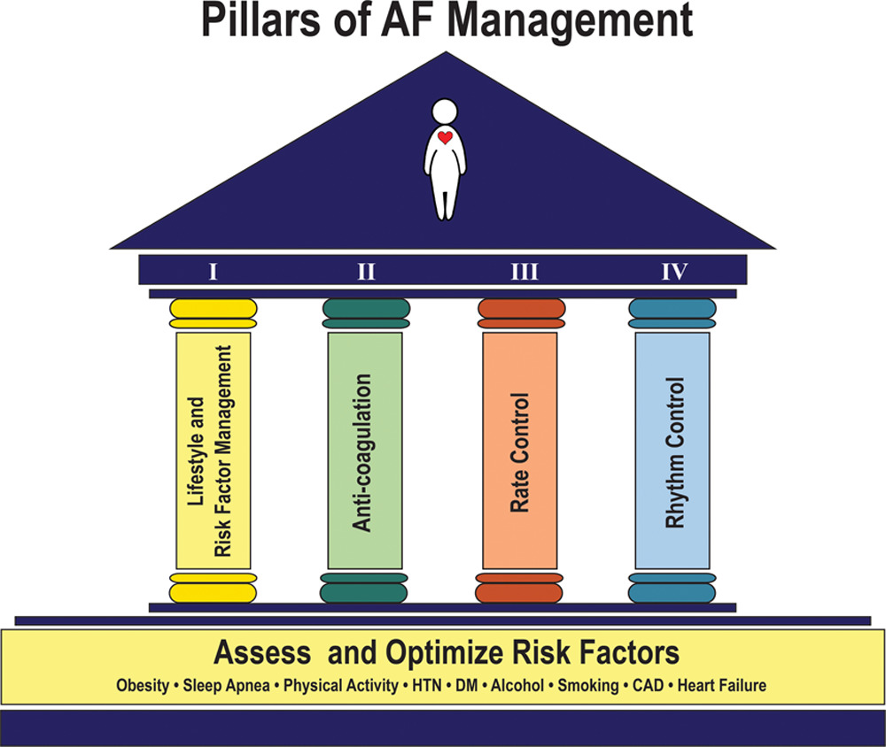

Slide 49
Atrial Fibrillation
Treatment:
CVA Prophylaxis
Rate Control
Rhythm Management

Slide 50
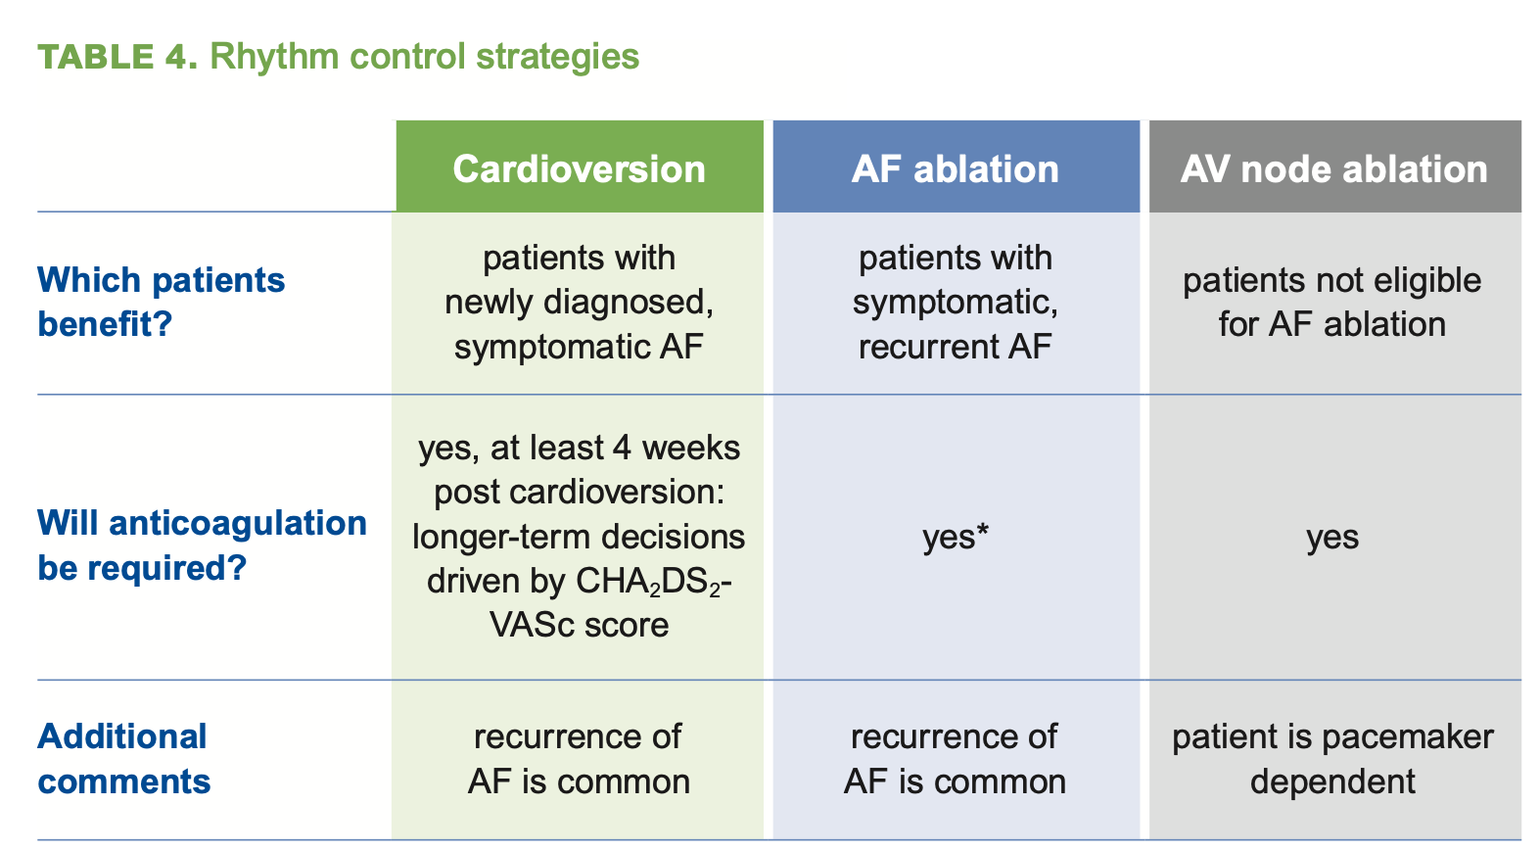

Slide 51
Atrial Fibrillation: Rate Control

Slide 52
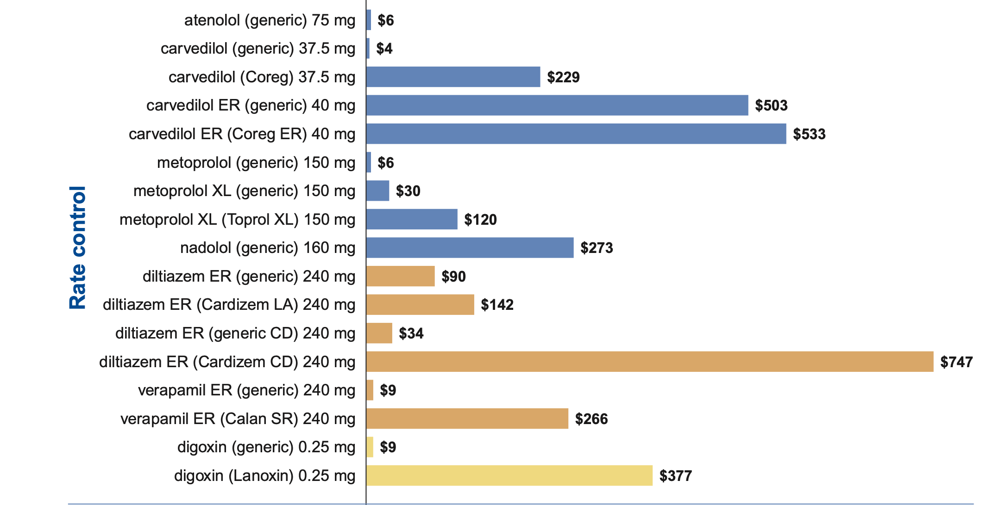
Afib Rate Controlling Agents: Cost

Slide 53
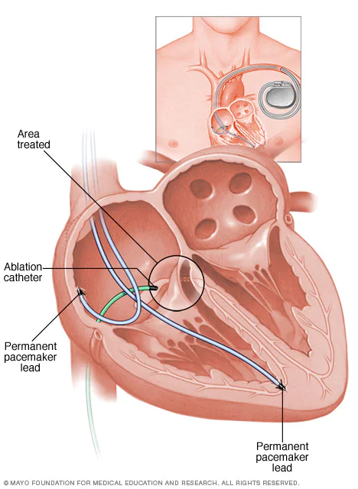

Slide 54
Atrial Fibrillation
Treatment:
CVA Prophylaxis
Rate Control
Rhythm Management

Slide 55
Notes:
````1`

Slide 57
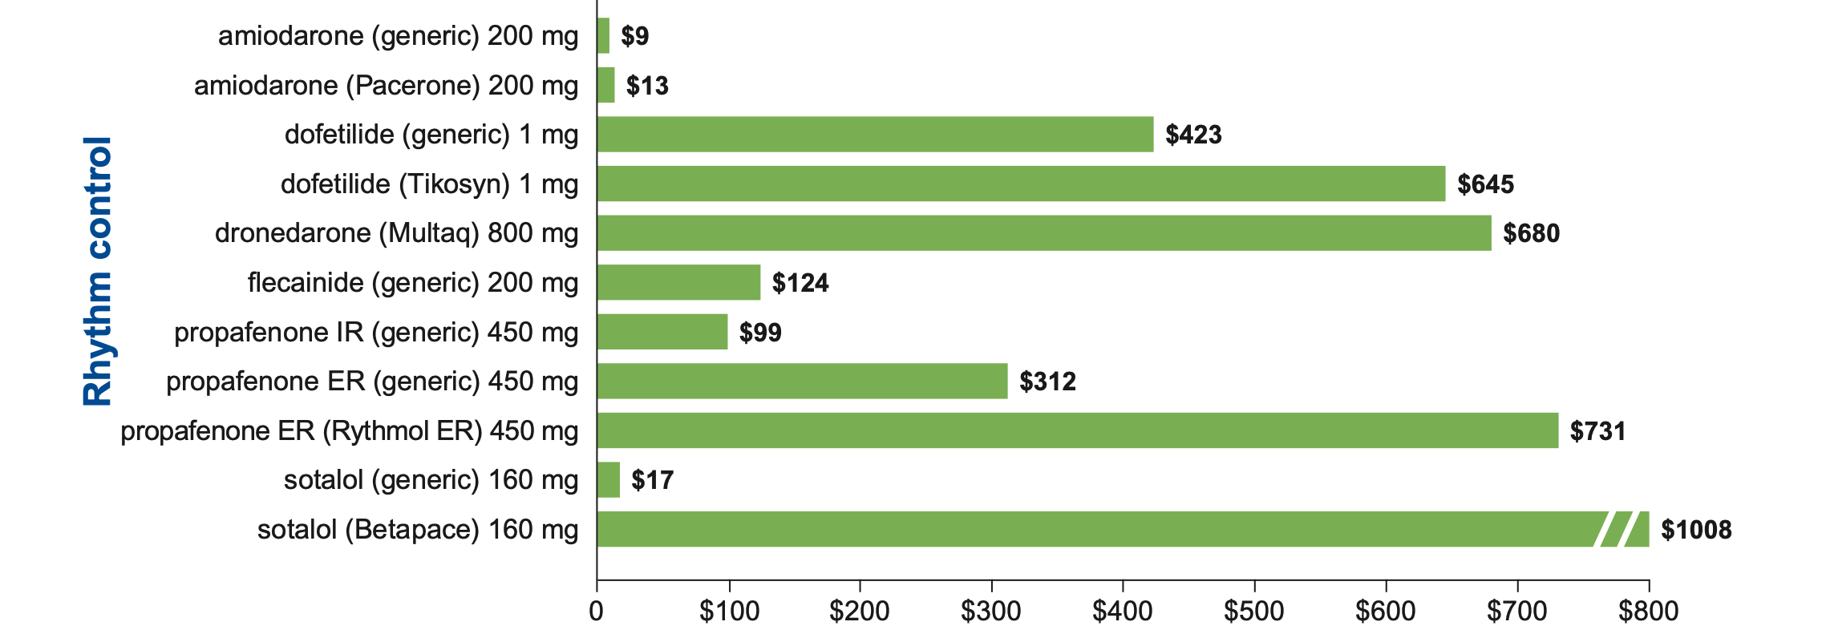
Afib Rhythm Controlling Agents: Cost

Slide 58
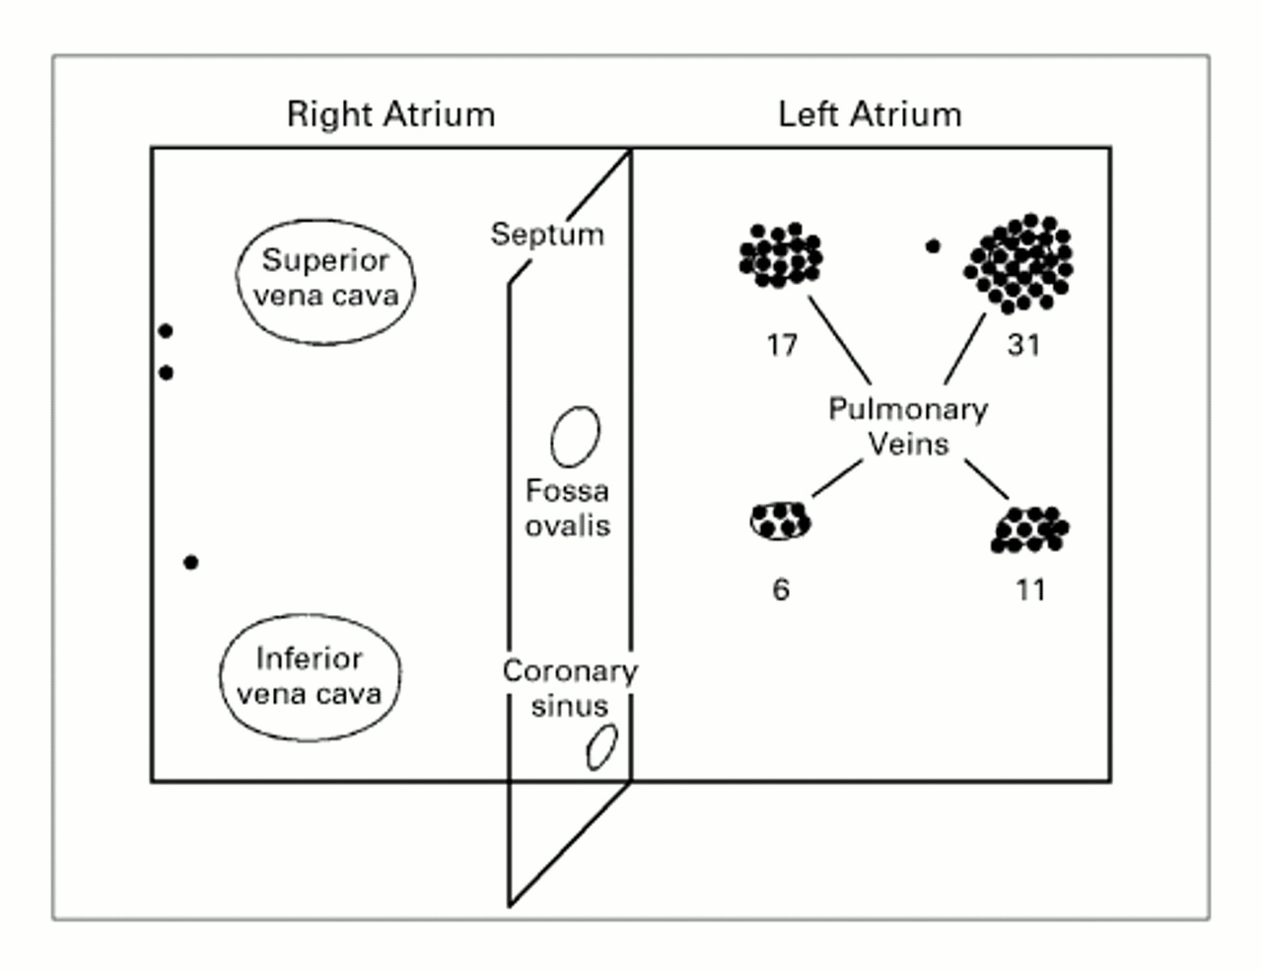

AFib Triggers
- Triggered by ectopic beats from
muscle fibers left atrium &
pulmonary veins
- Ectopic foci localized to
- Pulmonary Veins in 90% of pts
- 94% are 2-4 cm inside PV
- Remaining are right or left atrium
1998
Notes:
Figure 1. Diagram of the Sites of 69 Foci Triggering Atrial Fibrillation in 45 Patients.
Note the clustering in the pulmonary veins, particularly in both superior pulmonary veins. Numbers indicate the distribution of foci in the pulmonary veins.

Slide 59
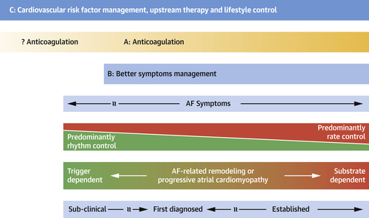
A. John Camm et al. J Am Coll Cardiol 2022; 79:1932-1948.

Slide 61
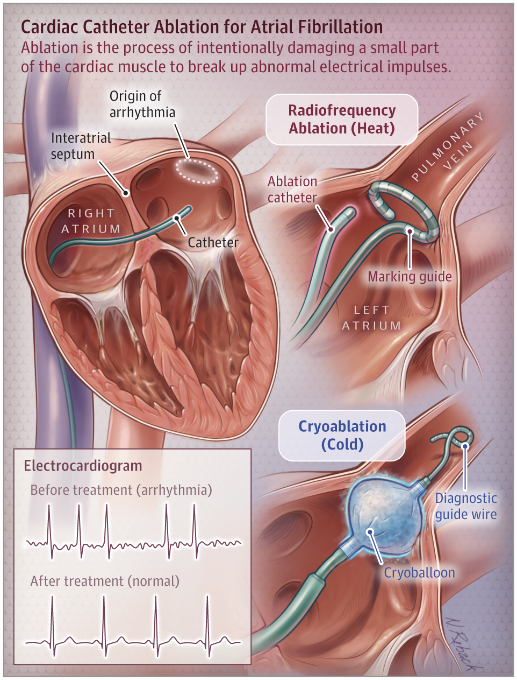

Slide 62
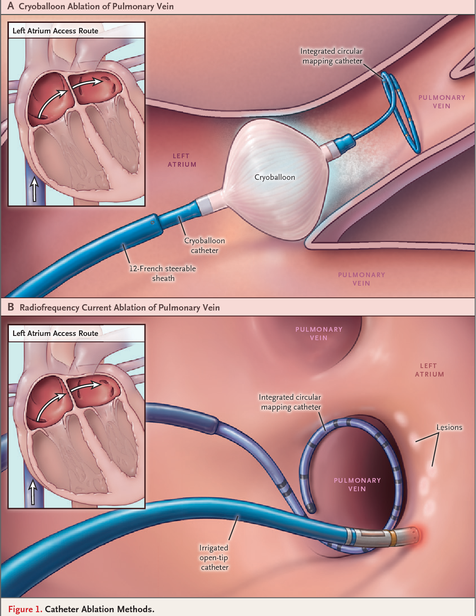

Slide 63
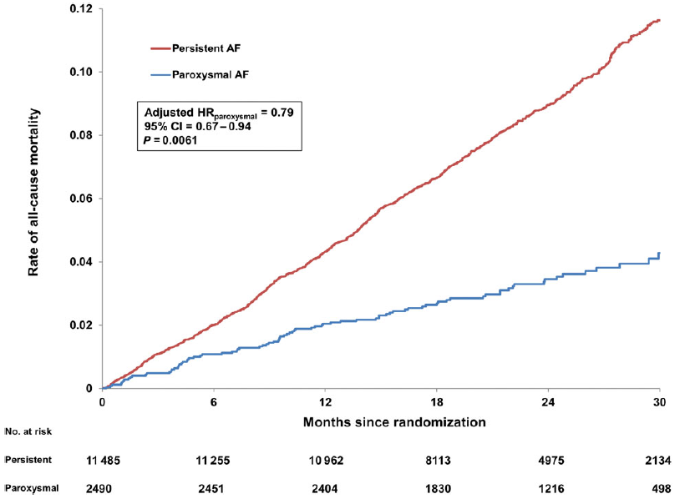
Consequences of Afib Progression
Increased mortality risk
ROCKET-AF Trial
14,062 AF patients
  18% paroxysmal
  82% persistent
Paroxysmal AF patients had
significantly lower rates of:
All-cause mortality
(adjusted HR: 0.79)
Stroke (adjusted HR: 0.78)
Composite of stroke,
systemic embolism, and
death (adjusted HR: 0.82)
P < 0.05 for all outcomes
Steinberg et al. Higher risk of death and stroke in patients with persistent vs. paroxysmal atrial fibrillation: results from the ROCKET-AF Trial. Europace. 2016; 18: 648-57.

Slide 64
Consequences of Afib Progression
Healthcare utilization and costs
MEAN CHANGES IN THE HEALTHCARE COST PER PATIENT PER MONTH
FOR THE 6-M PRE- AND 18-M POSTABLATION, INCL. COSTS FOR REPEAT ABLATION
Catheter ablation significantly reduced healthcare utilization and costs compared to pre-ablation, for both paroxysmal and persistent AF patients, but absolute costs remained higher for persistent AF, mainly due to reablation.
Friedman et al. Catheter ablation and healthcare utilization and cost among patients with paroxysmal versus persistent atrial fibrillation. Heart Rhythm O² 2020; 2(1):28-36

Slide 65
Consequences of Afib Progression
Beyond mortality
2.5x yearly cardiovascular event rate (permanent vs. non-permanent AF)¹
6.5x prevalence of stroke (persistent vs. paroxysmal AF)²
2.5x prevalence of heart failure (persistent vs. paroxysmal AF)²
~1.5x increased hospitalizations for cardiovascular problems and 3x for electrical cardioversions or stroke/transient ischemic attack (progression vs. no progression)³
Decreased health-related quality of life (EuroQoL-5D) due to worsening AF symptoms and adverse events (progression vs. no progression)⁴
De With RR et al. Atrial fibrillation progression and outcome in patients with young-onset atrial fibrillation. Europace. 2018; [Epub ahead of print].
Almeida ED et al. Clinical differences between subtypes of atrial fibrillation and flutter: cross-sectional registry of 407 patients. Arq Bras Cardiol. 2015; 105(1):3-10.
de Vos CB et al. Progression from paroxysmal to persistent atrial fibrillation: clinical correlates and prognosis. JACC. 2010; 55(8):725-731.
Dudink et al. The influence of progression of atrial fibrillation on quality of life: a report from the Euro Heart Survey. Europace. 2018; 20:929-934.

Slide 66
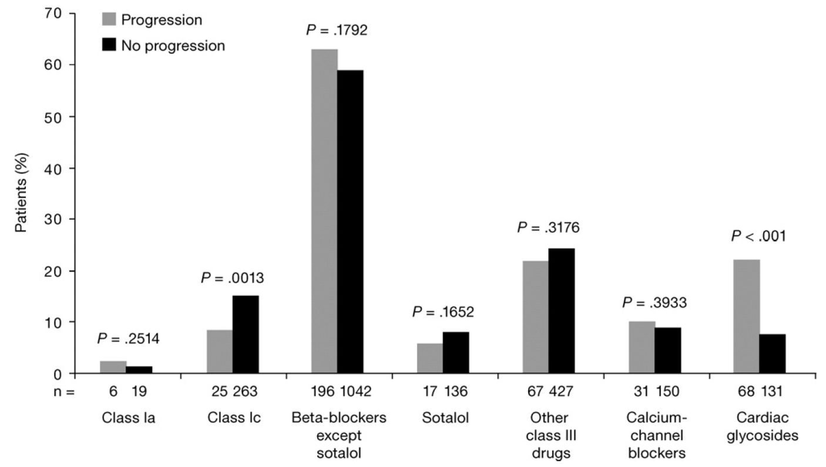
Preventing Progression of Afib: How to Treat?
Odds of AF progression are lower with rhythm vs. rate control drugs
RecordAF trial
Worldwide prospective study of
AF management
2,137 patients with recent-onset
paroxysmal AF
318 patients (15%) progressed
AF progression from paroxysmal
to persistent/permanent AF at
12 months was significantly
lower with rhythm vs. rate control (11% vs. 26%; P < 0.001)
Propensity score-adjusted odds ratio of AF progression with rate vs. rhythm control was 3.3 (95% CI 2.4-4.6; P < 0.0001)
de Vos et al. Progression of atrial fibrillation in the Registry on Cardiac rhythm disORDers assessing the control of Atrial Fibrillation cohort: clinical correlates and the effect of rhythm-control therapy. Am Heart J. 2012; 163:887-93.

Slide 67
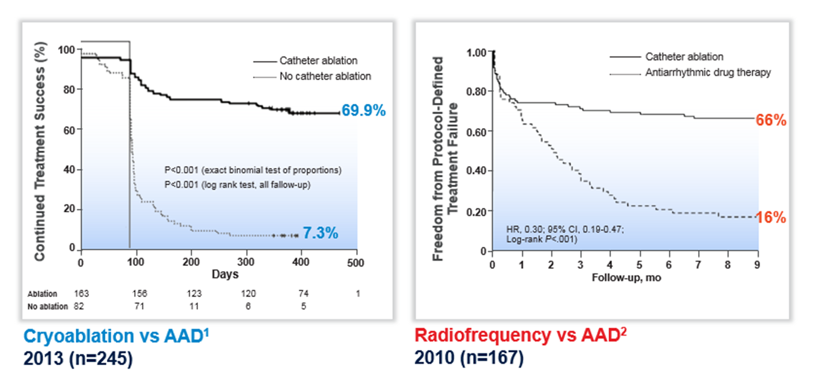
Preventing Progression of Afib: How to Treat?
AF treatment success is enhanced with ablation vs. rhythm-control drugs (AAD)
No. at risk:
Cryo 163 156 123 120 74 1
Drug 82 71 11 6 5
No. at risk:
RF 106 75 75 72 70 70 69 67 65 51
Drug 61 36 28 20 15 12 11 10 7 3
1. Packer et al. STOP AF Cryoablation Investigators. Cryoballoon ablation of pulmonary veins for paroxysmal atrial fibrillation: first results of the North American Arctic Front (STOP AF) pivotal trial. JACC. 2013; 61(16): 1713-23.
2. Wilber et al. ThermoCool AF Trial Investigators. Comparison of antiarrhythmic drug therapy and radiofrequency catheter ablation in patients with paroxysmal atrial fibrillation: a randomized controlled trial. JAMA. 2010; 303(4): 333-40.

Slide 68
Preventing Progression of AF: How to Treat?
RF ablation is superior to AAD in delaying progression to PsAF
Randomized control trial ATTEST
3-year follow-up
255 patients with drug-refractory, recurrent paroxysmal AF in 29 centers globally
Randomized to irrigated radiofrequency ablation vs. AAD treatment
RF ablation is superior to AAD in:
  Reducing AF/AT recurrence
  Reducing all cause mortality and hospitalization related to heart failure and cardiovascular cause
  Reducing AF burden at 2-5 years
  Delaying AF progression
Patients >_65 years were significantly more likely to progress to persistent AF/AT than patients <65 years
OCCURRENCE OF PERSISTENT AT/AF FOLLOWING BLANKING
Lower progression rates in
the RF ablation group than in the AAD treatment group were already
apparent at 1 and 2 years
Kuck et al. Catheter ablation or medical therapy to delay progression of atrial fibrillation: the randomized controlled atrial fibrillation progression trial (ATTEST). Europace 2020; 00:1-8

Slide 69
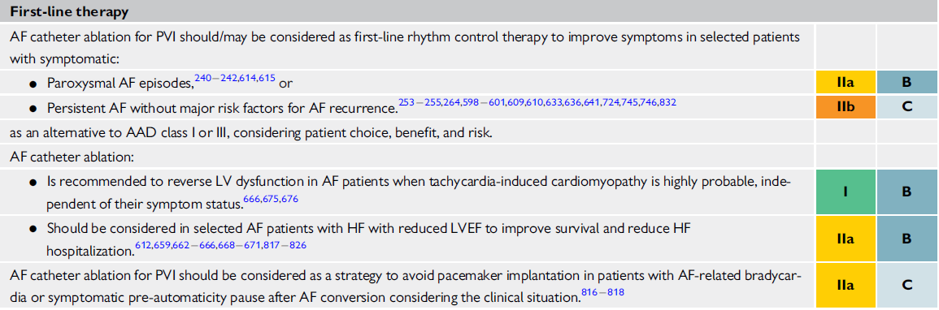
2020 ESC Guidelines for the Management of Atrial Fibrillation
Hindricks, G., et al. 2020 ESC Guidelines for the diagnosis and management of atrial fibrillation developed in collaboration with the European Association of Cardio-Thoracic Surgery (EACTS). European Heart Journal, 1–126. 2020.

Slide 70
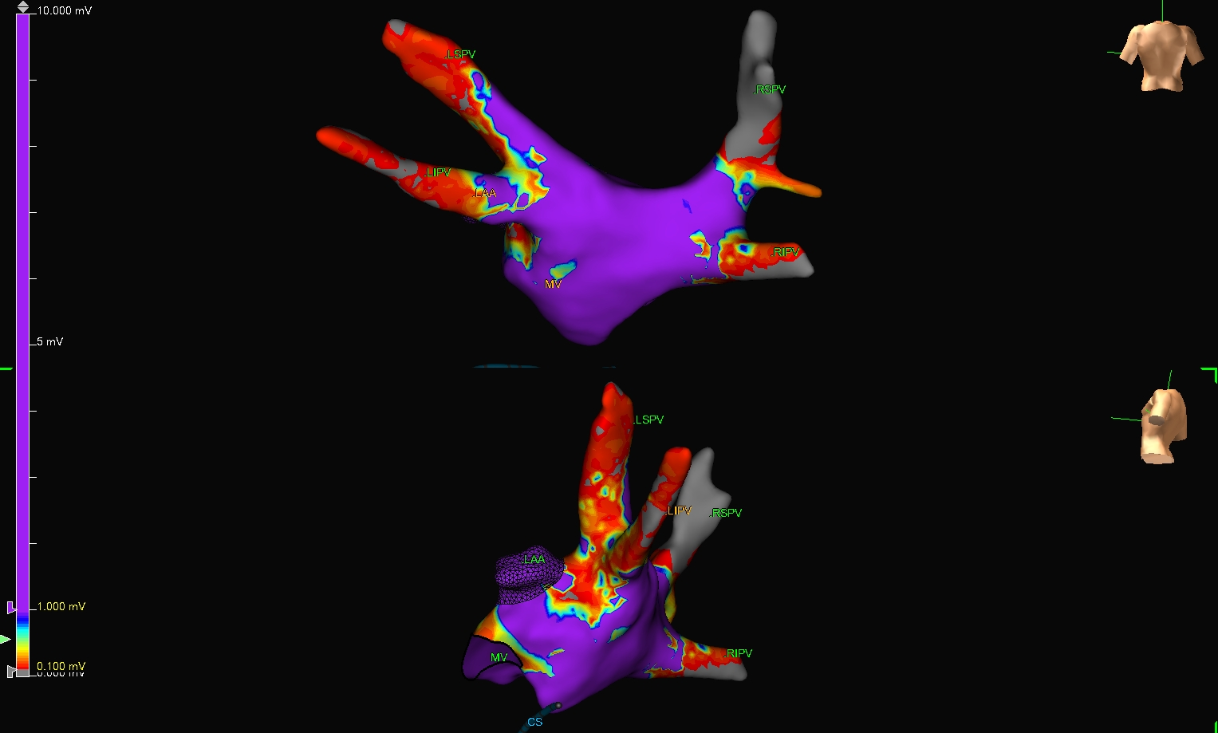
Pre-voltage Map

Slide 71
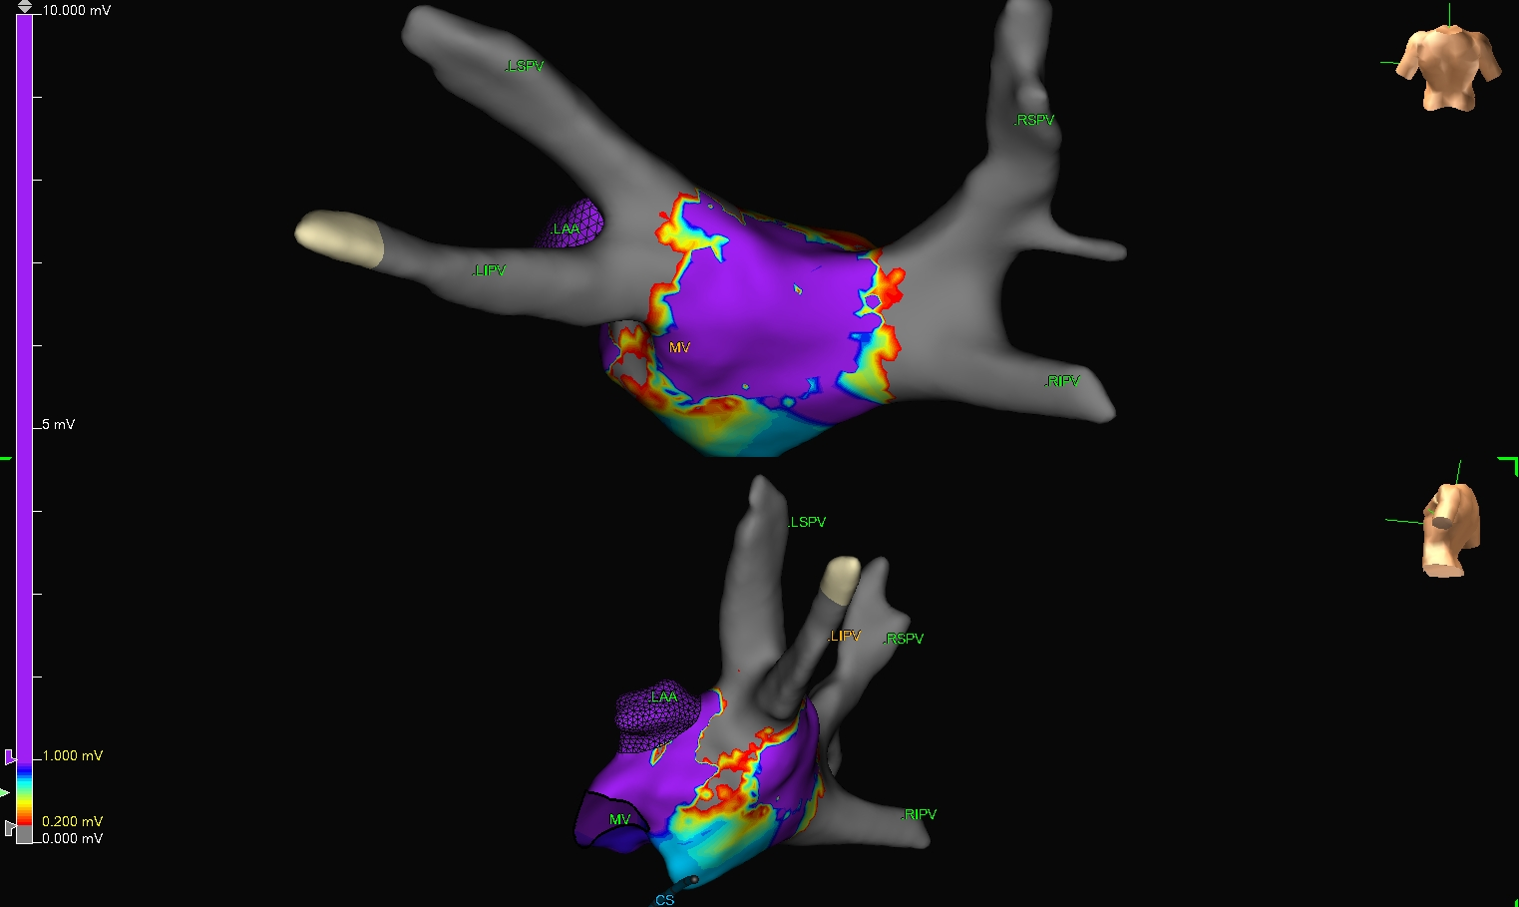
Post-voltage Map

Slide 72
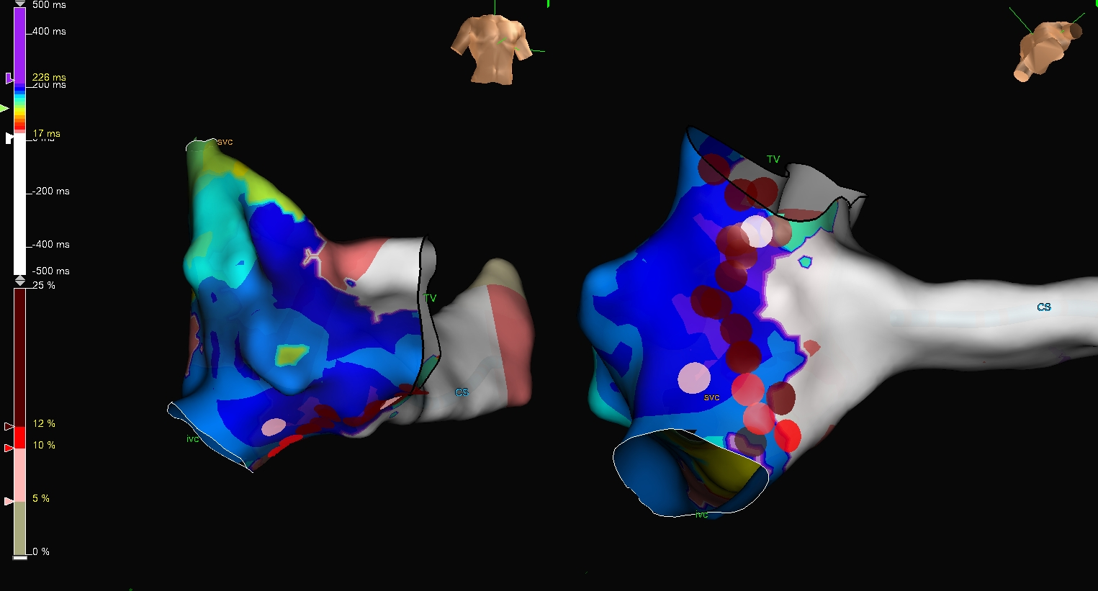

Slide 73
Atrial Fibrillation
Follow Up

Slide 74
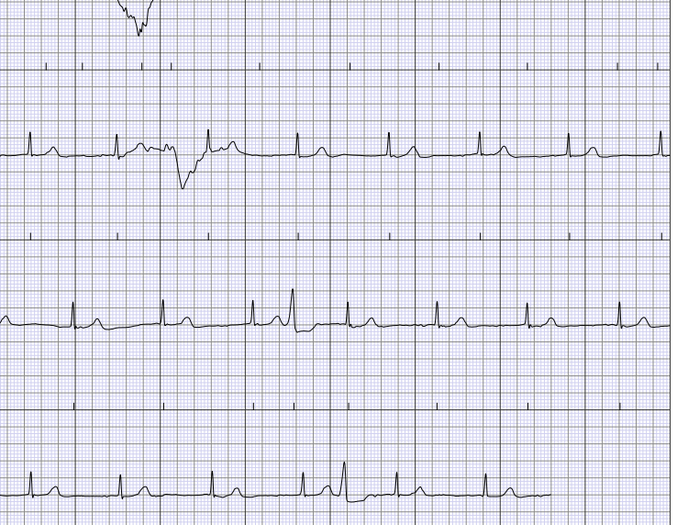
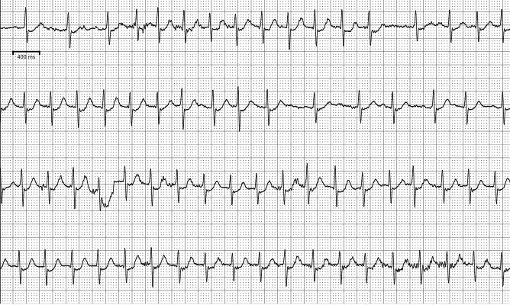
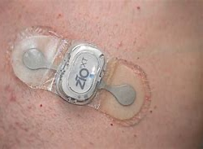

Slide 75
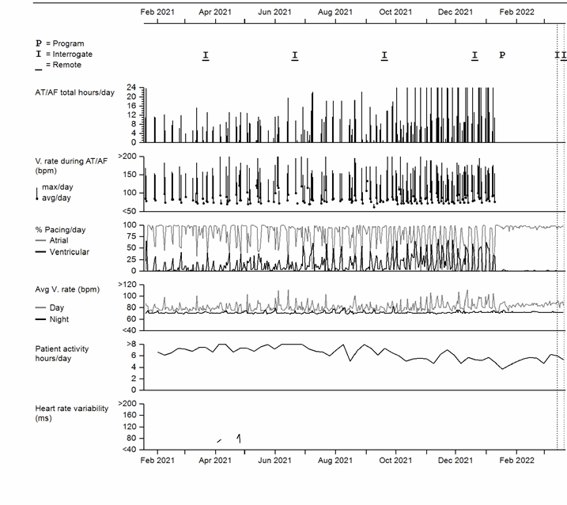

Slide 76
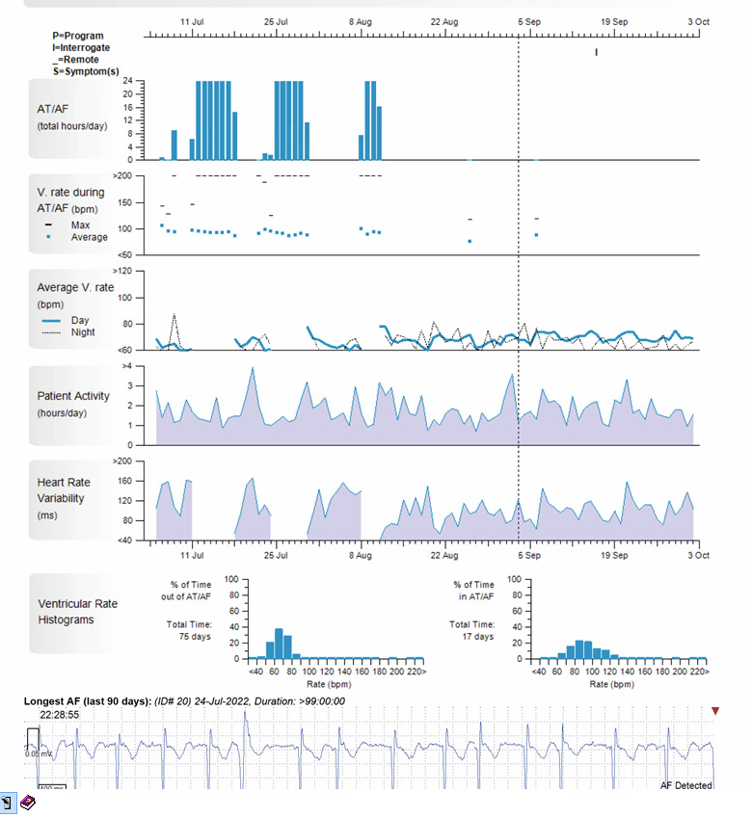

Slide 77
Summary
Atrial fibrillation is a progressive disease¹
Progression of AF increases risk of death, stroke, heart failure, cardiovascular events, and hospitalizations²⁻⁶
  These outcomes contribute to a decreased quality of life with progression of AF⁷
Early rhythm control was associated with lower risk of cardiovascular outcomes (CV death, stroke and hospitalization, and AF recurrence), and comparable safety to rate control⁸
Catheter ablation is more effective than pharmacological rhythm control for the prevention of AF progression^{9,10}
Earlier ablation after AF diagnosis, and antiarrhythmic therapy, is associated with improved long-term outcomes, including AF recurrence, repeat ablations, and death¹¹⁻¹⁴
¹ Kirchhof et al. 2016 Guidelines for the management of AF developed in collaboration with EACTS. Eur Heart J. 2016;37:2893-2962. ² Boriani et al. ‘Real-world’ management and outcomes of patients with paroxysmal vs. non-paroxysmal atrial fibrillation in Europe: the EURObservational Research Programme–Atrial Fibrillation (EORP-AF) general pilot registry. Europace. 2016; 18: 648-57. ³ Steinberg et al. Higher risk of death and stroke in patients with persistent vs. paroxysmal atrial fibrillation: results from the ROCKET-AF Trial. ⁴ De With RR et al. Atrial fibrillation progression and outcome in patients with young-onset atrial fibrillation. Europace. 2018; epub ahead of print. ⁵ Almeida ED et al. Clinical differences between subtypes of atrial fibrillation and flutter: cross-sectional registry of 407 patients. Arq Bras Cardiol. 2015; 105(1):3-10. ⁶ de Vos CB et al. Progression from paroxysmal to persistent atrial fibrillation: clinical correlates and prognosis. JACC. 2010; 55(8):725-731. ⁷ Dudink et al. The influence of progression of atrial fibrillation on quality of life: a report from the Euro Heart Survey. Europace. 2018; 20:929-934. ⁸ Kirchhof P et al. Early Rhythm-Control Therapy in Patients with Atrial Fibrillation. NEJM 2020 doi: 10.1056/NEJMoa2019422 ⁹ Jongnarangsin et al. Effect of catheter ablation on progression of paroxysmal atrial fibrillation. J Cardiovasc Electrophysiol. 2012; 23(1): 9-14. ¹⁰ Kuck et al. Catheter ablation or medical therapy to delay progression of atrial fibrillation: the randomized controlled atrial fibrillation progression trial (ATTEST). Europace 2020; 00:1-8 ¹¹ Bunch et al. Increasing time between first diagnosis of atrial fibrillation and catheter ablation adversely affects long-term outcomes. Heart Rhythm. 2013; 10(9): 1257-62. ¹² Lunati et al. Is the time between first diagnosis of paroxysmal atrial fibrillation and cryoballoon ablation a predictor of efficacy? J Cardiovasc Med. 2018; 19(8):446-452. ¹³ Chew DS, Black-Maier E, Loring Z, et al. Diagnosis-to-Ablation Time and Recurrence of Atrial Fibrillation Following Catheter Ablation: A Systematic Review and Meta-analysis of Observational Studies Circ Arrhythm Electrophysiol. 2020 Apr;13(4):e008128 doi:10.1161/CIRCEP.119.008128 ¹⁴ Pranata et al. Longer diagnosis-to-ablation time is associated with recurrence of atrial fibrillation after catheter ablation—Systematic review and meta-analysis. J Arrhythmia 2019;36: 289-294

Slide 78
Afib is a Progressive Disease
At-risk
for AF
Asymptomatic
Paroxysmal
Persistent
Long-Standing Persistent
Permanent
Kirchhof et al. 2016 Guidelines for the management of AF developed in collaboration with EACTS. Eur Heart J. 2016;37:2893-2962
Nattel et al. Early management of atrial fibrillation to prevent cardiovascular complications. Eur Heart J. 2014; 35(22):1448-56.
Schotten et al. Pathophysiological mechanisms of atrial fibrillation: a translational appraisal. Physiol Rev. 2011; 91:265-325.
Zhao et al. Observation of the efficacy of radiofrequency catheter ablation on patients with different forms of atrial fibrillation. Euro Rev Med Pharmacol Sci. 2016; 20:4141-47.
Quan et al. Predictors of late atrial fibrillation recurrence after cryoballoon-based pulmonary vein isolation: a meta-analysis. Kardiologia Polska. 2017; 75(4):376-85
Atrial remodeling, AF progression, consequences and co-morbidities^{2,3}
Ablation success rates^{4,5}
78

Slide 79

Questions?

