Slide 1
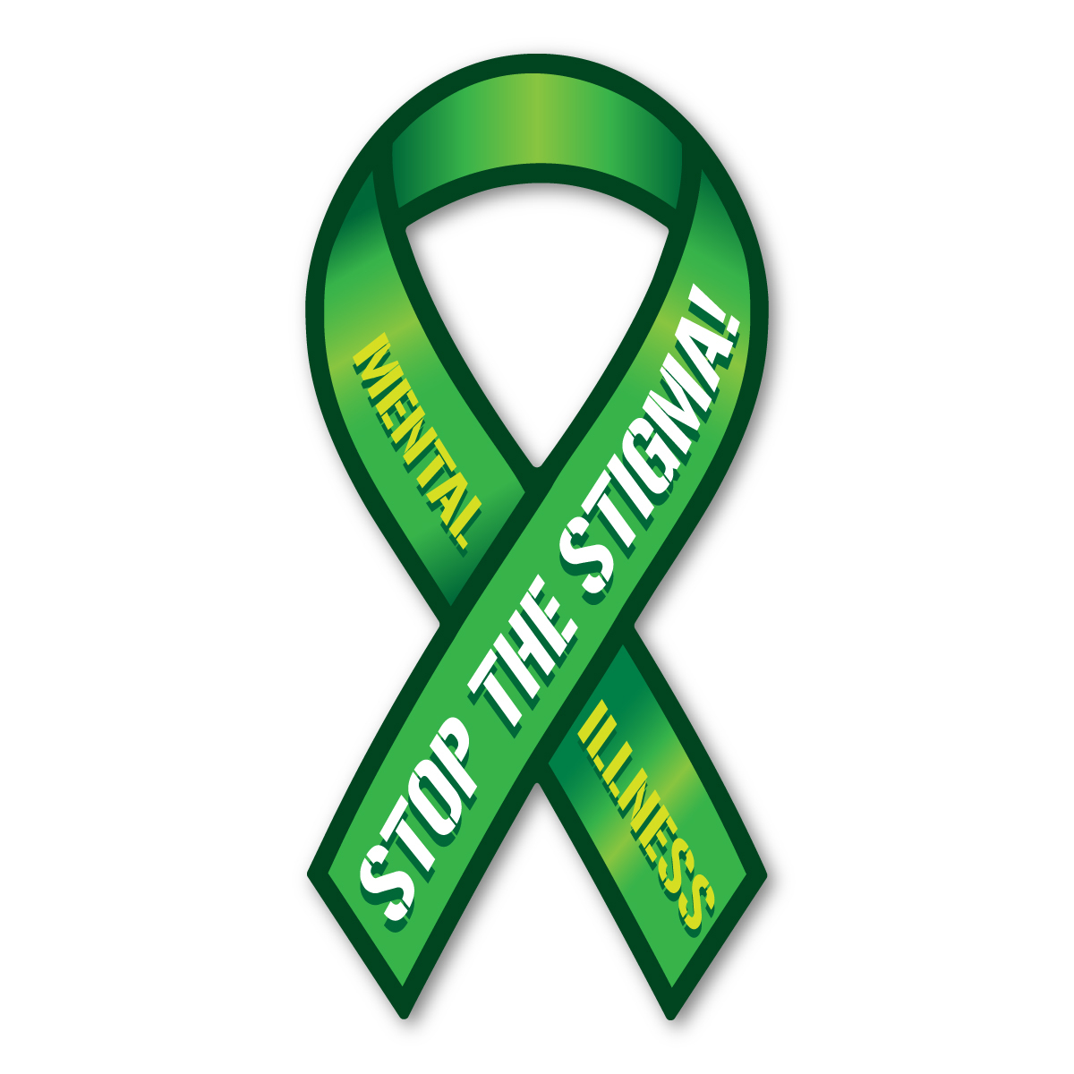
Mental Health Matters: Supporting Our Healthcare Heroes
Understanding Mental Health, Burnout, Compassion Fatigue, and Risk Factors for Suicide
Kimberly Kohli, Ph.D., Psychologist, Certified Bariatric Counselor
Fairfield Healthcare Professionals Psychiatry

Slide 3
What is Mental Health?
Mental health includes our emotional, psychological, and social well-being.
Impacts how we think, feel, and act.
Plays a role with how we handle stress, relate to others, and make choices. Mental health is important at every stage of life, from childhood and adolescence through adulthood
Mental illness is a condition that affects a person's thinking, feeling, behavior or mood. These conditions deeply impact day-to-day living and may also affect the ability to relate to others
A mental health condition is NOT the result of one event
Research suggests multiple, linking causes.
Genetics, environment and lifestyle influence whether someone develops a mental health condition. A stressful job or home life makes some people more susceptible, as do traumatic life events.
Biochemical processes and circuits and basic brain structure may play a role too
Obtained from NAMI

Slide 4
Prevalence of Mental Health Conditions in the U.S.
43.8 million people or 1 in 5 adults are affected by mental illness
17% of youth between the ages of 6 and 17 years experience a mental health condition
The avg. delay between onset of symptoms and treatment is 11 years
Around 50% of all chronic mental health conditions begin by the age of 14
About 75% of all chronic mental health conditions begin by the age of 24
Obtained from https://www.nami.org/About-Mental-Illness/Mental-Health-Conditions

Slide 5
Prevalence of Mental Health Conditions in U.S. cont.
1 in 25 adults or (10 million) experience serious mental illness
Depression is the leading cause of disability worldwide
18.1% (42 million) adults experience anxiety disorders
About 7-8% (8 million) people will experience Post Traumatic Stress Disorder (PTSD) at some point in their lives
About 10% of females will experience PTSD at some point in their lives
Obtained from https://nami.org/About-Mental-Illness/Mental-Health-Conditions

Slide 6
Prevalence of Mental Health Conditions in the U.S. cont.
About 4% of males will experience PTSD at some point in their lives
6.9% (16 million) adults experience Major Depressive Disorder
2.6% (16.2 million) adults experience Bipolar Disorder
1.1% (2.4 million) adults experience Schizophrenia

Slide 7
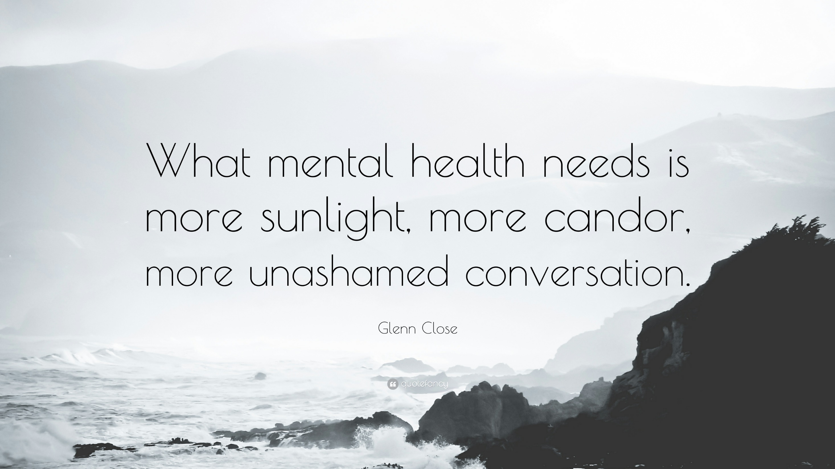

Slide 8
Impact of COVID-19 on Mental Health and Substance Use in the U.S.
Data as of February 2023:
The pandemic has resulted in various challenges, including isolation and loneliness, job loss/financial instability, illness, and grief/loss
32.3% reporting symptoms of anxiety and/or depressive disorder
Adults between 18-24 reported highest rates of depression and/or anxiety
50% of those 18-24 reported anxiety and depressive symptoms
Drug overdose deaths increased by 50%
Alcohol-induced death rates increased by 38%
30% of adolescent females and 14% of adolescent males seriously considered suicide in 2021
ED visits for suicide attempts increased for adolescents
KFF (2023) obtained from: www.kff.org

Slide 9
Warning Signs and Symptoms of Mental Health Conditions
Common signs of mental illness include:
Excessive worry or fear
Confused thoughts or problems with concentration
Extreme mood changes, including uncomfortable “highs” or “lows”
Prolonged or strong feelings of anger or irritability
Avoiding social activities, social isolation, or difficulty with relating to others

Slide 10
Warning Signs and Symptoms of Mental Health Conditions cont.
Fatigue, low energy or motivation
Changes in sleep patterns and eating habits (eating too little or eating too much)
Difficulty perceiving reality (delusions or hallucinations in which a person experiences or senses things that don’t exist in objective reality)
Overuse of substances
Multiple physical symptoms without obvious medical causes such as, headaches & gastrointestinal symptoms
Inability to perform daily activities

Slide 11
Aspects that Negatively Impact Healthcare Professionals
Burnout
A term that has been used since the early 1970s to describe the physical and emotional exhaustion that workers can experience when they have low job satisfaction and feel powerless and overwhelmed at work
Cumulative process marked by emotional exhaustion and withdrawal associated with increased workload and institutional stress, NOT trauma-related
“A syndrome of emotional exhaustion, depersonalization and lack of feelings of personal accomplishment”
Lee & Ashforth, 1996

Slide 12
Maslach’s 6 Areas of Burnout
Healthcare has been the primary occupation for research on burnout for several decades
Maslach Burnout Inventory (MBI)
MBI-HSS (MP)- for medical personnel
Workload- too much, not enough resources
Control- Micromanagement, accountability without power
Reward – Insufficient pay, acknowledgement, satisfaction
Community- Isolation, conflict, disrespect
Fairness -Discrimination, favoritism
Values -Ethical conflicts, meaningless tasks

Slide 13
Research on Burnout among Healthcare Professionals
Study by Shaikh et al. (2019) examined burnout among 71 internal medicine physicians, interns, and post-graduate trainees using abbreviated Maslach Burnout Inventory (MBI)
Results:
More than 25% have moderate to high burnout
High degree of burnout among internal medicine physicians
Interns reported highest frequency of burnout
Working hours and number of on-call days significant correlating factors
Most significant findings: the perception that burnout is an inevitable side effect of the profession, glamorization of survival of the fittest, and self-denial

Slide 14
Burnout Among Healthcare Professionals
Burnout is linked to:
Poor quality of patient care
Decreased safety- increased medical errors
Poor relationships with colleagues
Greater risk of substance abuse
Greater risk of depression and suicidal ideation
Greater likelihood of leaving the healthcare profession

Slide 15
Signs of Burnout
Dreading work and trouble getting started on frequent basis
Becoming irritable or impatient with co-workers, patients, or others
Lack energy to be consistently productive
Difficulty with concentration
Lack satisfaction from achievements
Feeling disillusioned about your job
Using food, alcohol, or illicit substances to feel better or to numb emotions
Change in sleep habits (sleeping too much or too little)

Slide 16
Compassion Fatigue
What is Compassion Fatigue?
The emotional residue or strain of exposure to working with those suffering from the consequences of traumatic events. It differs from burn-out but can co-exist. Can occur due to exposure to one case or can be due to a “cumulative” level of trauma
Compassion Fatigue (Figley, 1982) refers to the profound emotional and physical erosion that takes place when helpers are unable to refuel and regenerate

Slide 17
Signs of Compassion Fatigue
Can experience the same symptoms as burnout but other symptoms may include:
Feeling burdened by the suffering of others or blaming others for their suffering
Isolation from others
Loss of pleasure in life
Physical and mental fatigue
Increased nightmares/intrusive images
Feelings of hopelessness or powerlessness

Slide 18
Signs of Compassion Fatigue cont.
Receiving a lot of complaints about work or having a negative attitude
Anger, irritability, decreased ability to feel sympathy and empathy
Dread working with certain patient populations
Decreased sense of satisfaction/enjoyment at work
Decreased problem-solving ability at work
Increased anxiety/irrational fears

Slide 19
Strategies to prevent and manage burnout and vicarious trauma
Develop and maintain strong social support both at home and at work
Increase self-awareness through mindfulness such as, journaling, meditation, and grounding techniques
Self-Regulation- Take stock of what’s on your plate and prioritize. Look at your list carefully; What stands out? What factors contribute to feeling overwhelmed?
Set healthy boundaries with others
Balance, self-care, and positive activities
Talk about your feelings
Seek professional help such as, EAP, wellness programs, counseling/psychotherapy, or support groups

Slide 20
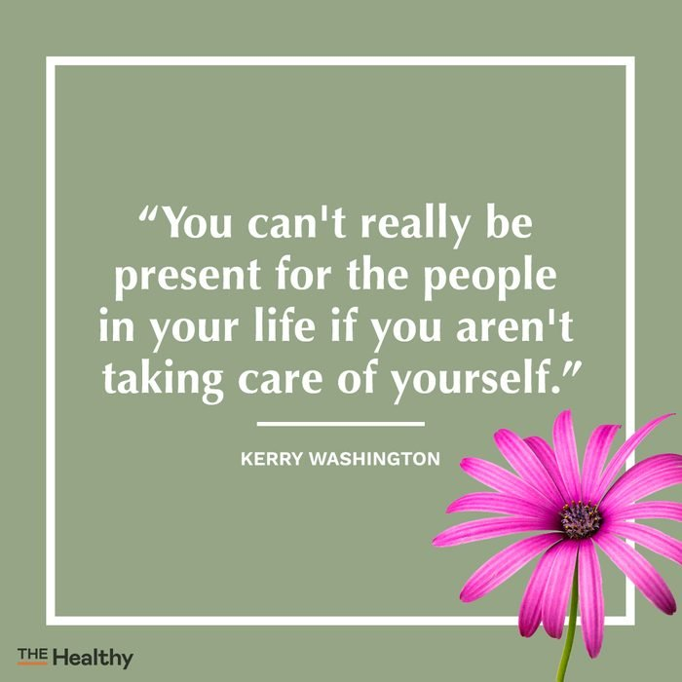

Slide 21
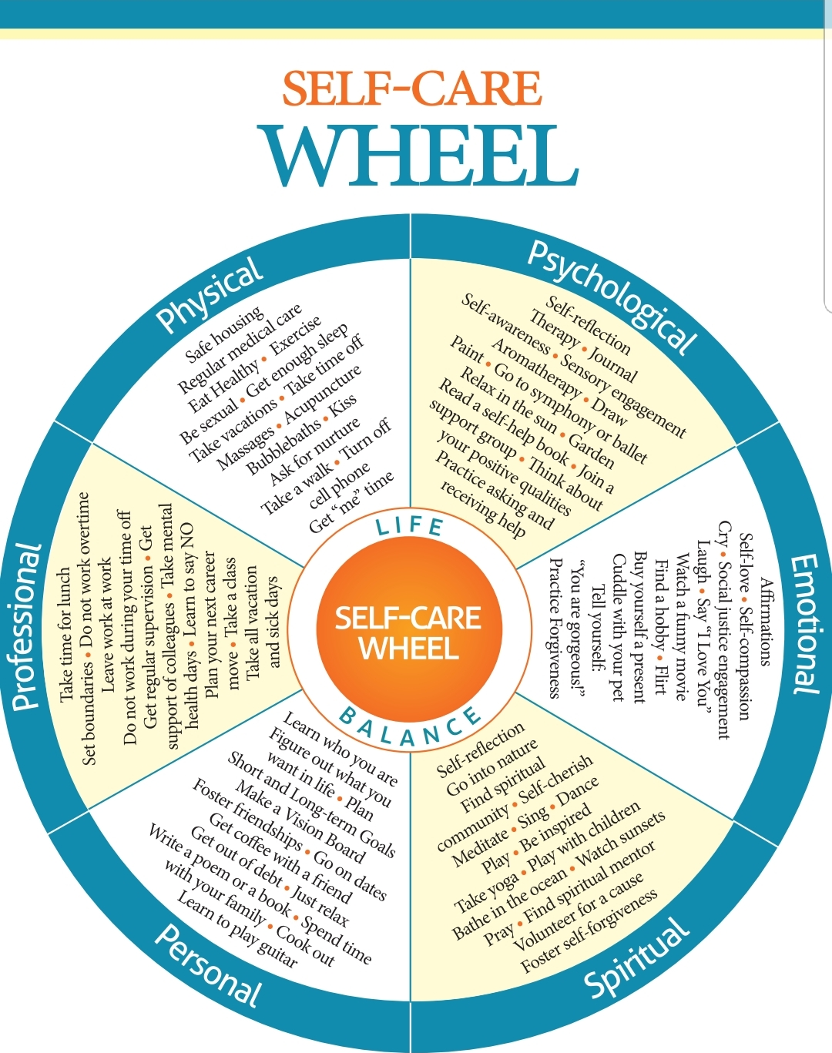

Slide 22
Self-Care cont.
Self-Care Strategies:
1. Make sleep a priority- If you have difficulty with falling asleep/staying asleep, examine your nightly routine (for more information, look for sleep hygiene strategies)
2. Physical Activity/Exercise-3. Engage in positive activities that you enjoy
4. Learn to say no to others, yes to your self-care
Set healthy boundaries with others. Schedule your self-care time

Slide 23
Self-Care cont.
5. Spend time outside (walking, hiking, and gardening).
Studies have shown that getting outside can help reduce fatigue and depression.
6. Get organized (keep a planner/calendar)
7. Take 5 minutes each day to decompress
8. Strive to maintain work/life balance (take time off when possible)
9. Start your day with something positive (such as, daily affirmations) Practice gratitude
10. Take a break from technology
11. Focus on your accomplishments/not failures- Practice self-compassion and use positive self-talk. Reward yourself for accomplishments
12. Try to focus on the moment and each day (not on your past or worrying about future (“what ifs” and “should”/”could”). This hold us back from accomplishing our goals and moving forward
13. Use Humor

Slide 24
Facts about Suicide
Suicide is a serious public health problem
Rates of Suicide have increased by 36% from 2000-2021
Suicide was responsible for more than 48,000 deaths in 2021
One person dies every 11 minutes and each day from suicide
Suicide is the 9th leading cause of death in the U.S.
Suicide was the 2nd leading cause of death for those 10-14 and 20-34
Obtained from CDC (2023)
Information based upon Centers for Disease Control Fatal Injury Report for 2018 (obtained from American Foundation for Suicide Prevention website: https://afsp.org/suicide-statistics/).

Slide 25
Facts about Suicide cont.
Caucasian males accounted for 69.67% of suicide deaths
Veterans, those who live in rural areas, and certain industries (such as, physicians, mining and construction) have higher than avg. rates
LGBTQ+ adolescents have higher rates of suicidal thoughts as compared to their peers
Males died from suicide 3.56 times more often than females
Firearms accounted for 50.57% of suicide deaths
Obtained from CDC (2023)

Slide 26
Suicide Among Healthcare Professionals
Results from study conducted by APA in 2018 among physicians in the U.S.:
Physicians have highest suicide rate of any profession
One physician dies from suicide each day (rate is twice that of general population)
Suicide rate is higher among physicians than those in military
15-30% of medical students experience depression
12% of male physicians experience depression
19.5% of female physicians experience depression
50% of female physicians admitted to not seeking mental health treatment due to the fear of stigma

Slide 27
Warning Signs of Suicide
Talking about wanting to die/wishing to be dead
Talking about feeling hopeless or having no purpose
Talking about feeling trapped or being in unbearable pain
Talking about being a burden to others or being better of dead
Increasing the use of alcohol or drugs
Agitated, or reckless behavior
Sleeping too little or too much
Showing rage or talking about seeking revenge
Displaying extreme mood swings
Pre-occupation with death, dying, or violence
Giving personal belongings away

Slide 28
Risk Factors for Suicide
Mental health condition, particularly mood disorders, schizophrenia, anxiety disorders and certain personality disorders
Alcohol and other substance use disorders
Hopelessness
Impulsive and/or aggressive tendencies
History of trauma or abuse
Major physical or chronic illnesses
Previous suicide attempt(s)
Family history of suicide
Recent job or financial loss
Recent loss of relationship
Easy access to lethal means
Lack of social support and sense of isolation
Stigma associated with asking for help
Lack of health care, especially mental health and substance abuse treatment
Cultural and religious beliefs, such as the belief that suicide is a noble resolution of a personal dilemma
Exposure to others who have died by suicide (in real life or via media)

Slide 29
Protective Factors for Suicide
Protective factors are characteristics that make a person less likely to engage in suicidal behavior.
Promote resilience and ensure connectedness with others during difficult times.
Effective clinical care for mental and physical health and substance use disorders
Easy access to a variety of clinical interventions
Restricted access to highly lethal means of suicide (such as, guns)
Strong connections to family and community support
Support through ongoing medical and behavioral health relationships
Skills in problem solving, conflict resolution, and handling problems in a non-violent way
Cultural and religious beliefs that discourage suicide and support self-preservation

Slide 30
How to help someone who is in crisis/feeling suicidal
Strategies that can be helpful:
Stay calm (even if you don’t feel calm)
Be sensitive and remember this person is going through a very difficult time
Ask questions (asking about suicidal thoughts Will NOT encourage them to do something self-destructive- it may save their life)
Examples of questions: How are you doing? Are you thinking about giving up or dying? Are you thinking about hurting yourself? Do you have access to guns or other objects that could be used to harm yourself?
Listening and offering opportunity to talk about their feelings can reduce the risk of self-harm/suicide. Shows concern and that they are not alone

Slide 31
Resources to help individuals in crisis/having suicidal thoughts
For immediate help
If someone has attempted suicide or you are concerned about their imminent safety and/or the safety of others:
Do Not leave the person alone
Remove weapons/anything that can be used for self-harm
If at FMC (contact Emergency Services). Call 911 or your local emergency number right away. Or, if you think you can do so safely, take the person to the nearest hospital emergency room yourself

Slide 32
References
Deepika, T., & Brodsky, B. (2018). American Psychiatric Association. Doctors’ suicide rate highest of any profession.
Lee, R. T., & Ashforth, B. E. (1996). A meta-analytic examination of the correlates of the three dimensions of job burnout. Journal of Applied Psychology, 81(2), 123–133. http://doi.org/10.1037/0021-9010.81.2.12
Self-care wheel. Olga Phoenix Project Healing for Social Change. 2013. olgaphoenix.com.
Shaikh, A. A., Shaikh, A., Kumar, R., & Tahir, A. (2019). Assessment of Burnout and its Factors Among Doctors Using the Abbreviated Maslach Burnout Inventory. Cureus, 11. https://doi.org/10.7759/cureus.4101

Slide 33
Resources to help individuals in crisis/having suicidal thoughts
Other Resources:
Crisis Text line- 741741 (free, 24-hour support from trained crisis counselors). Text “HOME” to 741741
Encourage the person to call a suicide hotline number. In the U.S., call the National Suicide Prevention Lifeline at 988 to reach a trained counselor. Use that same number and press "1" to reach the Veterans Crisis Line

Slide 34
Resources
Burnout/Compassion Fatigue
http://www.compassionfatigue.org/
https://www.nsvrc.org/sites/default/files/nsvrc-publications_sane-mobile-app_resources-vicarious-trauma.pdf
https://www.workplacestrategiesformentalhealth.com/managing-workplace-issues/burnout-response
Recommended- Documentary Film “Suicide: The Ripple Effect”
Kevin Hines #BeHereTomorrow
http://www.kevinhinesstory.com/
Suicide Prevention Activist
Diagnosed with Bipolar Disorder at 17 and struggled with substance use
In 2000, Kevin jumped off the Golden Gate Bridge (he was 19)

Slide 35
Resources cont.
Text “HOME” to 741741 to speak with a crisis trained counselors (free, anonymous, and available 24 hrs. per day)
Kevin Hines #BeHereTomorrow
http://www.kevinhinesstory.com.
Suicide
https://www.suicidepreventionlifeline.org/
Mental Health
National Alliance on Mental Illness (nami.org)
Mental Health America (mhanational.org)
National Suicide Prevention Lifeline 988
Self-Care
Bbrfoundation.org https://www.psychologytoday.com/us/blog/click-here- happiness/201812/self-care-12-ways-take-better-care-yourself
Sleep Hygiene Tips
https://www.cdc.gov/sleep/about_sleep/sleep_hygiene.html

