Slide 1
The Joint and Beyond:
Articular and Extra-articular Manifestations of Inflammatory Arthropathies
Sheryl Mascarenhas, MD
Rheumatology
Fairfield Medical Center
September 2023

Slide 2
Objectives
Recognize common presentations of inflammatory arthropathies
Identify initial workup for inflammatory arthropathies
Recognize extra-articular manifestations of inflammatory arthropathies

Slide 3



Nomenclature
Arthritis
INFLAMMATORY
NON-INFLAMMATORY

Slide 4
Inflammatory Arthritis Models
AM stiffness> 30 minutes
  Rigid, hard to move joints
  Beware of fibromyalgia patients that may report prolonged stiffness
Ask what time of day is their pain the worst
  If they say right when they wake up—this could be a concern
Improves with activity
  When you have the pain is their first inclination to keep moving or stop and rest
Worsens with rest
  While they are laying down do they feel pain
  Be careful not to confuse with gelling phenomenon
Generally synovial fluid with WBC > 2000

Slide 5
INFLAMMATORY | NON-INFLAMMATORY
AM Stiffness >30 min | AM Stiffness < 30 min
worse with rest | Better with rest
Improved with activity | Worse with activity
Worse in the AM

Slide 6
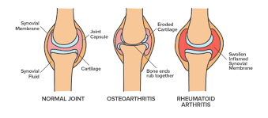
https://pt.khanacademy.org/science/health-and-medicine/muscular-skeletal-diseases/arthritis/a/arthritis-and-rheumatoid-arthritis

Slide 7
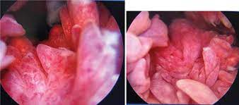
https://clinmedjournals.org/articles/jrdt/journal-of-rheumatic-diseases-and-treatment-jrdt-6-086.php?jid=jrdt

Slide 8
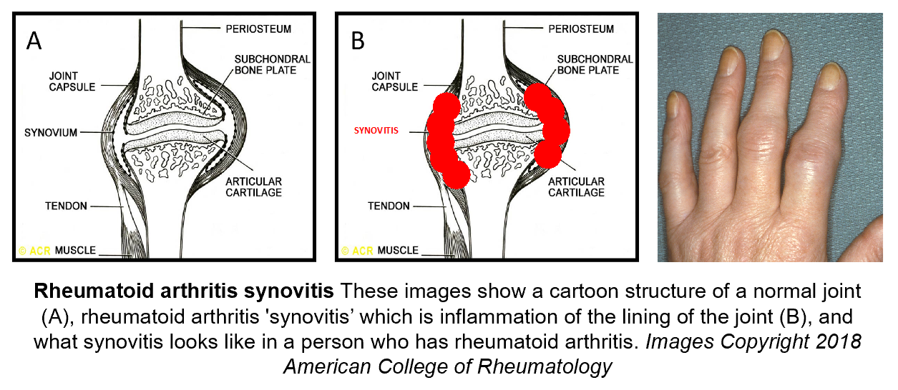

Slide 9
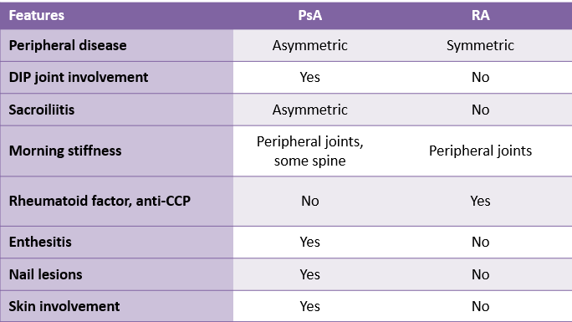
McArdle A, et al. Clin Rev Allergy Immunol. 2018;55:271-294; Mease P, et al. J Am Acad Dermatol. 2005;52(1):1-19.

Slide 10



Arthritis
INFLAMMATORY
RA
REACTIVE
AS
PSORIATIC
ENTEROPATHIC

Slide 11

RA

Slide 12
RA model
Female
Onset 30s-50s and 60s
Symptoms > 6 weeks
Symmetric
Small joint
Palpable synovial swelling that is painful (synovitis)
No axial involvement except C1-C2

Slide 13
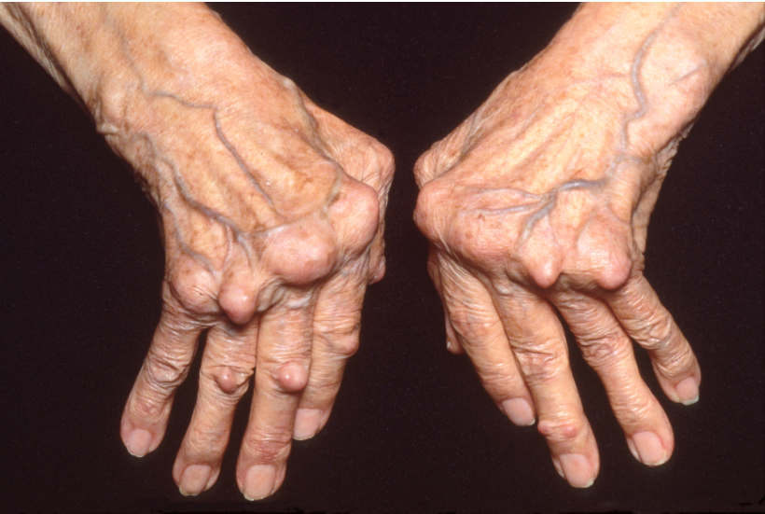
ACR image bank

Slide 14
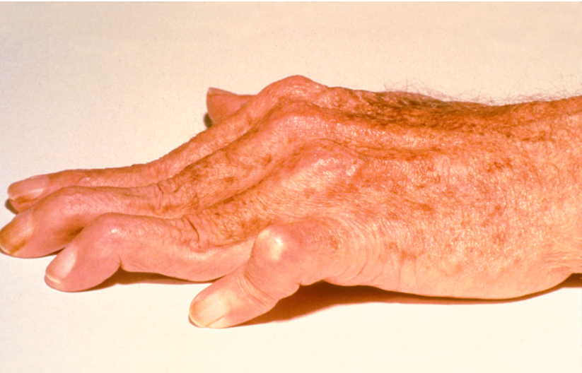
ACR image bank

Slide 15
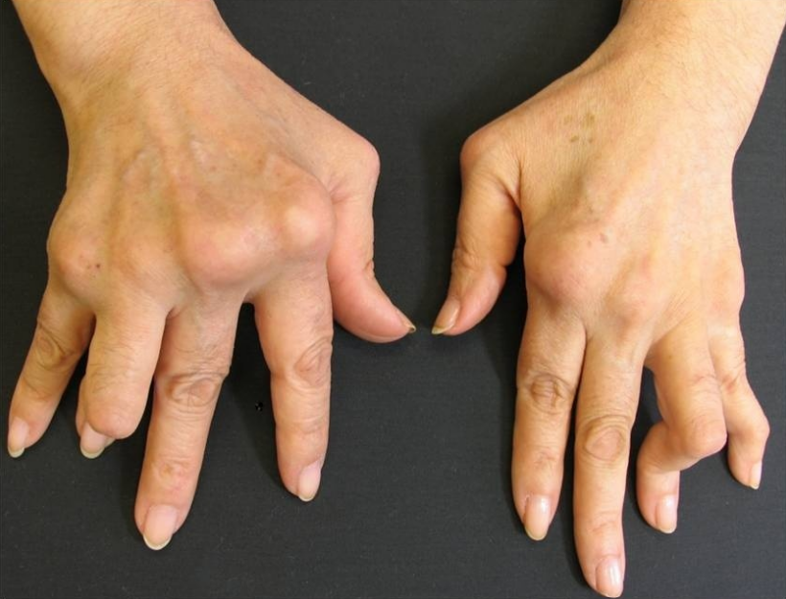
ACR image bank

Slide 16
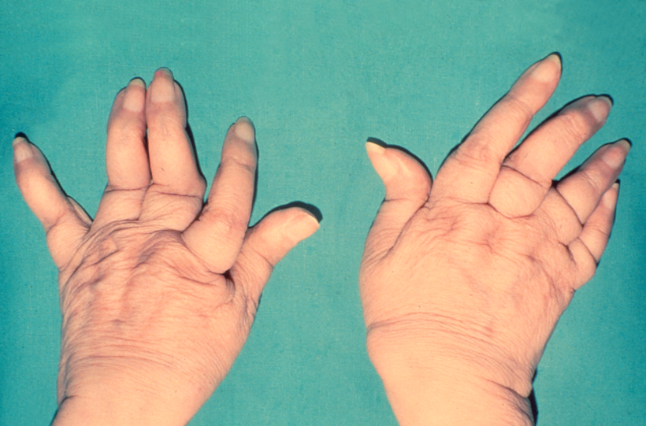
Telescoping digits
ACR image bank

Slide 17
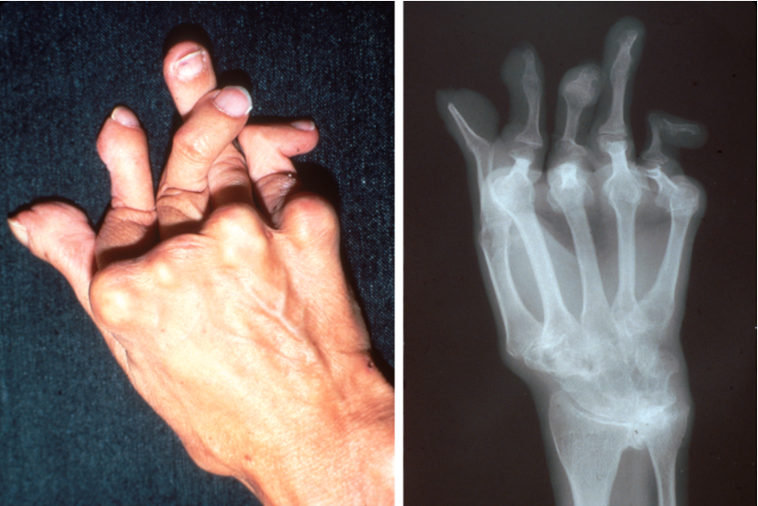
Arthritis Mutilans
ACR image bank

Slide 18
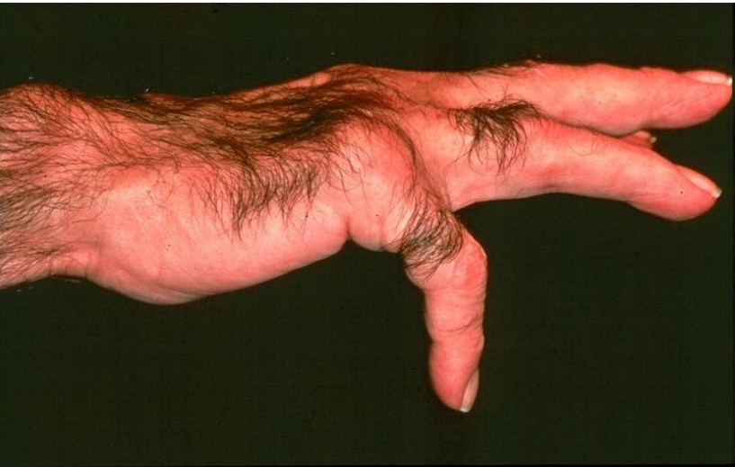
Extensor Tendon rupture
Loss of extensor function of the 5th finger due to rupture of the extensor digiti minimi tendon. Note relative preservation of extensor function of the other fingers, indicating the extensor digitorum is intact.
ACR image bank

Slide 19
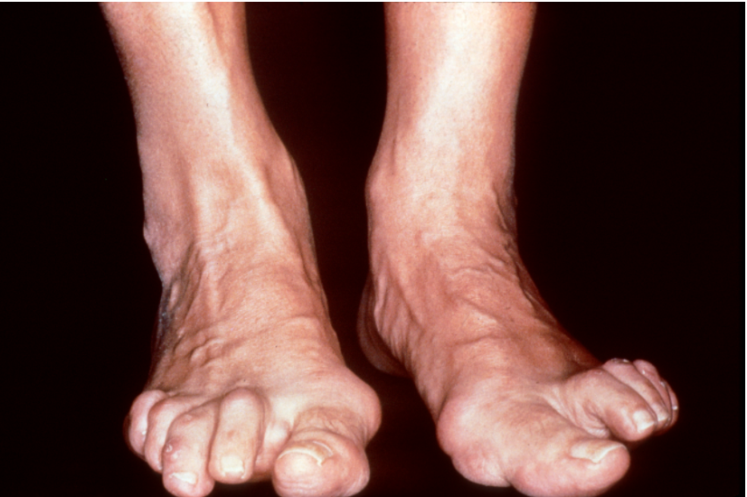
Hammer toe
The most common foot deformities in rheumatoid arthritis are hallux valgus and hammertoes. The ""cock-up"" toe deformities in this patient are associated with subluxation of the metatarsophalangeal joints. Painful corns and bunions over these deformities result primarily from irritation caused by ill-fitting shoes.
ACR image bank

Slide 20
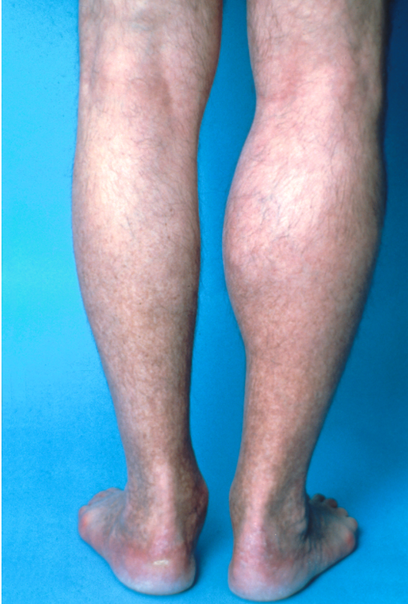
Baker’s cyst
ACR image bank

Slide 21
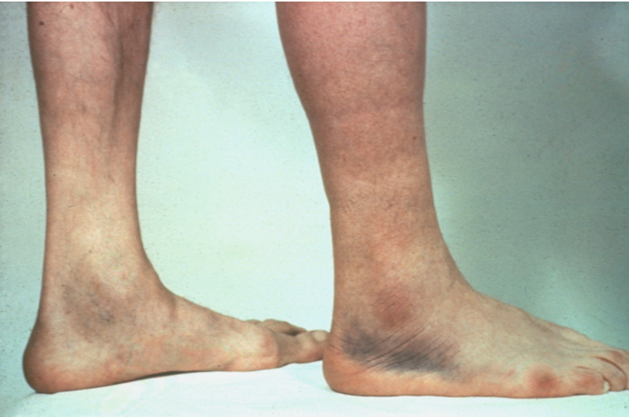
Crescent Sign from Ruptured Baker Cyst
A middle-aged man with classic rheumatoid arthritis developed a right knee effusion after dancing. Two days later the right calf became tender and swollen. Four days thereafter a distinct crescentic discoloration appeared below both malleoli. This crescent sign is secondary to hemorrhage caused by an acute synovial rupture of the knee, the ecchymosis eventually dissecting downward through the tissues and settling below the malleoli. Kraag G, Thevathasan EM, Gordon DA, Walker IH. The hemorrhagic crescent sign of acute synovial rupture. Ann Intern Med 1976;85:477-478.
ACR image bank

Slide 22
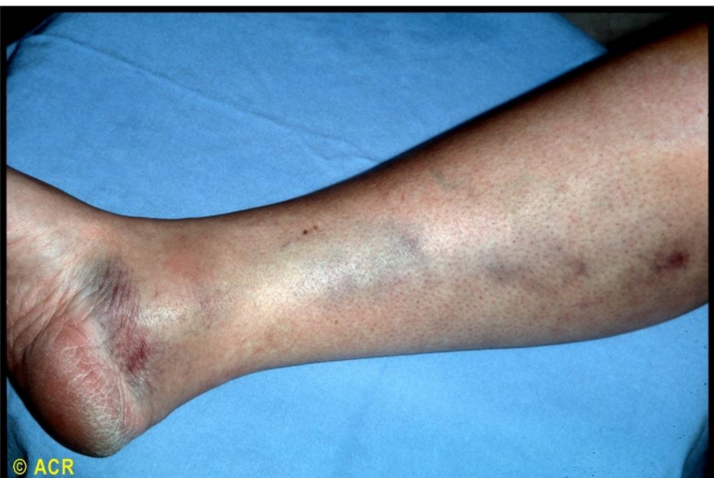
ACR image bank

Slide 23
Working up RA
RF
  If positive get hepatitis antibodies
CCP
ESR/CRP (possible)
Examine to look for synovitis
Plain film of affected joint
  Consider if has symptoms been present several years
    Looking for erosions
    Looking for periarticular osteopenia
    Hands and feet (small joints) most high yield
Ultrasound/MRI to look for subclinical synovitis
.

Slide 24
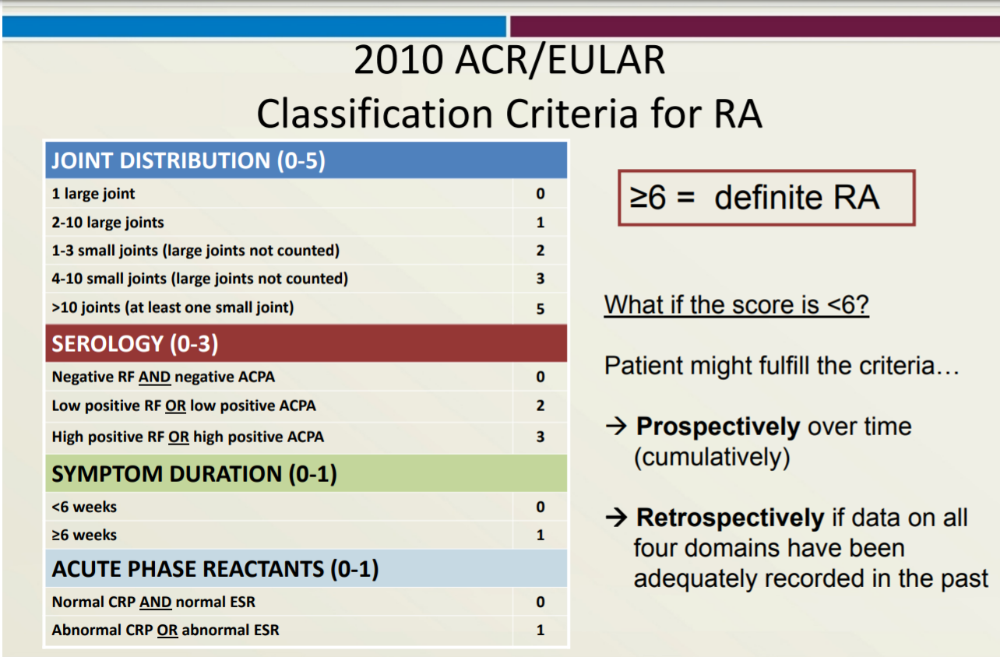
https://www.rheumatology.org/Portals/0/Files/ra_class_slides.pdf
2010 ACR/EULAR Classification Criteria fo RA. ARTHRITIS & RHEUMATISM Vol. 62, No. 9, September 2010, pp 2569–2581

Slide 25
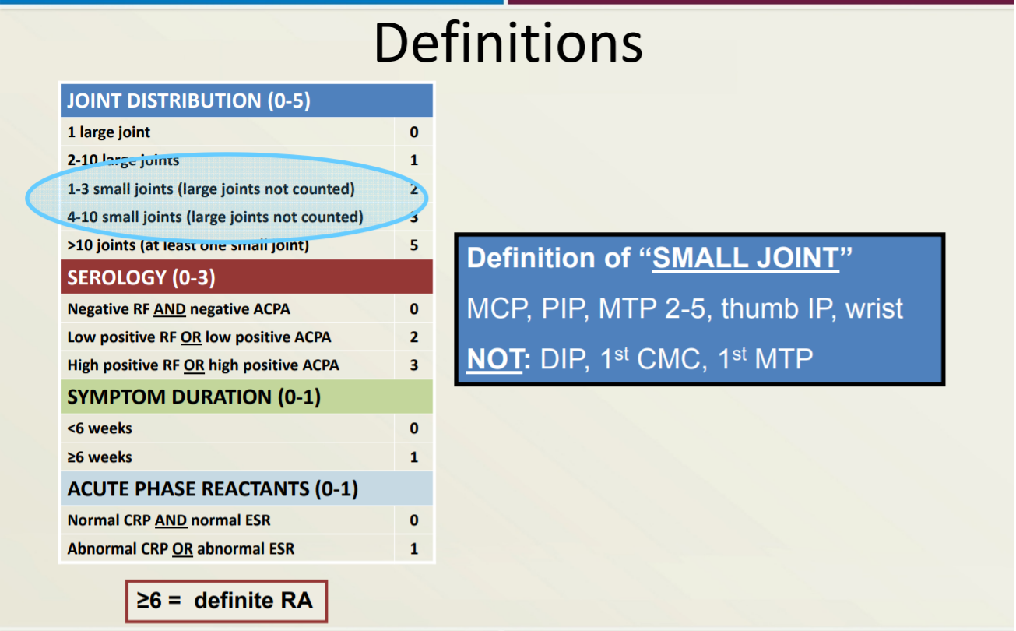
2010 ACR/EULAR Classification Criteria fo RA. ARTHRITIS & RHEUMATISM Vol. 62, No. 9, September 2010, pp 2569–2581

Slide 26
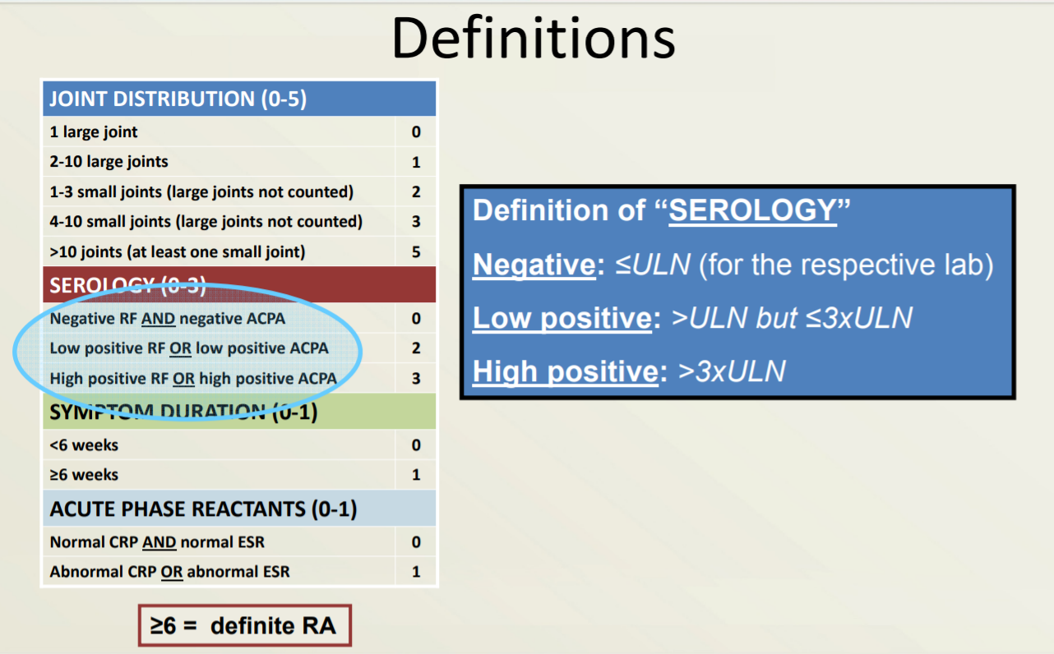
2010 ACR/EULAR Classification Criteria fo RA. ARTHRITIS & RHEUMATISM Vol. 62, No. 9, September 2010, pp 2569–2581

Slide 27
RF
PPV of 28%
5% positive in general population
Some patients may be negative early then become positive later
Positivity may lead to increase risk in extra-articular symptoms
Also seen in Viral hepatitis, Sjogren’s, endocarditis, malignancy
Raza K, et al. J Rheumatol. 2005;32(2):231-238.

Slide 28
CCP
Sensitivity 66.4%
specificity 98.3%
active TB: 7%–39%
Can be present even more than a decade prior to RA clinical symptoms
Associated with more aggressive joint disease
Associated with increased risk in extra-articular symptoms
Raza K, et al. J Rheumatol. 2005;32(2):231-238.

Slide 29
Extra-articular RA

Slide 30
Cardiac RA
Accelerated atherosclerosis
  Leading cause of death in RA patients
Pericarditis
  30-50% RA patients will have this
  Rarely leads to tamponade

Slide 31
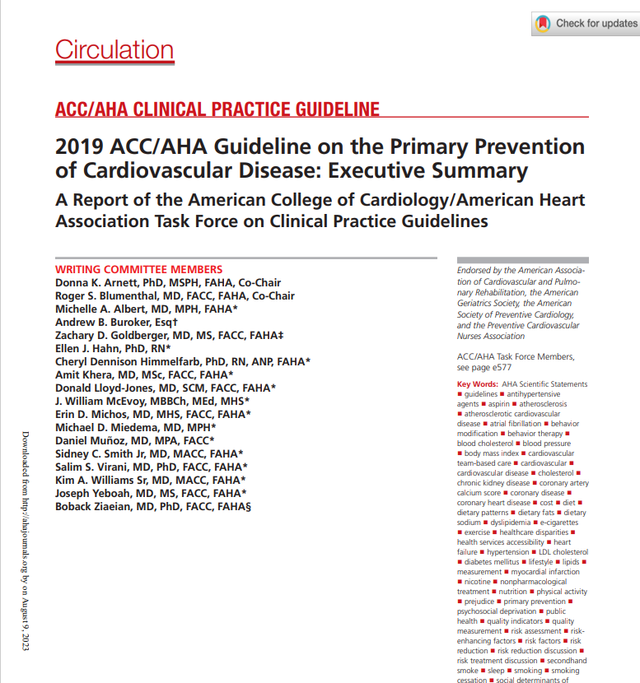

Slide 32
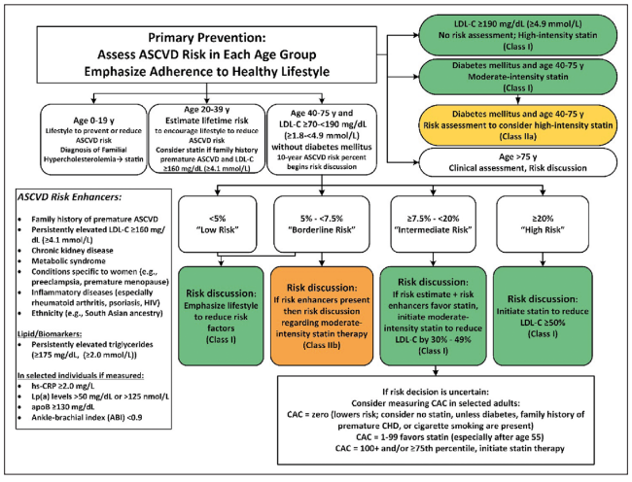
Circulation. 2019;140:e563–e595. DO

Slide 33
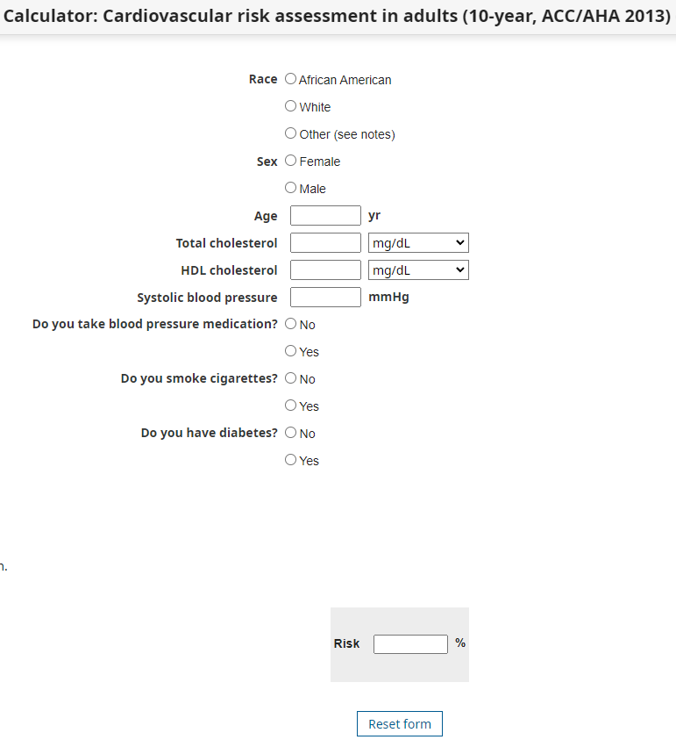
Calculator: Cardiovascular risk assessment in adults (10-year, ACC/AHA 2013) (Patient education) - UpToDate

Slide 34
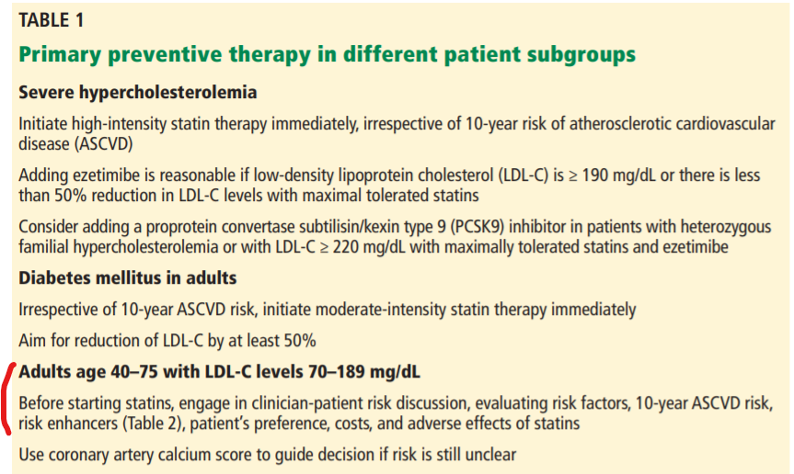
2019 ACC/AHA guidelines
https://www.ccjm.org/content/ccjom/87/4/231.full.pdf
Circulation. 2019;140:e563–e595. DO

Slide 35
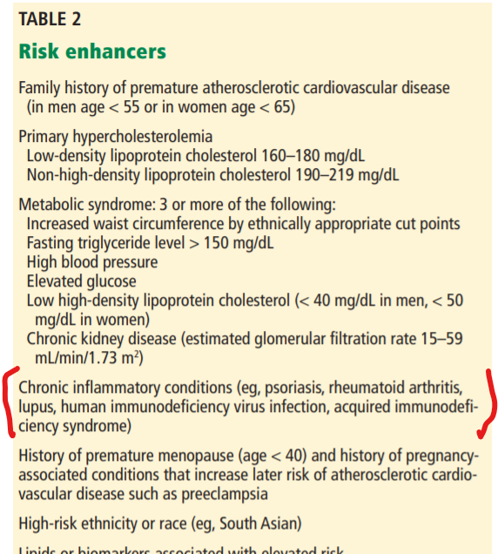

Slide 36
Hematologic RA
Amyloidosis
  Most likely in longstanding, seropositive, poorly controlled
  Most common symptoms
    Proteinuria
    Diarrhea
    Cardiomyopathy

Slide 37
Hematologic RA
Felty’s syndrome
  Splenomegaly
  Neutropenia
  Thrombocytopenia

Slide 38
Pulmonary RA
  ILD
  Pleural effusion
    Exudative with low glucose (*it’s not sweet to have RA)
  Pulmonary nodules
    Can be asymptomatic
  PAH
  Caplan syndrome
    Coal miner’s

Slide 39
Pulmonary RA
Cricoarytenoid arthritis
Bronchiectasis
Pneumothorax
Bronchopulmonary fistula
Drug toxicity
infection

Slide 40
Derm RA
Rheumatoid nodules
  Firm or rubbery, located on pressure areas (eg, olecranon)
Vasculitis
  Poor prognosis, increased mortality, rare but occurs with severe RA (ie, erosive, deforming, and seropositive disease)

Slide 41
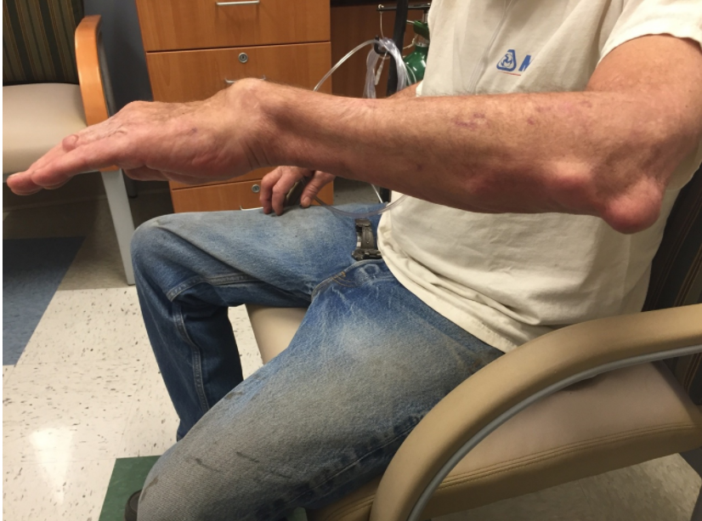
RHEUMATOID NODULES
ACR IMAGE BANK

Slide 42
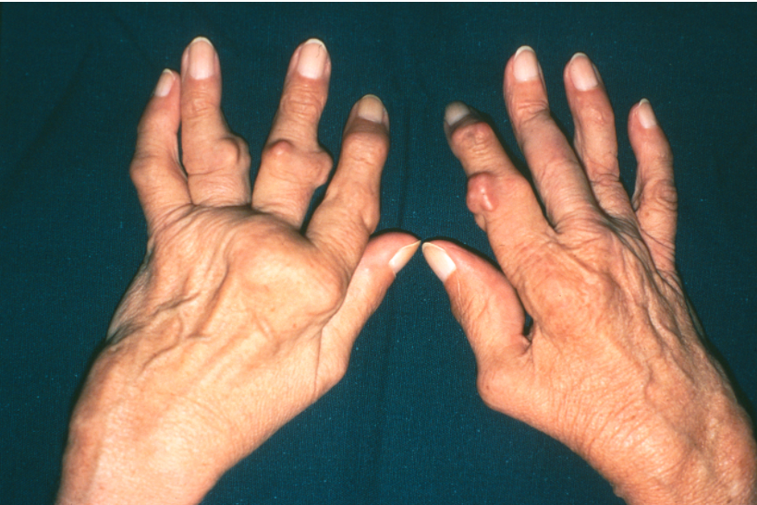
RA Nodules

Slide 43
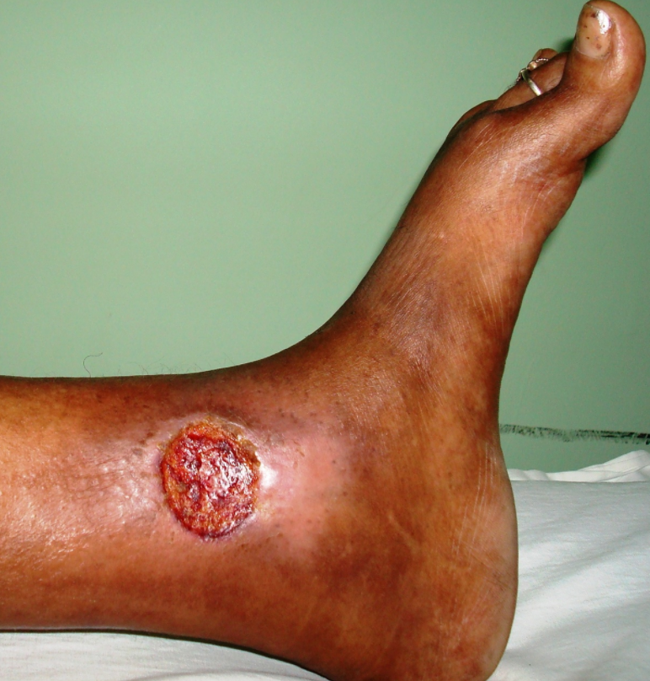
RA Vasculitis
Note the large, deep, necrotic ulcer with edematous border. The differential diagnosis for this lesion includes pyoderma gangrenosum and rheumatoid vasculitis.

Slide 44
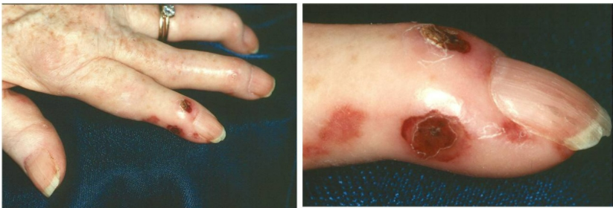
RA Vasculitis
Image of the finger from a woman with rheumatoid arthritis complicated by systemic vasculitis demonstrates numerous ischemic lesions. Note also the swan-neck deformity from erosive RA

Slide 45
Nervous system RA
CNS
  Cervical Myelopathy
    C1-C2 subluxation/impaction
PNS
  Neuropathies
  Carpal Tunnel
  Mononeuritis multiplex
    Foot drop

Slide 46
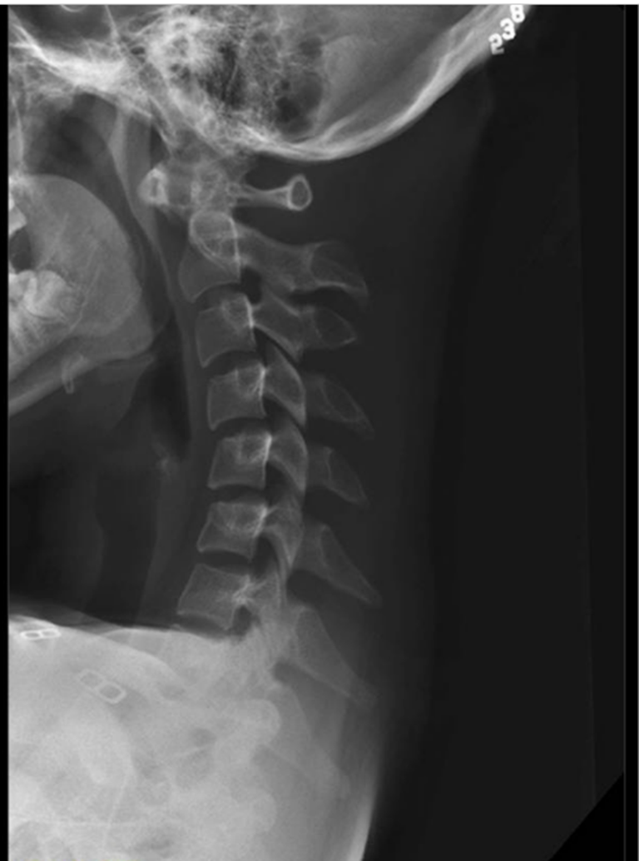

Slide 47


Slide 48
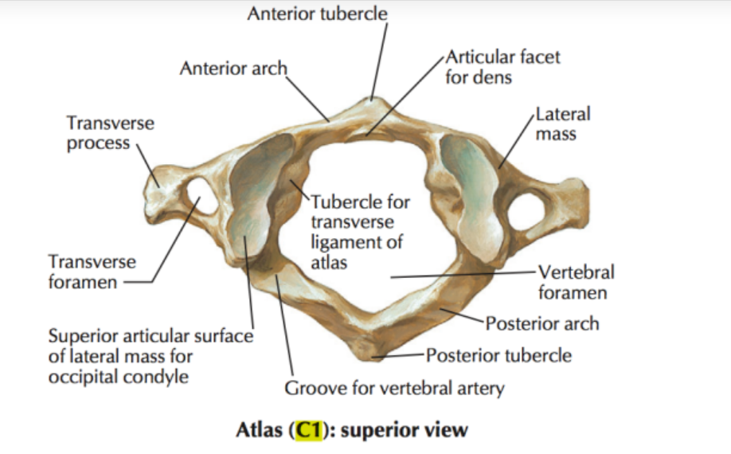
https://theartofmed.wordpress.com/2015/06/05/c1-vertebra-atlas-and-accompanying-structures/

Slide 49
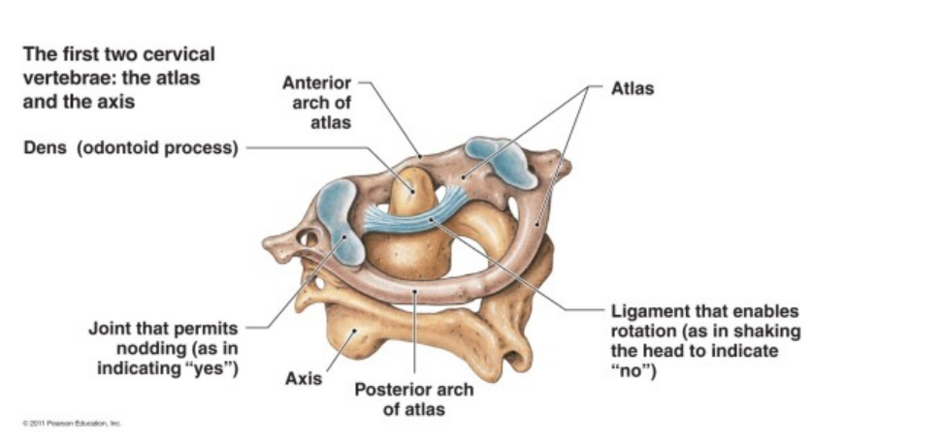

Slide 50
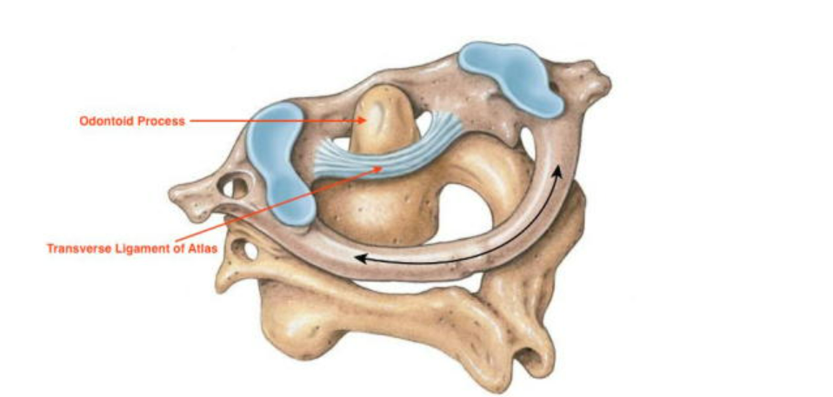

Slide 51
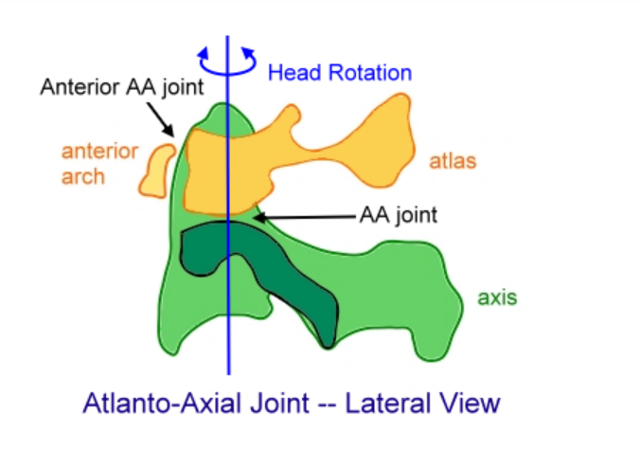

Slide 52

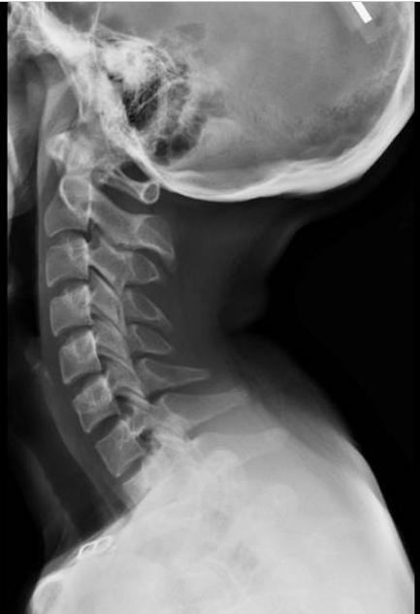
Atlantoaxial subluxation
The lateral radiograph in flexion shows separation between the anterior inferior aspect of C1 and the odontoid process (lines) of greater than 2.5 mm.

Slide 53
Anterior subluxation of C1-C2 results in a widening of arch of C1 and odontoid of C2 of >than 3 mm in men and 2.5 mm in women.*
  >3 mm in men
  > 2.5 mm in women
Risk of spinal cord compression
  anterior atlanto-odontoid interval is ≥9 mm
  posterior antlando-odontoid interval is ≤14 mm
Risk of severe neurologic findings for C1 C2 vertical impaction
  ≥5mm above Ranawat’s line
*Hinck VC, Hopkins CE. Measurement of the atlanto-dental interval in the adult. Am J Roentgenol Radium Ther Nucl Med 1960;84:945–51

Slide 54
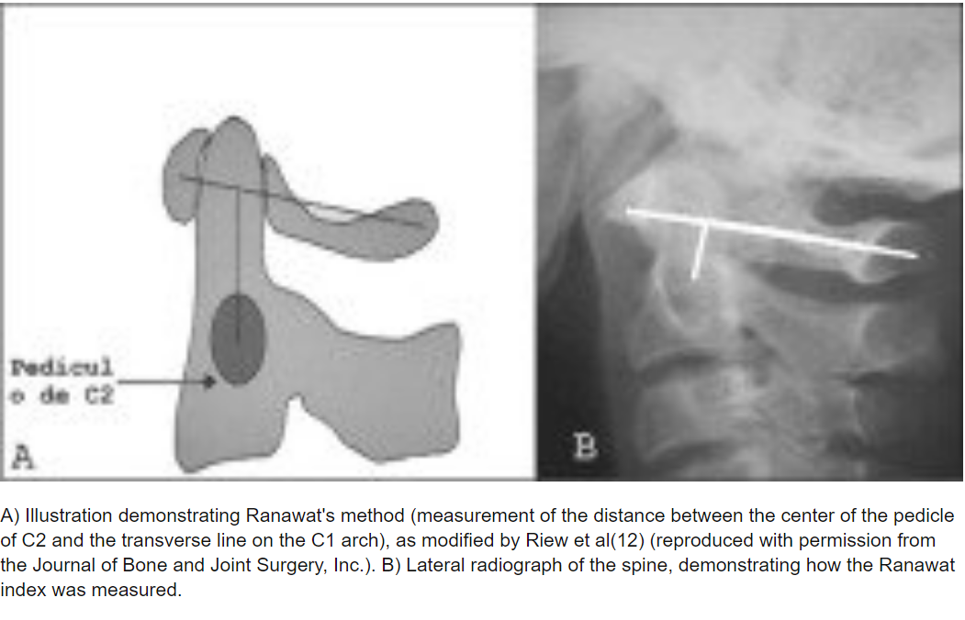
Ranawat’s line
https://www.researchgate.net/figure/A-Illustration-demonstrating-Ranawats-method-measurement-of-the-distance-between-the_fig1_290613782

Slide 55
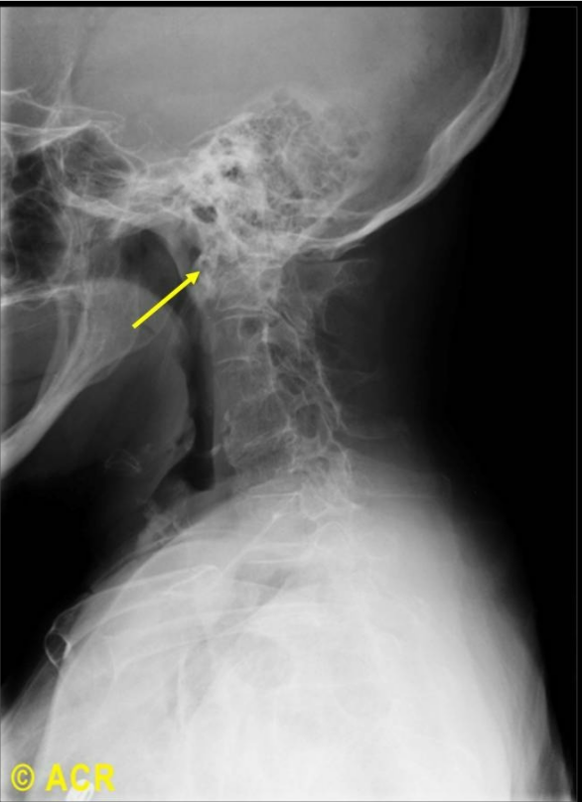
Vertical atlantoaxial subluxation

Slide 56
Ophthalmologic RA
Episcleritis/Scleritis
<1% of RA patients
Scleromalacia/Peripheral ulcerative keratitis
  More severe scleritis, may perforate anterior chamber
Corneal perforation
Ketoconjuctivitis sicca
  Secondary sjogren’s
  May have dry mouth

Slide 57
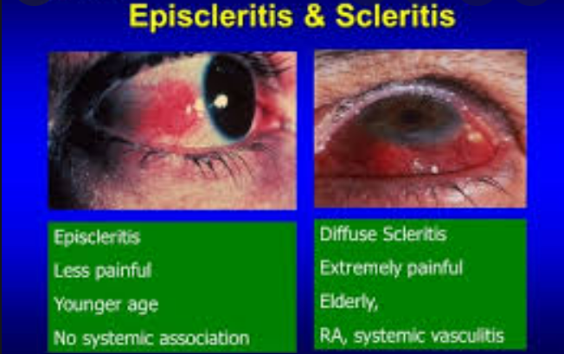
https://quizlet.com/gb/379365980/the-red-eye-flash-cards/

Slide 58
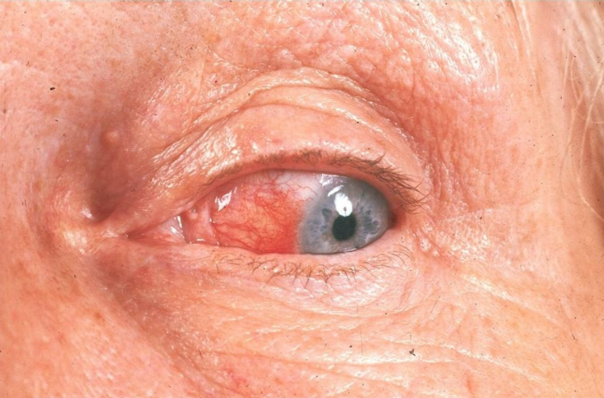
Episcleritis
Image of the eye shows episcleritis due to active rheumatoid arthritis. Note the hypervascularity most intense near the limbus and the absence of conjunctival exudate.

Slide 59
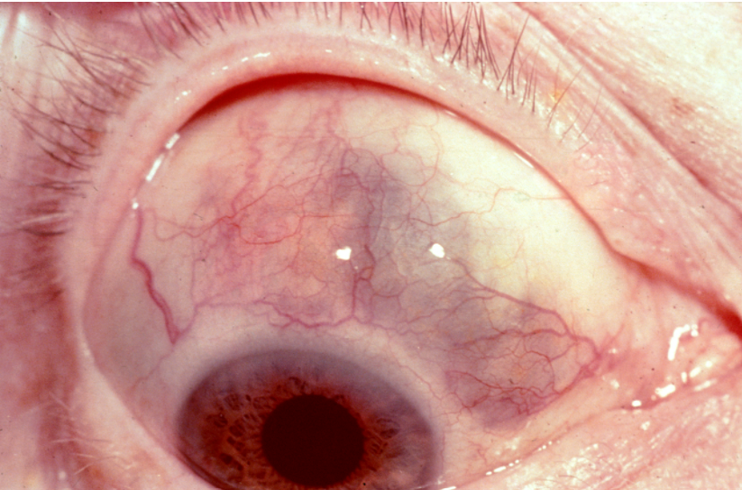
Scleromalacia
Rheumatoid nodules involving the sclera of the eye may result in scleromalacia. The bluish choroid is visible because of thinning of the sclera. The surrounding bulbar conjunctiva appears slightly atrophic, and superficial vessels are dilated. Focal chronic inflammatory cell infiltration and necrosis may appear in the sclera. When these changes become more extensive, the lesion resembles the subcutaneous nodule of rheumatoid arthritis.

Slide 60
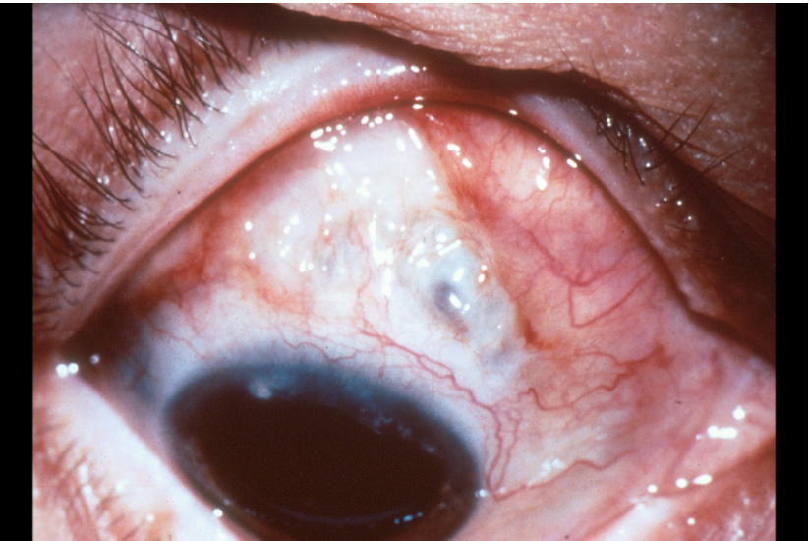
Scleromalacia perforans
This eye demonstrates several rheumatoid scleral nodules, scleral thinning, and adjacent conjunctival injection. The uveal tissue is about to herniate through the softened sclera in the midsuperior portion of the eye, which could result in a perforation of the globe.

Slide 61
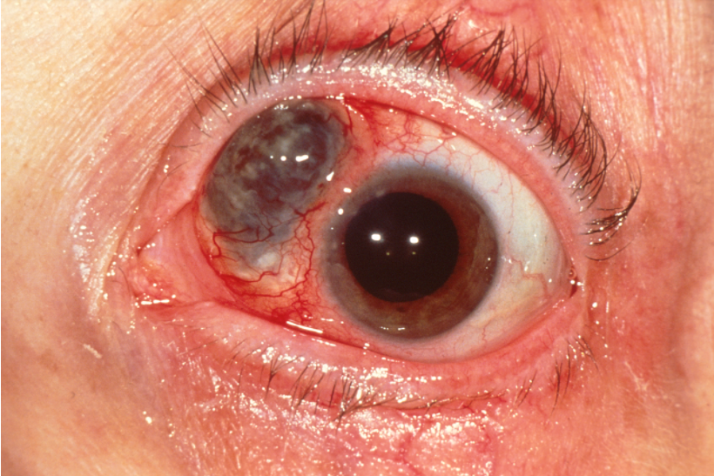
Scleromalacia perforans herniation
This eye demonstrates marked scleral thinning and adjacent scleral and conjunctival injection. The darker pigmented uveal tissue has herniated through the softened sclera, and perforation is imminent. Note the nonconcentric pupil.

Slide 62
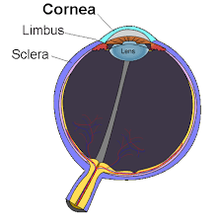
https://en.wikipedia.org/wiki/Cornea

Slide 63
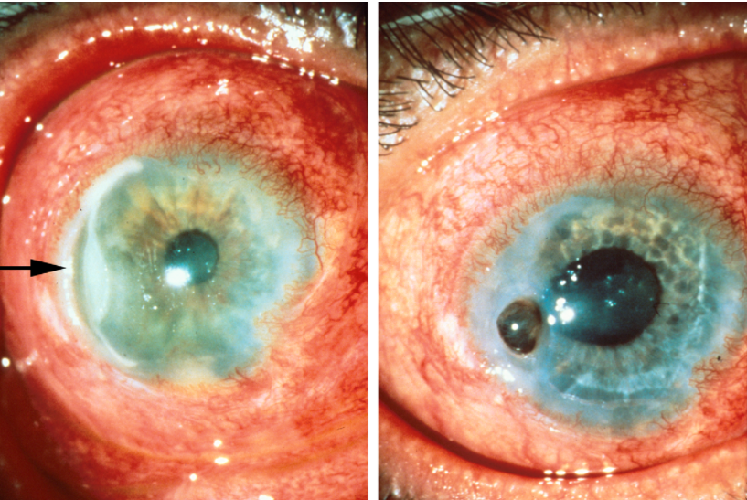
Marginal corneal disease
Left, A marginal corneal furrow (arrow) has developed in a patient with longstanding rheumatoid arthritis. There are also marked hyperemia and swelling of the conjunctiva, which are secondary reactions. Right, A full-thickness corneal perforation with an iris prolapse has occurred 3 days later. The patient was treated with a corneal patch graft and vision was restored.

Slide 64

Psoriatic Arthritis

Slide 65
Psoriatic arthritis model
Men=women
Asymmetric
DIP
May involve axial back
Most have psoriasis (70% have psoriasis at presentation)
Nail pitting
Enthesitis
Dactylitis

Slide 66
Psoriatic arthritis classification
1) Distal (ray pattern) 5%
2) arthritis mutilans 5%
3) oligoarthritis 70%
4) polyarthritis (similar to RA pattern) 15%
5) spondylarthritic alone 5%

Slide 67
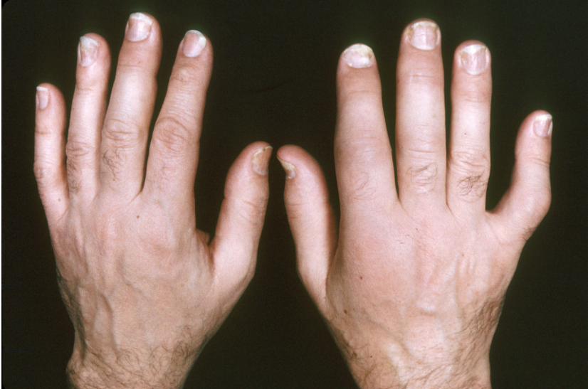
Synovitis
Soft-tissue swelling is present in the second metacarpophalangeal joints of both hands and in the second, third, and fifth proximal interphalangeal joints of the right hand in this patient with psoriatic arthritis. These changes closely resemble those found in rheumatoid arthritis. Nail deformities caused by psoriasis are present in both hands.

Slide 68
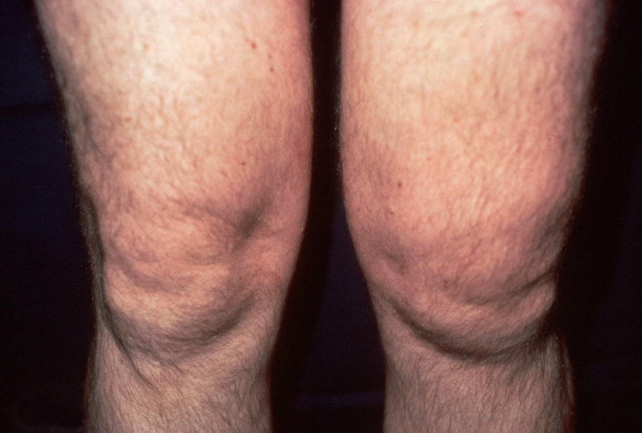
Asymmetric knee swelling

Slide 69
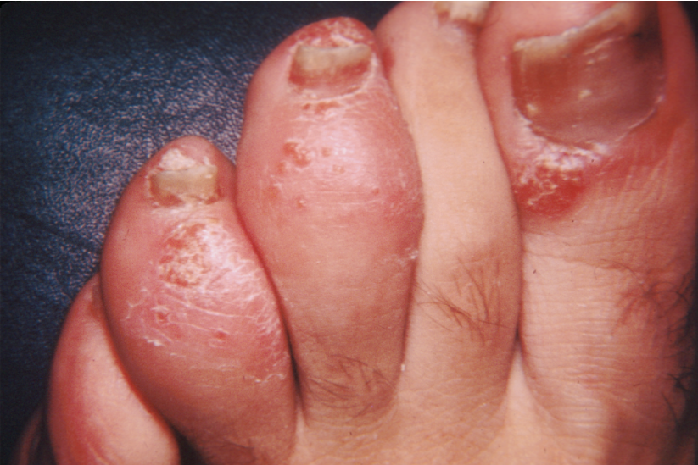
Sausage digit
Psoriasis involving the first, third, and fourth toes is accompanied by psoriatic arthritis of interphalangeal joints of the third and fourth toes. The ""sausage shape"" of these toes is caused by soft-tissue swelling more marked than that usually seen in rheumatoid arthritis.

Slide 70
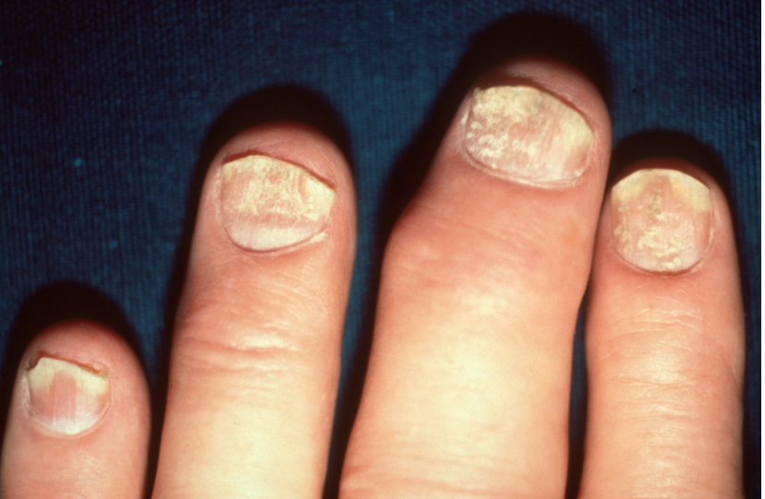
Pitting and Onycholysis
Punctate pitting of the nail is a common finding in patients with psoriatic arthritis. The pitting is most clearly seen on the index finger. The distal portions of all the nails have lifted up (onycholysis). There are also swelling and deformity of the third distal interphalangeal joint.

Slide 71
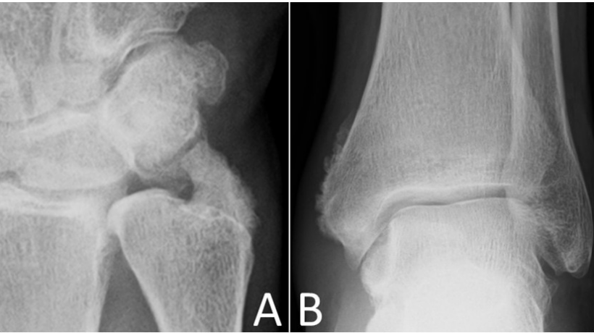
Periosteal reaction
Radiography of hands and feet of a 48-year-old male with well-controlled skin psoriasis and psoriatic arthropathy was performed for evaluation of recent pain in his wrists and ankles. Exuberant and fluffy periosteal reaction of the ulnar styloid and the distal tibia stands out, while bony proliferation of both triquetrum and pisiform can be observed as well. Periostitis of the metaphyses and diaphyses of bones in the course of psoriatic arthropathy is most often seen in the hands and the feet, being a treasured diagnostic sign.

Slide 72
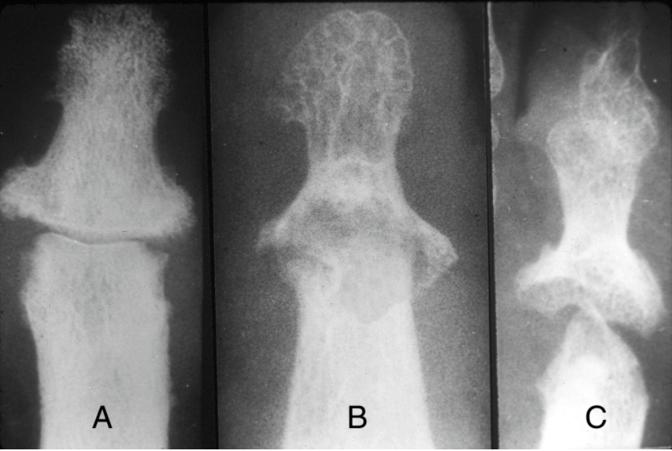
Progressive psoriatic changes
Progressive changes can be seen in these interphalangeal joints beginning with (A) mild soft-tissue swelling, narrowing of the joint space, and erosions of adjacent condyles of the middle phalanx. These changes are followed by (B) greater loss of bone substance and early resorption. Eventually (C), more advanced changes appear, including further loss of bone with tapering and a "pencil-in-cup" appearance.

Slide 73
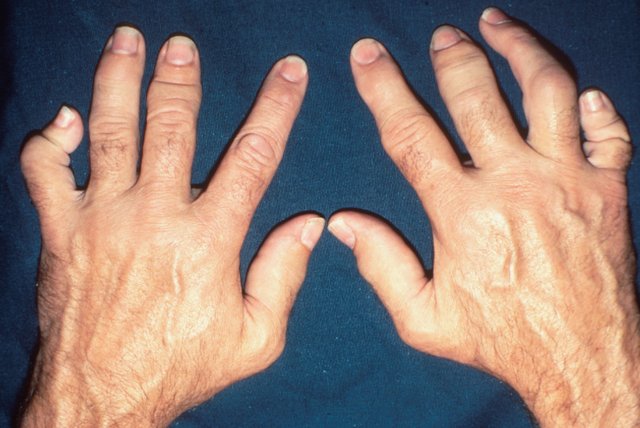
Telescoping and dactylitis
Soft-tissue swelling can be seen in the metacarpophalangeal joints bilaterally. Marked deformity in both fifth digits has produced telescoping of the joints. There is also ""sausage-like"" swelling of the right third digit. No psoriatic skin changes have occurred on the hands, but onycholysis of several nails is present, most easily seen in the left second digit.

Slide 74
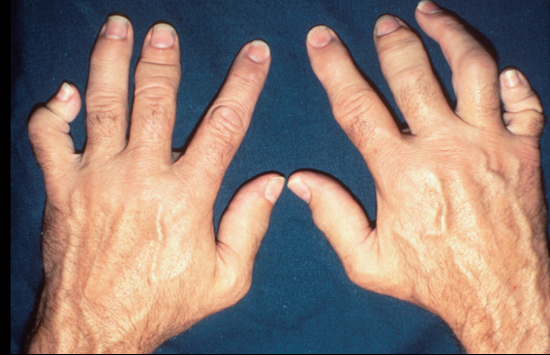
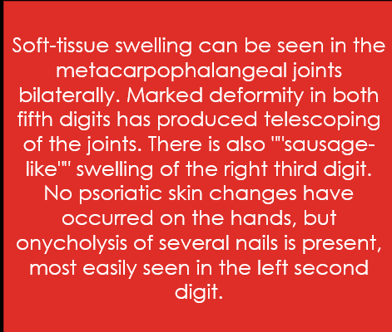
Telescoping and dactylitis

Slide 75

Arthritis mutilans
The radiograph on the left shows deformities of the digits from resorption of bone and dissolution the joints. The clinical image on the right shows redundant overlying skin from foreshortening of the fingers that leads to a telescoping motion of the digit.

Slide 76


Finger ankylosis
Note the psoriatic plaques and fixed flexion deformities of the fingers. The radiograph demonstrates ankylosis of all interphalangeal joints, except for the thumb.

Slide 77
Working up psoriatic arthritis
Consider getting RF and CCP (should be negative)
Examine joints to look for synovitis/dactylitis
Consider xray of most affected joints depending on disease duration
Ultrasound/MRI to look for synovitis

Slide 78
Dermatology- PsA
Psoriasis
  Psoriasis vulgaris is the most common type
  Evaluate knees, elbows, scalp, gluteal cleft
Nail changes
  Pitting
  Ridges
  onycholysis
  Often adjacent joint has psoriatic arthritis

Slide 79

Nail pitting
Pitting of the nail is a characteristic finding in many patients with psoriasis and is often associated with arthritis of the distal interphalangeal joints.

Slide 80
Cardiovascular PsA
Increased risk of CV disease
  DMARD treatment may result in improvement in CV outcomes
Ann Rheum Dis. 2015 Feb;74(2):326-32. Epub 2014 Oct 28.

Slide 81
Ocular PSA
Conjunctivitis
Uveitis
  Acutely painful eye

Slide 82

AS

Slide 83
AS model
Male: Female 2:1
Onset < 40 year old
Axial involvement

Slide 84

Ankylosis
This 51 yr old gentleman has complete fusion of the entire spine. There is fusion of anterior and posterior elements in their entirety.

Slide 85


Slide 86


Slide 87


Slide 88

Sacroiliitis, Retrocalcaneal Bursitis, and Enthesitis, Spine and Ankle
This 24 year-old HLA-B27 positive man developed back pain and swelling at the Achilles tendon insertion. Ultrasound images of the sacroiliac (SI) joints show increased power doppler signal consistent with active synovitis in the left SI joint (B, arrowhead). This finding contrasts with the normal SI vascular signal from the sacral perforans artery (A, right SI joint; B, left SI joint, arrow). Long axis gray scale images of the affected Achilles tendon show a distended retrocalcaneal bursa (C, arrow). Power doppler signal is detected in the retrocalcaneal bursa as well as in the Achilles paratenon and tendon, reflecting active enthesitis (D). (10-18 MHz wide linear transducer)

Slide 89
Working up AS
Good history and exam
Plain film imaging of affected axial/sacroiliac regions
ESR/CRP
HLA-B27
MRI with contrast to look for sacroiliitis

Slide 90
Pulmonary AS
Apical fibrosis
Restrictive lung disease
  Related to decrease thoracic expansion
Subpleural nodules
Spontaneous pneumothorax

Slide 91

Apical pulmonary fibrosis
Linear and patchy infiltrates with cavity formation are present in the left upper lobe of this patient with ankylosing spondylitis. Similar but less marked infiltrates without cavitation are located in the right apex.

Slide 92
Ocular AS
Unilateral uveitis
  acute unilateral pain, photophobia, and blurring of vision
  Estimates in 25-40%

Slide 93

Iridocyclitis with Synechiae
Ciliary injection and irregularity of the pupil are present. Adhesions between the iris and lens (synechiae) appear at the 1-o'clock and 4-o'clock positions. Synechiae are caused by repeated episodes of iritis and may eventually lead to glaucoma and blindness. The pupil is dilated from medication. The medial aspect of the sclera has been blanched by topical medication.

Slide 94
Bone density- AS
Osteopenia/osteoporosis
  DEXA can be hard to interpret due to syndesmophytes

Slide 95
CV- AS
Increased CV risk
Aortitis
AR

Slide 96
Neurologic AS
Can be due to ankyloses or fracture
Spinal cord compression
Cauda equine syndrome
Atlanto-axial subluxation

Slide 97

Reactive arthritis

Slide 98
Reactive arthritis model
Preceding infection (often GI)
  Chlamydia trachomatis, Yersinia, Salmonella, Shigella, and Campylobacter, Escherichia coli, Clostridioides difficile, and Chlamydia pneumoniae
An interval ranging from several days to weeks between the antecedent infection and arthritis
A typically mono- or oligoarticular pattern of the arthritis (knee)
Enthesitis
Dactylitis

Slide 99
Can’t see
Can’t pee
Can’t climb a tree
And gunk on the feet

Slide 100

Enthesitis

Slide 101
Sausage digit
Psoriasis involving the first, third, and fourth toes is accompanied by psoriatic arthritis of interphalangeal joints of the third and fourth toes. The ""sausage shape"" of these toes is caused by soft-tissue swelling more marked than that usually seen in rheumatoid arthritis.

Slide 102
Working up ReA
Get a good history
Exam
May have inflammatory joint fluid on aspiration
  Need to rule out crystalline arthritis
Consider HLA-B27

Slide 103

Oral ulcer
A sharply demarcated erosion of the hard palate is probably the most common oral manifestation of reactive arthritis.

Slide 104

Oral ulcer
Superficial erosions of the tongue in reactive arthritis are usually asymptomatic. Similar erosions are observed more frequently on the buccal mucosa, palate, and pharynx.

Slide 105

Conjunctivitis
The erythema and exudate on the bulbar and palpebral conjunctivae are characteristic of the acute transient conjunctivitis of reactive arthritis. The reaction is often mild and easily overlooked, but photophobia, excessive lacrimation, burning, and intense hyperemia may occur. Iritis and episcleritis usually do not involve the palpebral conjunctivae.

Slide 106

Balanitis
Left, This photograph demonstrates meatitis and early balanitis. The lesion is erythematous, moistened by the urethral discharge, and, like the later stages, painless. Center, A discrete, moist, well-circumscribed lesion is seen on the glans. Such lesions often begin as small vesicles or pustules. Right, More advanced lesions are dry, scaly, and painless. In circumcised patients, the lesions on the glans may become crusted and hyperkeratotic, similar to those seen on the skin, or they may remain moist and weeping.

Slide 107

Pustules
Grouped pustules and vesicles are shown on the sole of the foot. They may eventually develop into the more advanced changes of keratoderma blennorrhagica.

Slide 108

Keratoderma Blennorrhagica
Discrete, circinate, scaly, and plaque-like lesions on the foot in reactive arthritis resemble secondary syphilis and psoriasis. Note the two small lesions are in an early phase of keratoderma.

Slide 109

Pustules and Keratoderma Blennorrhagica
Numerous pustules are present on the feet of a patient with reactive arthritis. They begin as vesicles on erythematous bases and become sterile pustules. On the patient's right sole, the development of keratotic scales (keratoderma blennorrhagica) is most evident.

Slide 110

Nail dystrophy
The separation of the distal portion of the nails (onycholysis), accumulation of subungual keratotic material, and periungual scaly lesions occur in both reactive arthritis and psoriasis. Arthritis is also evident.

Slide 111
Take home points
Exam and history are critical in detecting inflammatory arthropathies
Extra-articular manifestations are broad and can include ocular, cutaneous, pulmonary
Remember-chronic inflammatory arthropathies are considers risk enhancers according to the 2019 ACC/AHA guidelines when looking at primary prevention for ASCVD

Slide 112


Slide 113
Questions?

Slide 114

Thank You

