Slide 1
Perspectives from a Pulmonologist: COVID Controversies
11 Mar 2023

Slide 2
Agenda
Introduction
Therapeutics
Anticoagulation
Cardiac disease
Post-COVID syndrome
Vaccinations
Resources for Patients and Providers

Slide 3
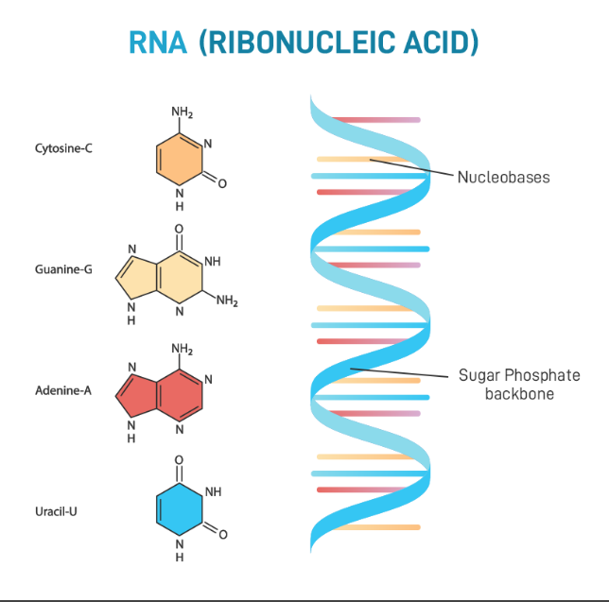
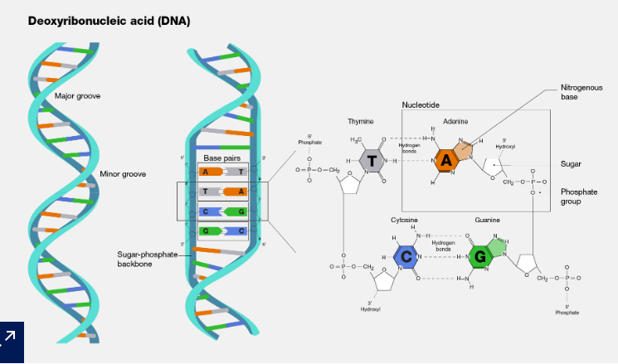
DNA and RNA
Photo credit: Deoxyribonucleic Acid (DNA) (genome.gov)
Photo credit: RNA - Definition, Structure, Types and Functions - GeeksforGeeks

Slide 4
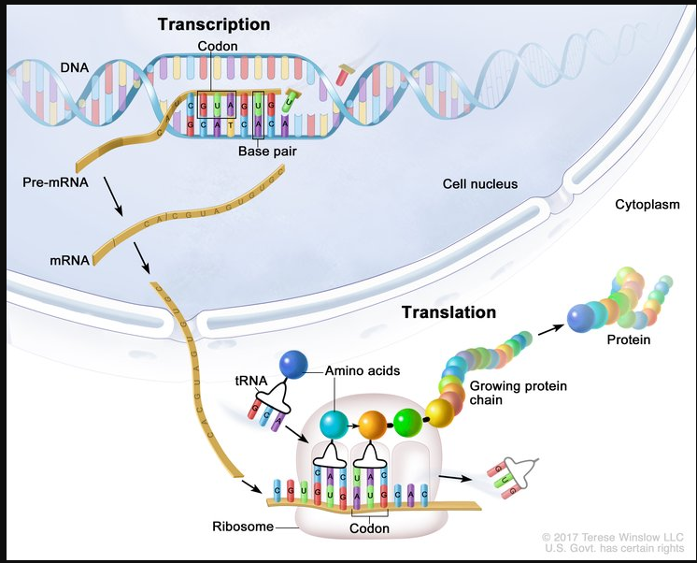
Transcription and Translation
Photo credit: Transcription And Translation: Image Details - NCI Visuals Online (cancer.gov)

Slide 5
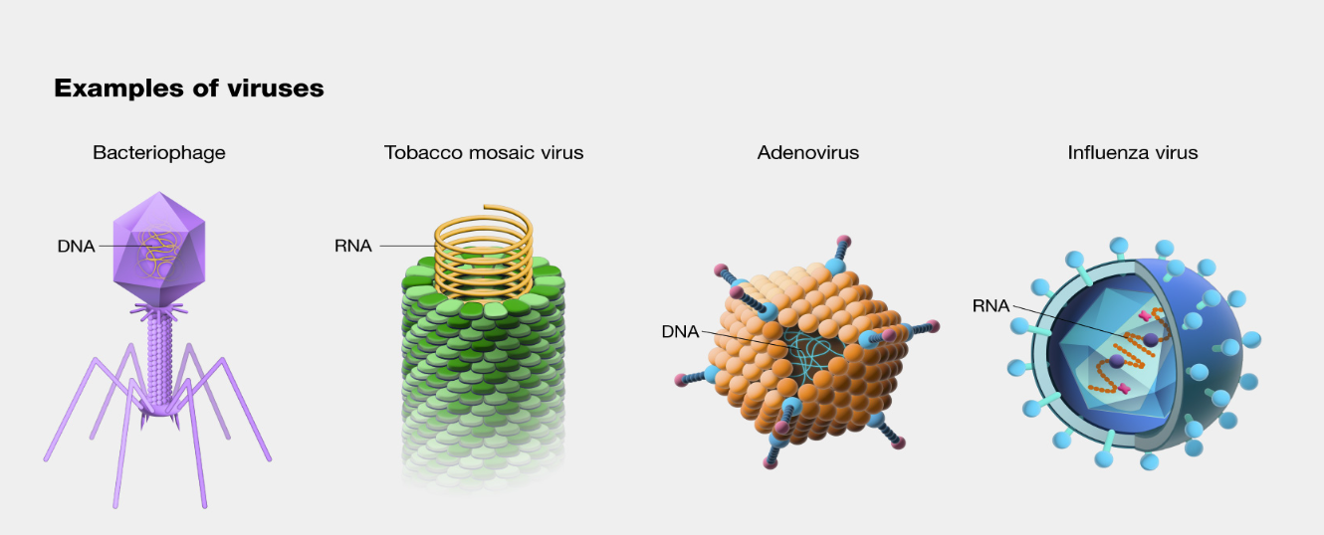
Viruses
Photo credit: Virus (genome.gov)

Slide 6
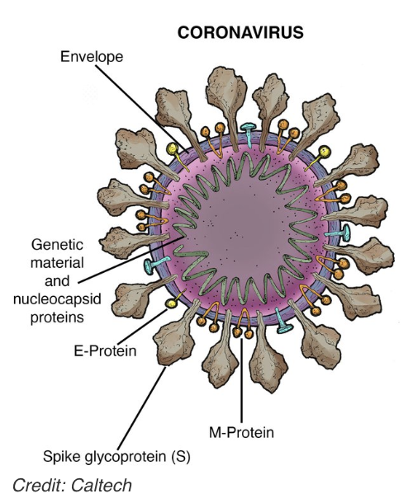

Slide 7
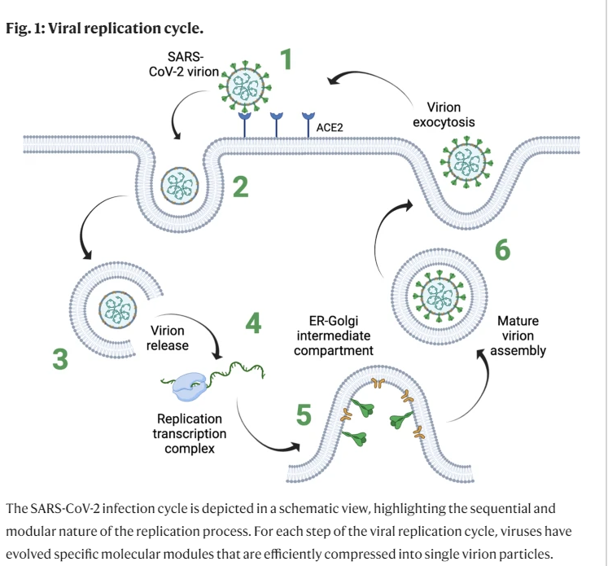
Viral replication
Photo credit: Bottom-up assembly of viral replication cycles | Nature Communications

Slide 8
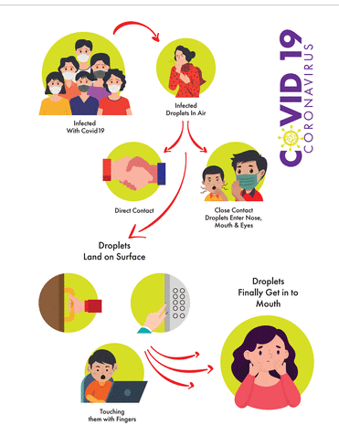
COVID transmission
Human-Human
exposure to infectious respiratory fluids
inhalation, depositions, contact with mucous membranes
droplets versus aerosolized particles
Photo credit: Origin, transmission, diagnosis and management of coronavirus disease 2019 (COVID-19) | Postgraduate Medical Journal (bmj.com)

Slide 9
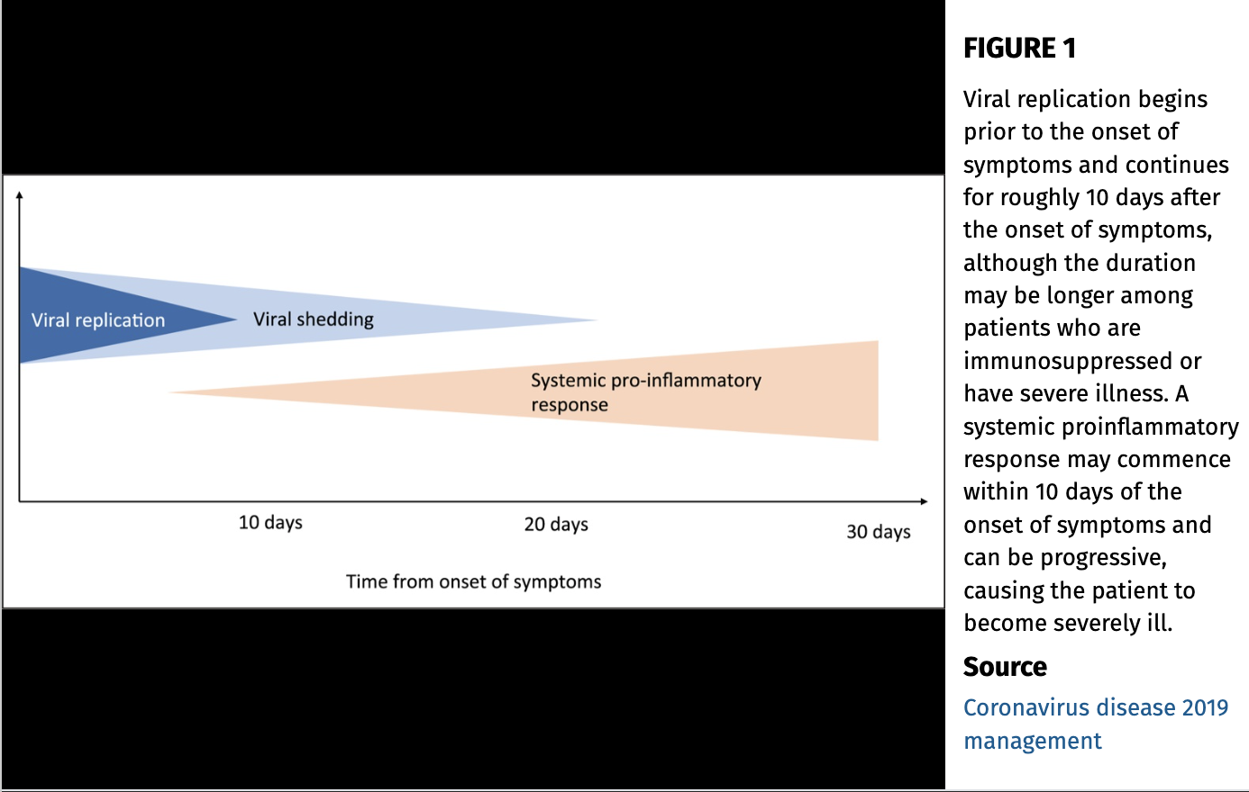

Slide 10
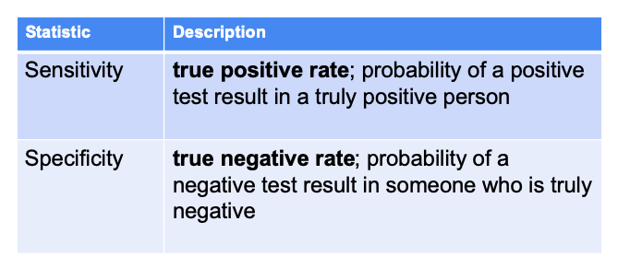
Sensitivity and Specificity
Describes the accuracy of a test

Slide 11
Sensitivity and Specificity
SPPIN: A highly specific test, when positive, rules in a disease
SNNOUT: A highly sensitive test, when negative, rules out a disease.
Ex: D dimer. 100% sensitivity, 60% specificity. We think of a negative D dimer as truly ruling out a PE/DVT.

Slide 12
Types of testing
Antigen: immunoassays that detect the presence of a viral antigen, indicating current infection
Nasopharyngeal, nasal, saliva specimens
Placed on extraction buffer or reagent
These include: POC, lab-based, self-tests
Results within 15-30 minutes
Less sensitive than RT-PCR or NAAT
For best results: a negative antigen test should be repeated at least 48H apart
Source: CDC

Slide 13
Testing: CDC
NAAT (nucleic acid amplification test): gold-standard; detect RNA sequences comprising the genetic material of the virus
Upper or lower respiratory tract
Can reliably detect small amounts and are less likely to return false negative
Amplify the nucleic acids using multiple methods including RT-PCR
Most sensitive; can be used to confirm results of other lower sensitivity tests
Can remain positive for weeks to months after initial infection even when virus cannot be cultured
Source: CDC

Slide 14
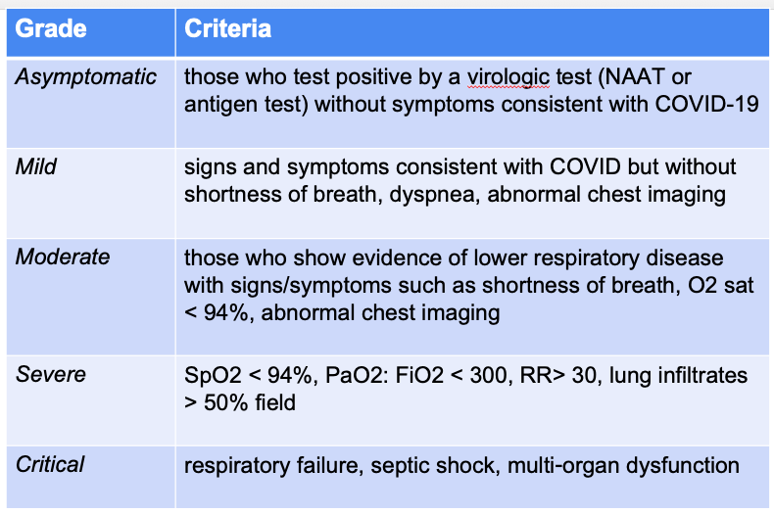
Source: NIH

Slide 15
Acute Respiratory Distress Syndrome
Berlin definition: acute, diffuse inflammatory lung injury leading to poor lung compliance and refractory hypoxemia.
Severity is graded by the P:F ratio, essentially a comparison of the PaO2 (as measured on an arterial blood gas) and the FiO2 (of fraction of inspired FiO2).
Direct interventions: usually based on supportive care
preventing further lung injury by controlling tidal volume (6cc/kg IBW), ventilator synchrony
prone ventilation
deep sedation/paralysis
inhaled pulmonary vasodilators
ECMO

Slide 16
Multisystem inflammatory syndrome
New clinical entity, characterized in children and adults. Hyperinflammation
Distinct from severe COVID-19; post-acute, post-infectious illness
Fever, multi-organ dysfunction, increased inflammatory markers
Shares some similarities with cytokine release syndrome
Can also include new-onset neurological signs and symptoms, peripheral neuropathy, Guillain-Barre syndrome, abdominal pain, shock or hypotension, thrombocytopenia
Mediated by immune response including complement activation, formation of autoantibodies, and excessive T cell stimulation with cytokine release
Generally considered rare in adults; most patients identified in JAMA review were ages 19-34YO
Source: CDC

Slide 17
COVID in special populations: Pregnant and Breastfeeding
Pregnant and postpartum persons are more likely to have severe illness including the need for ICU management, invasive mechanical ventilation, or death
Increased risk of preterm birth, stillbirth
May pass to the fetus (but seemingly rare)
Increased risk for need for NICU care
Source: ACOG

Slide 18
COVID in special populations: Immunocompromised persons
Vaccination remains the most effective way to prevent serious outcomes and deaths
Vaccine response rates may be lower in patients who are moderately to severely immunocompromised
All close contacts of immunocompromised persons are recommended to stay up to date with vaccinations and boosters
There is insufficient evidence from the NIH working group panel to recommend serologic testing for vaccine response or immunity

Slide 19
Current isolation/quarantine recommendations (CDC)
If you are not hospitalized and test positive:
No symptoms: Day 0 is the day you were tested, Day 1 is the first full day following the day you were tested and you isolate for 5 days
If you develop symptoms within 10 days, the clock restarts as day 0 on the day of symptom onset
Symptoms: Day 0 is the day of symptom onset; you can end isolation after day 5 if you are fever-free for > 24H without the use of medications
If you had moderate illness with shortness of breath or severe illness requiring hospitalization: isolation through day 10
Patients with severe COVID may remain infectious beyond 10 days and may need to extend isolation for up to 20 days
Moderately or severely immunocompromised patients should isolate through at least day 20

Slide 20
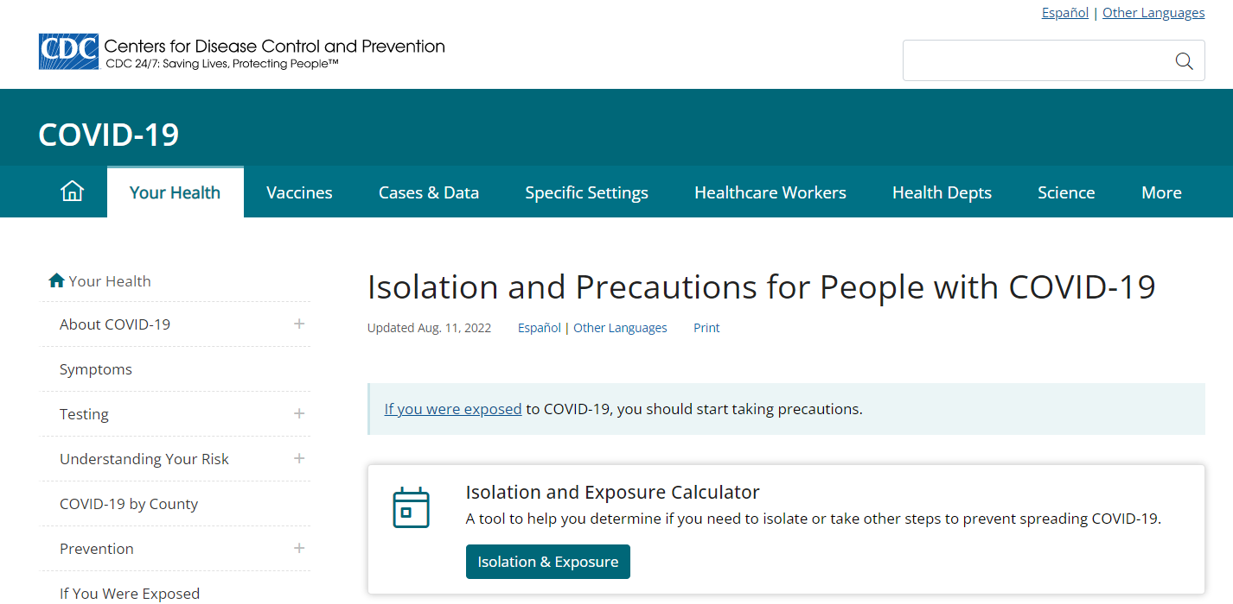

Slide 21
Summary Slide:
Viruses need other cells to replicate
Testing is based on detection of components of the virus; the gold standard per the CDC is NAAT but most POC or home testing is a variation of an antigen test
Manifestations of COVID can be classified into grades of a disease; these tend to dictate outpatient versus inpatient management
Severe/critical illness requires ICU or PCU level management

Slide 22
Agenda
Introduction
Therapeutics
Anticoagulation
Cardiac disease
Post-COVID syndrome
Vaccinations
Resources for Patients and Providers

Slide 23
Big Trials to be aware of
ACTIV:
1: Immune modulators
2: Outpatient monoclonal antibodies and other therapies
3: Inpatient monoclonal antibodies and other therapies
4: Anti-thrombotics
5: Big Effect trial
6: Outpatient repurposed drugs
STRIVE: inpatients with acute severe respiratory infection
RECOVER: evaluating treatments for long COVID. Multiple arms.
REMAP-CAP: designed to determine effective treatment strategies for patients with severe PNA
RECOVERY (randomized evaluation of COVID-19 Therapy)

Slide 24
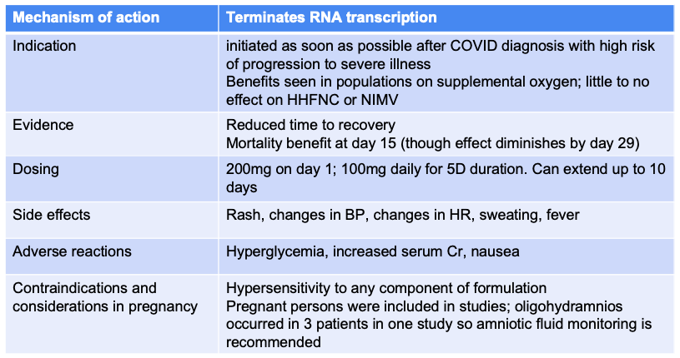
Therapeutics: Remdesevir

Slide 25
Evidence: Remdesevir
ACTT-1: NIH
1,062 hospitalized patients with confirmed SARS-CoV-2 and evidence of pulmonary disease
Result: the administration of remdesevir reduced time to recovery by 5 days and mortality by day 15 (this effect was diminished by day 29)
SOLIDARITY: WHO
Currently in pre-peer review format
Administration of remdesevir did not have an effect on 28 day in-hospital mortality; there was a trend towards decrease in mortality at 28 days for those with mild respiratory dysfunction but there were too few events to confirm this
No effect on progression to mechanical ventilation or length of hospitalization
SIMPLE: Gilead
596 adults across US, Europe, Asia.
No differences in mortality between intervention and control group

Slide 26
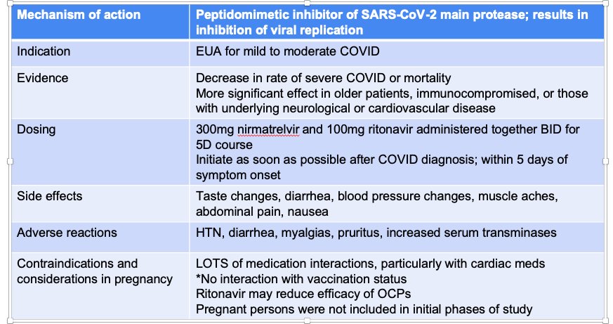
Therapeutics: Paxlovid (aka nirmatrelvir and ritonavir)

Slide 27
Evidence: Paxlovid
EPIC-HR trial led to EUA for treatment of mild to moderate COVID
Significant decrease in rate of severe COVID or mortality
Found to be more effective in older patients, immunosuppressed patients, and those with underlying neurological or cardiovascular disease
No significant interaction with vaccination status

Slide 28
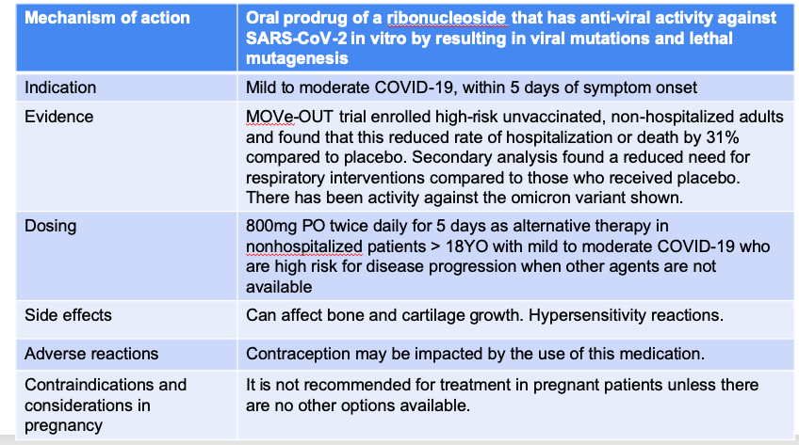
Therapeutics: Molnupiravir

Slide 29
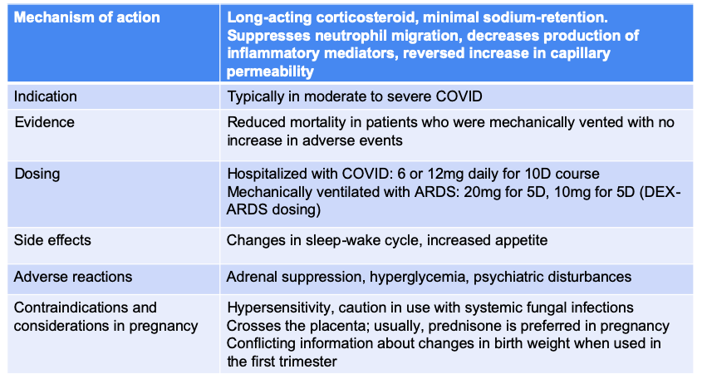
Therapeutics: Dexamethasone

Slide 30
Evidence: Dexamethasone
RECOVERY trial (2021):
2,104 patients randomized to receive dexamethasone and 4,321 to receive usual care
Lower incidence of death in dexamethasone group among patients receiving invasive mechanical ventilation and among those receiving oxygen without invasive mechanical ventilation
No difference among those receiving no respiratory support at time of randomization
Conclusions: lower 28D mortality (invasive or noninvasive support)
REACT working group: meta-analysis of administration of systemic corticosteroids in critically-ill patients with COVID-19
Found that administration of systemic corticosteroids compared with usual care or placebo was associated with lower 28 day all-cause mortality in that population
DEX-ARDS (2020): 277 patients randomly assigned to dexamethasone group and control group in patients with moderate to severe ARDS
Protocol: 20mg dexamethasone for 5 days followed by 10mg for 5 days
Higher number of ventilator-free days in dexamethasone group though trial stopped due to low enrollment

Slide 31
Evidence: Inhaled Corticosteroids
ACTIV-6: RCT of ICS monotherapy among predominantly vaccinated population. Included patients at modest risk for complications from COVID-19
Conclusions: treatment with inhaled fluticasone did not reduce hospitalizations, health care visits, or time to sustained recovery
RCT in Brazil studied combination of inhaled budesonide and oral fluvoxamine. >90% of patients studied had received at least 2 doses of the vaccine.
Conclusions: significant reduction in incidence of composite outcome of hospitalization or retention in COVID-19 emergency setting for > 6 hours. Did not find significant difference between secondary outcomes like health care attendance
There is insufficient evidence to recommend treatment either for or against the use of ICS in the treatment
Similarly, there is insufficient evidence to recommend for or against use of inhaled budesonide + fluvoxamine for the treatment of COVID-19 in non-hospitalized patients

Slide 32
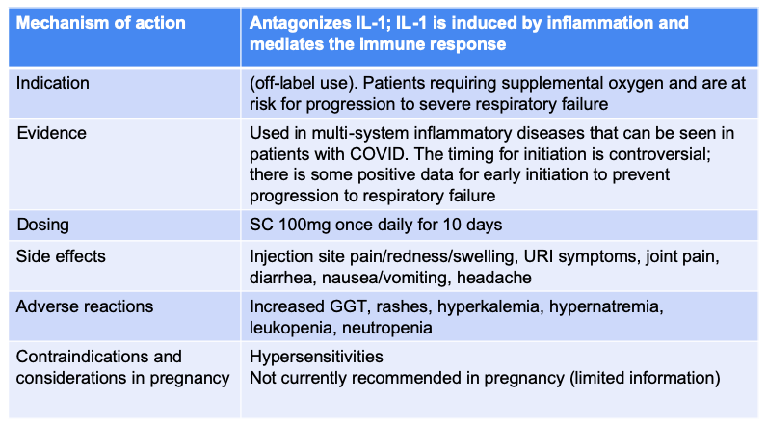
Therapeutics: IL-1 inhibitors (anakinra)

Slide 33
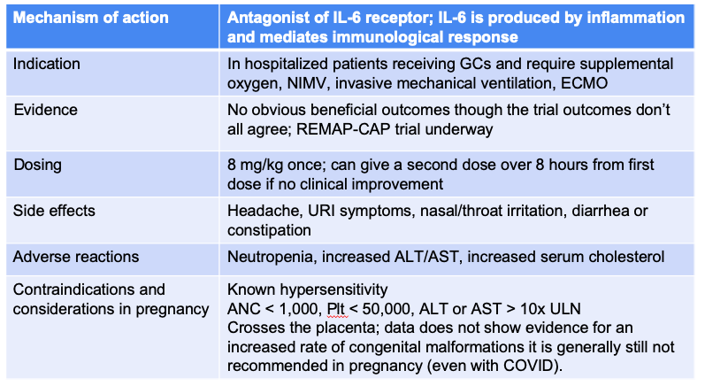
Therapeutics: IL-6 inhibitors (tocilizumab)

Slide 34
Evidence: Tocilizumab
Best studied of the IL-6 inhibitors in three RCTs
EMPACT
COVACTA
BACC BAY
REMAP-CAP is in progress
No beneficial outcomes consistently across the three RCTs though sporadic positive outcomes seen in each of the trials

Slide 35
Vilobelimab
EUA issued by the FDA in Apr 2023
Anti-C5a monoclonal antibody
Authorized in hospitalized patients when administered within 48H of mechanical ventilation or ECMO
Currently, there is insufficient evidence to recommend either for or against use in treatment of COVID-19

Slide 36
Pour one out for our retired therapies:
Hydroxychloroquine: no positive studies thus far
Ivermectin: no positive studies thus far
Bamlanivimab: reduced efficacy against current variants
Convalescent plasma
Evusheld (a combination of two human monoclonal antibodies against spike protein that was used a post-exposure prophylaxis in vulnerable patients)

Slide 37
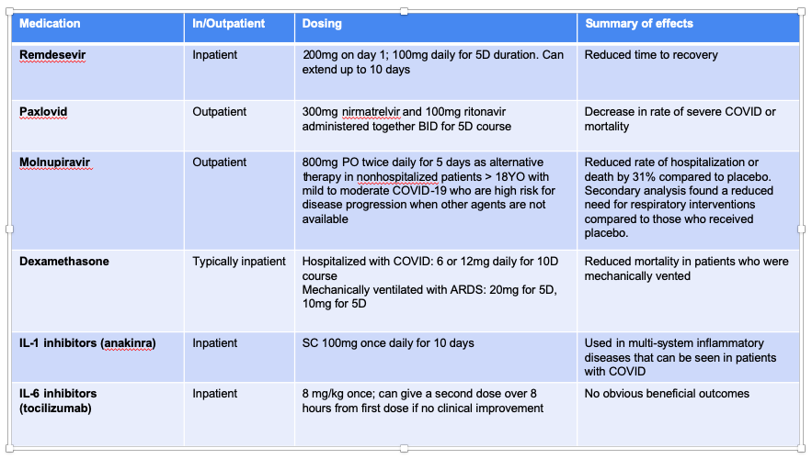

Slide 38
Updates to the guidelines
For patients who are immunocompromised, there is a loose recommendation for longer and/or additional courses of paxlovid or remdesevir
Dosing for remdesevir has been updated to be used without adjustment in patients with estimated GFR < 30 mL/min, including those on dialysis

Slide 39
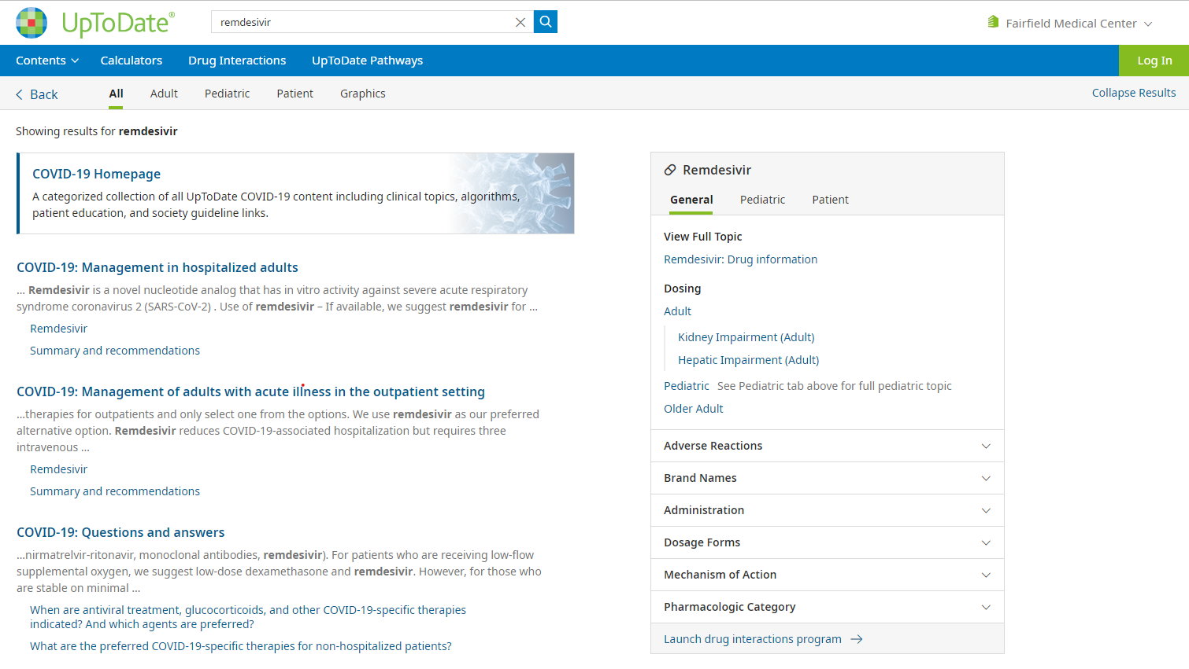

Slide 40
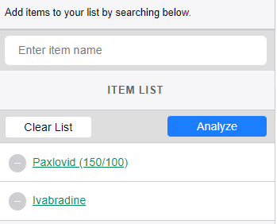

Slide 41
Agenda
Introduction
Therapeutics
Anticoagulation
Cardiac disease
Post-COVID syndrome
Vaccinations
Resources for Patients and Providers

Slide 42
Anticoagulation
Clinical concern: pathophysiologic mechanisms during the phases of systemic inflammation leading to large vessel macrothrombosis and primary endotheliopathy with more extensive immunothrombosis
Meta-analysis of 66 observational studies through Aug 2020
Prevalence of VTE in hospitalized patients: 9.5% without screening US, 40% with screening US
In ICU patients: 18.7% without screening US and 45.6% with
More severe disease and additional risk factors had higher risk of VTE than those with mild/asymptomatic disease
There is insufficient evidence from the NIH to recommend for or against routine VTE screening in patients with COVID-19 who do not have other signs/symptoms of VTE. However, in hospitalized patients with rapid deterioration of organ systems or localized loss of peripheral perfusion, they do recommend evaluation for thromboembolic disease

Slide 43
Non-hospitalized patients without evidence of VTE
NIH panel recommends against use of AC and antiplatelet therapy (such as aspirin, P2Y12 inhibitors) for prevention of VTE or arterial thrombosis outside of a clinical trial

Slide 44
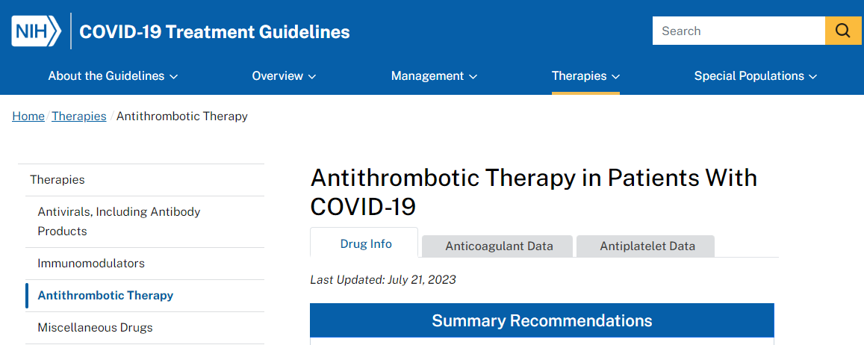

Slide 45
Non-Critically Ill Hospitalized Patients (without suspected VTE)
MPT stopped early for superiority: benefit for use of therapeutic dose anticoagulation compared to institution standard thromboprophylaxis in prevention of disease progression
Used same primary composite outcomes
RAPID: randomized 465 non-ICU patients with elevated D dimer to either therapeutic or prophylactic dosing
Primary outcome: composite of death, invasive mechanical ventilation, NIMV, ICU admission
Not statistically significant between the two arms
Decreased odds ratio for death in therapeutic dose arm
Was a numeric decrease in number of VTEs
The evidence is still confusing but generally, the panel recommends LMWH or UFH over oral AC. They recommend against the use of AC or anti-platelet therapy to prevent thrombosis outside of the usual standard-of-care. They recommend therapeutic dose heparin for patients with D-dimers above the ULN who require low-flow oxygen and a normal risk of bleeding

Slide 46
Critically Ill Patients (without suspicion for VTE)
Multiplatform Adaptive-Design Trial (the largest RCT for hospitalized patients involving ATTACC, ACTV-4a, REMAP-CAP): incorporated three multicenter studies
Primary outcome: 21-day organ support-free days (defined as the number of hospital days not requiring HFNC, NIMV, invasive mechanical ventilation, vasopressor therapy, ECMO) together with in-hospital mortality
Trial was stopped for futility: no benefit for therapeutic anticoagulation in reducing organ support or death at 21 days. Also, no difference in survival to discharge.
INSPIRATION trial: examined intermediate dose LMWH compared to standard prophylactic dose. No benefit in intermediate dose in preventing venous/arterial thrombosis, ECMO, or mortality within 30 days
Increase in major bleeding events: 2.5% in intermediate dose vs. 1.4% in standard prophylactic dose
ANTICOVID RCT: Mar 2023 (hot off the presses); RCT enrolling 334 patients with severe hypoxemic COVID-19 PNA
High dose prophylactic AC provided net clinical benefit of 4 fold reduction in de novo thrombosis with no increase in risk of bleeding compared to standard dose. No benefit from therapeutic AC.
Link: Table: Anticoagulant Therapy Clinical Data | COVID-19 Treatment Guidelines (nih.gov)

Slide 47
Anticoagulation after discharge
ACTION trial: compared therapeutic dose rivaroxaban for moderately ill inpatients
followed by 30 days post discharge. No decrease in events or mortality at 30 days compared to inpatient dosing of LMWH only
MICHELLE trial: addresses the role of extended dose rivaroxaban post discharge
Patients received standard heparin prophylaxis in the hospital and were randomly assigned to receive low-dose rivaroxaban (10mg daily for 35D) after discharge or nothing
More than half the patients in the study were in the ICU or CCU during hospitalization
Patients with risk factors like thrombocytopenia, severe renal failure were excluded
Primary outcome: composite of symptomatic or fatal VTE, asymptomatic VTE, symptomatic arterial thromboembolism, or cardiovascular death at day 35
Reduction in secondary endpoint of symptomatic and fatal VTE
Conclusions: in patients estimated to be at high risk for VTE and low bleeding risk, post-discharge anticoagulation can be effective at reducing thrombotic events and thrombotic-related death with low risk of bleeding
*Note: this is a small trial

Slide 48
ACTIV-4b
Placebo-controlled RCT evaluating efficacy of using ASA or prophylactic dosing apixaban in outpatients with COVID-19 > 40YO
657 outpatients
Trials topped in Jun 2021 due to low event rate for composite outcome of thromboembolic events, hospitalizations, or death

Slide 49
Summary of Recommendations
All hospitalized patients with COVID-19 should at least receive minimum thromboprophylaxis
LMWH is preferred over UFH
Combined pharmacologic and mechanical prophylaxis is not recommended
If there is no increased risk of bleeding: therapeutic dosing is recommended
There is now some debate in critically ill patients; there is a recommendation from the Mar 2023 study that we should be using higher dose prophylactic AC rather than standard dose
There is no advice on starting anticoagulation for acutely-ill COVID 19 positive outpatients
There is no advice on routine anticoagulation for post-discharge patients; there are scores like IMPROVEDD to determine whether an individual may merit post discharge prophylaxis. Analysis of a newer trial suggest that low dose prophylactic DOAC may be helpful
Aztrazeneca or J&J recipients were at a small risk for vaccine-induced immune thrombosis; there is no overall increased risk for VTE following mRNA vaccinations

Slide 50
Agenda
Introduction
Therapeutics
Anticoagulation
Cardiac disease
Post-COVID syndrome
Vaccinations
Resources for Patients and Providers

Slide 51
Cardiac complications
Significant proportion of COVID+ patients admitted to the hospital had an increased serum troponin
Associated with adverse outcomes
Proposed mechanisms:
Inflammation of myocardium
RV strain from pulmonary embolism
Demand NSTEMI
Direct myocardial injury
SIRS

Slide 52
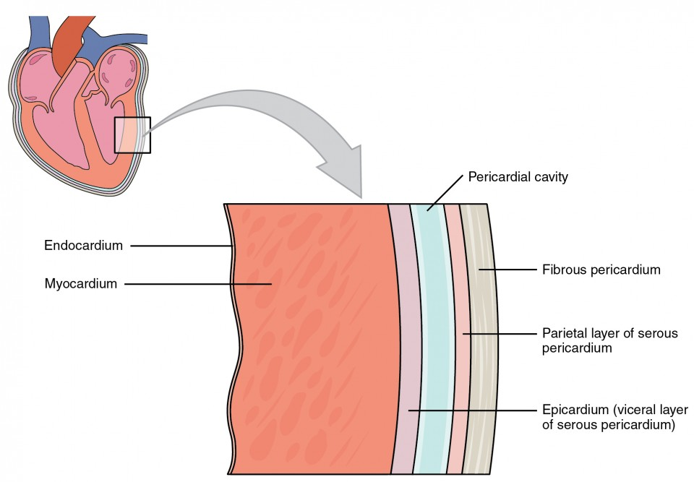
Photo credit: Heart Anatomy | Anatomy and Physiology II (lumenlearning.com)

Slide 53
Myocarditis and Pericarditis
Inflammation of the myocardium (myocarditis) or pericardium (pericarditis)
Symptoms:
Myocarditis: symptoms of new onset heart failure, chest pain, shortness of breath
Pericarditis: positional chest pain
Diagnosis:
Echocardiogram
EKG:
Pericarditis has a specific EKG pattern: diffuse ST elevation and PR depression
Troponin, BNP
Cardiac MRI

Slide 54
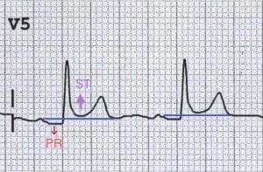
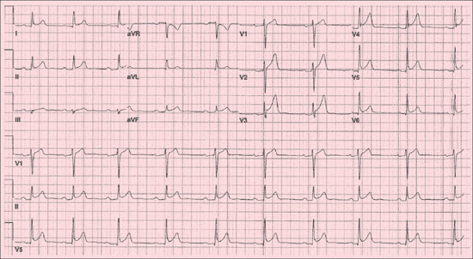
Photo credit: Pericarditis ECG Changes • LITFL • ECG Library Diagnosis
ECG Changes in Pericarditis | Consultant360

Slide 55
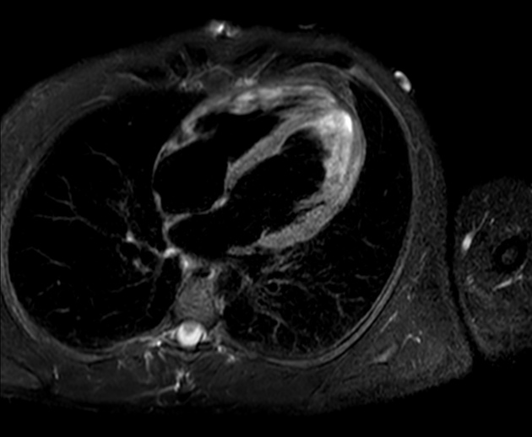
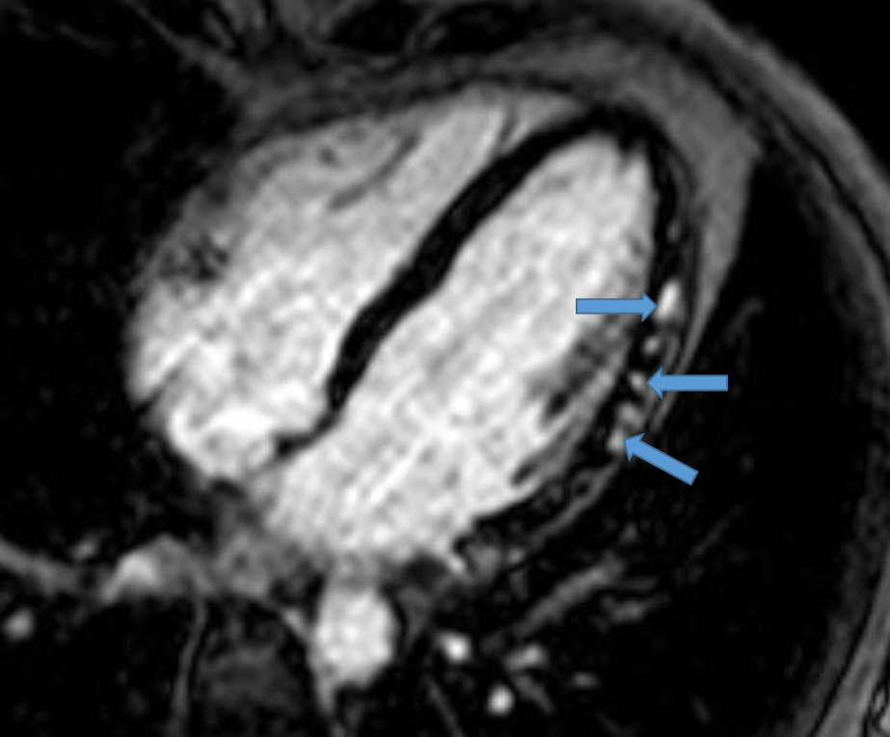
Photo credit: Acute myocarditis | Radiology Case | Radiopaedia.org
Photo credit: Myocarditis in the Athlete - American College of Cardiology (acc.org)

Slide 56
Myocarditis and Pericarditis
Reported in adolescents and young males within several days of mRNA vaccination (Pfizer or Moderna)
More often after second dose, within 1 week of vaccination
Rare
Most responded to standard care and could return to normal daily activities
Also associated with COVID-19 infection
Pericarditis was treated as it typically is, with NSAIDs, colchicine, +/- corticosteroids

Slide 57
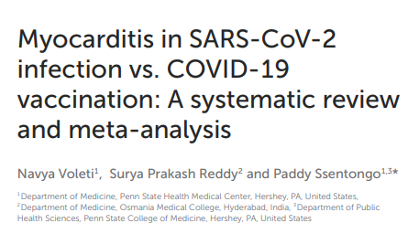
May 2022
22 studies with 55.5 million vaccinated cohorts and 2.5 in infection cohort
Findings: Risk of myocarditis after vaccination and infection increased by factor or 2 and 15 respectively
Younger populations had increased risk of myocarditis after receiving vaccination
Conclusion: Relative risk of myocarditis is more than seven-fold in persons infected with SARS-CoV-2 than in those who received the vaccine

Slide 58
One year later…
VA cohort who survived the first 30 days of COVID-19
Cohort was noted to be at an increased risk of cardiovascular diseases such as:
CVA
Dysrythmias
Ischemic and non-ischemia heart disease
Pericarditis, myocarditis
Heart failure
Thromboembolic disease
The breadth of cardiovascular disease involvement was “eye-opening” per investigators
Clinical takeaway: COVID-19 should be considered a cardiovascular disease risk

Slide 59
Summary slide:
COVID-19 infection remains a much higher risk factor for the development of myocarditis than vaccination does
However: Young, adolescent males are at a higher risk for myocarditis/pericarditis after vaccination
A history of COVID-19 may be considered an independent cardiovascular risk

Slide 60
Agenda
Introduction
Therapeutics
Anticoagulation
Cardiac disease
Post-COVID syndrome
Vaccinations
Resources for Patients and Providers

Slide 61
Post-COVID syndrome
Persistent health issues encompass the following:
“Long COVID”
Multi-organ effects of COVID
Effects of treatment/hospitalization
The clinical trajectory and long term outcomes are unknown
Many of the current guidelines are built on emerging data and established complications from prior respiratory viral infections
Post-ARDS literature: investigators found a heterogeneity in lung function impairments in short term follow up that generally resolved by 1 year
There is a subgroup that will have persistent physical impairments at 5 years out
Common findings: subjective dyspnea and physical impairment out of proportion to PFTs

Slide 62
Respiratory complications
Symptoms:
Dyspnea, cough, fatigue
Many patients have symptoms weeks to months after initial diagnosis
Radiographic findings:
Ground glass opacities
Fibrosis
Organizing pneumonia
Bronchial wall thickening
Bronchiectasis
PFT findings:
Diffusion impairments
Reductions in total lung capacity
Obstructive physiology

Slide 63
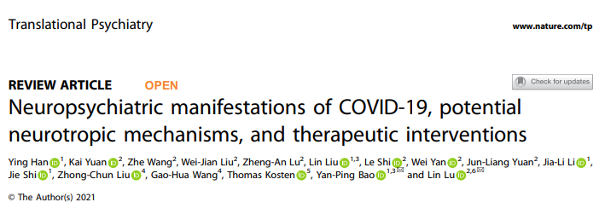
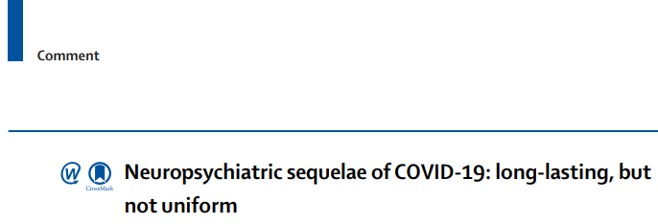

Slide 64
Neuropsychiatric manifestations of COVID-19
Wide scope of sequelae: mood disorders like anxiety and depression, memory impairment, psychotic disorders, dementia
The risk of mood disorders peaked during acute infection and returned to baseline within a couple months
The incidence of psychotic disorders and dementia did not normalize over the 2 year follow-up period
Potential etiologies: based on early postmortem brain MRIs and antibody titers
White matter changes
Acute hypoxic injury in vulnerable regions
Encephalopathy without brainstem changes
Impaired blood brain barrier?

Slide 65
PICS: Post Intensive Care Syndrome
Impairments in physical, cognitive, and mental health functions after an episode of critical illness
Examples: PTSD, depression, anxiety, neuromuscular weakness, critical illness myopathy
Even people with mild disease can have protracted symptoms including:
Reported decrease in quality of life
Dyspnea
Chest pain, cough, fatigue
Joint pains

Slide 66
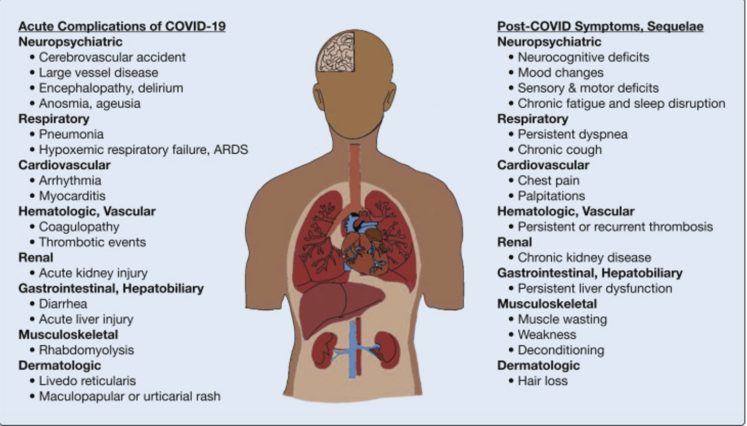
Lutchmansingh, D et al. CHEST 2020

Slide 67
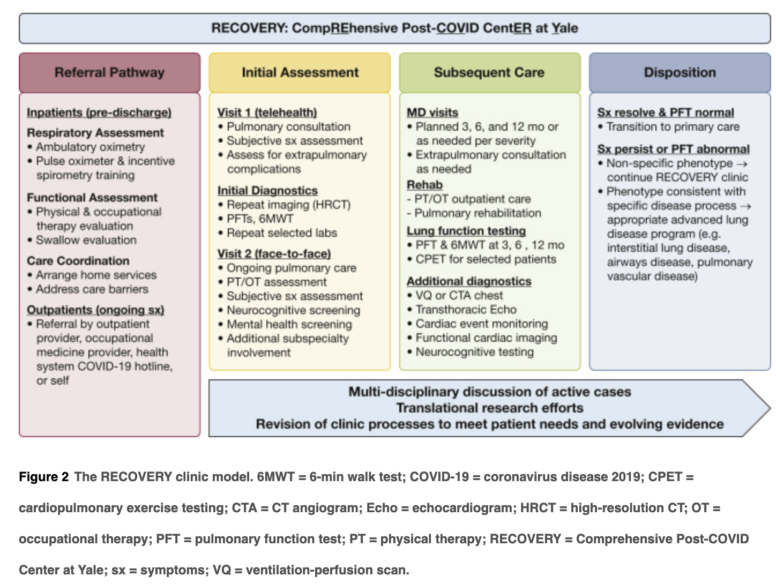

Slide 68
INSPIRE trial
CDC funded to study long-term health outcomes
Prospective multicenter longitudinal cohort study in 8 regions across the US
Involves completing online surveys every 3 months for a total of 18 months
Inclusion criteria: (estimated enrollment: 6,000 participants)
>18 YO
At least one self-reported symptom of acute infection
Positive test result

Slide 69
Modafinil
Currently case-report level data in use for “brain fog” and severe fatigue as part of the long-COVID syndrome
Currently undergoing study in an NIH clinical trial
Starting dose: 200mg daily
Kozlov, Max.
Nature News 1 Aug 2023

Slide 70
Local resources:
Recommendations as primary care providers:
Caring for People with Post-COVID Conditions | CDC
Post-COVID Syndrome | AAFP
Long COVID Patient Fact Sheet (thoracic.org)
Coronavirus disease (COVID-19): Post COVID-19 condition (who.int)
Places to refer:
Ohio State University: PACS (Post-Acute Sequelae of COVID-19)

Slide 71
Agenda
Introduction
Therapeutics
Anticoagulation
Cardiac disease
Post-COVID syndrome
Vaccinations
Resources for Patients and Providers

Slide 72
COVID-19 Vaccines
Modified mRNA vaccines: manufactured by Moderna and Pfizer
Lipid nanoparticle-formulated nucleoside-modified mRNA encoding the spike glycoprotein
Adenovirus vector: J&J
Uses modified version of a different virus to inform cells to produce the spike protein. Cells then display them on their surfaces, allowing the body’s immune system to recognize and produce antibodies against this
Protein subunit: Novovax
Not commonly administered in the US

Slide 73
COVID-19 Vaccines
Updated (bivalent): protect against both the original virus and the omicron variant BA.4 and BA.5
Pfizer and Moderna both have updated vaccines
Original vaccines are sometimes called monovalent; they were designed to protect against the original virus
New vaccines are expected in Fall 2023

Slide 74
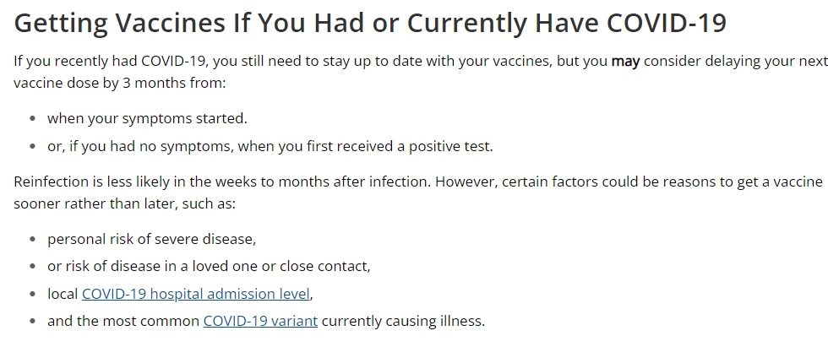

Slide 75
Current CDC Recommendations
Every 6 years and older should get 1 updated Pfizer or Moderna vaccine regardless of whether they’ve received the original vaccines
>65YO can get a 2nd updated dose of updated Pfizer or Moderna
People who are moderately to severely immunocompromised can get additional doses of updated Pfizer or Moderna
6mos-5YO: may need multiple doses to be up to date, including at least one dose of updated Pfizer or Moderna

Slide 77
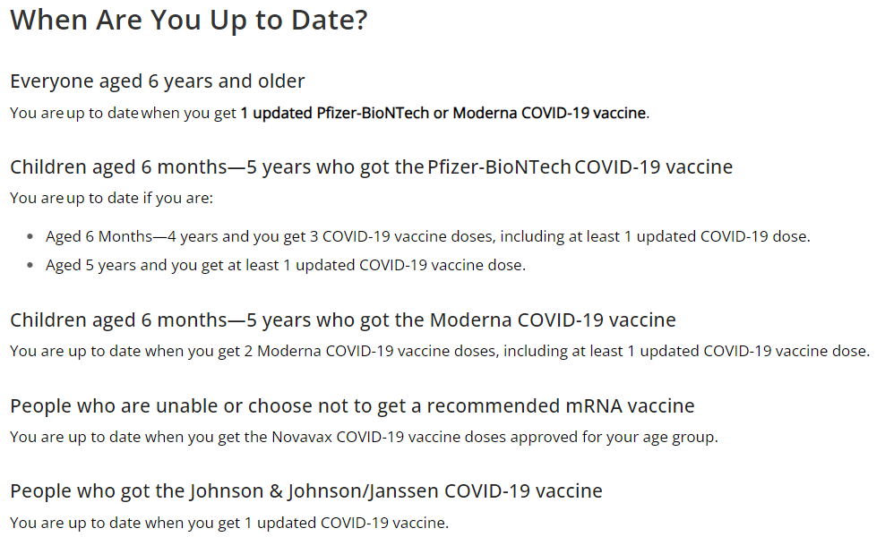

Slide 78
What is considered moderate to severe immunocompromise?
active treatment for solid tumor and hematologic malignancies
hematologic malignancies associated with poor responses to vaccines (regardless of current treatment status): NHL, multiple myeloma, acute leukemia, chronic lymphocytic leukemia
receipt of solid organ or islet transplant; taking immunosupressive therapy
moderate or severe primary immunodeficiency: CVID, DiGeorge, Wiskott-Aldrich
advanced HIV: CD4 < 200
active treatment with corticosteroids > 20mg/day for > 2 weeks, alkylating agents, antimetabolites, TNF blockers, biologics that are B cell depleting

Slide 79
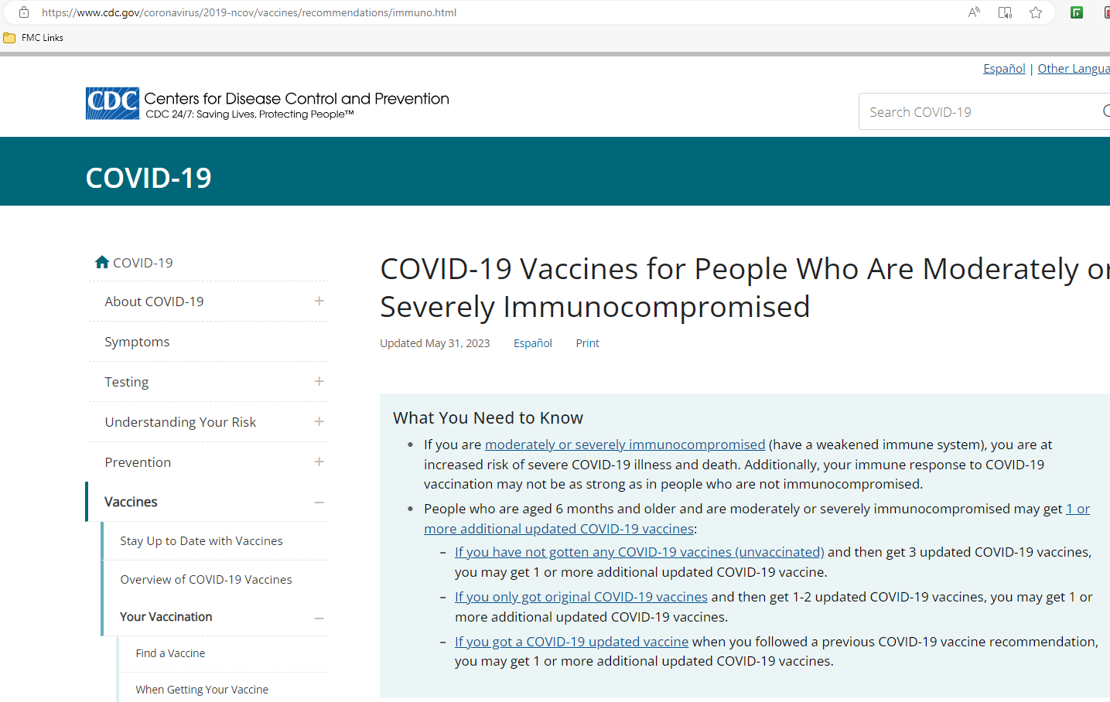

Slide 80
Recommendations for Pregnant Persons:
General note: NONE of the COVID vaccines contains a live virus. They cannot cause COVID 19 in anyone.
However, fever in pregnancy can be associated with adverse outcomes (regardless of reason); this can be treated with acetaminophen.
current CDC recommendations: any patient> 6mos of age INCLUDING people who are pregnant, breastfeeding, trying to get pregnant now or might become pregnant in the future. Antibodies made by pregnant person can travel to baby before birth or through breastmilk after birth
vaccination is recommended at any point during pregnancy
it is recommended that people who are breastfeeding get vaccinated and stay up to date. There is no evidence for harm to person or baby during breastfeeding
Pregnant people can get the COVID-19 vaccine and other vaccines like the flu vaccine at the same time

Slide 81
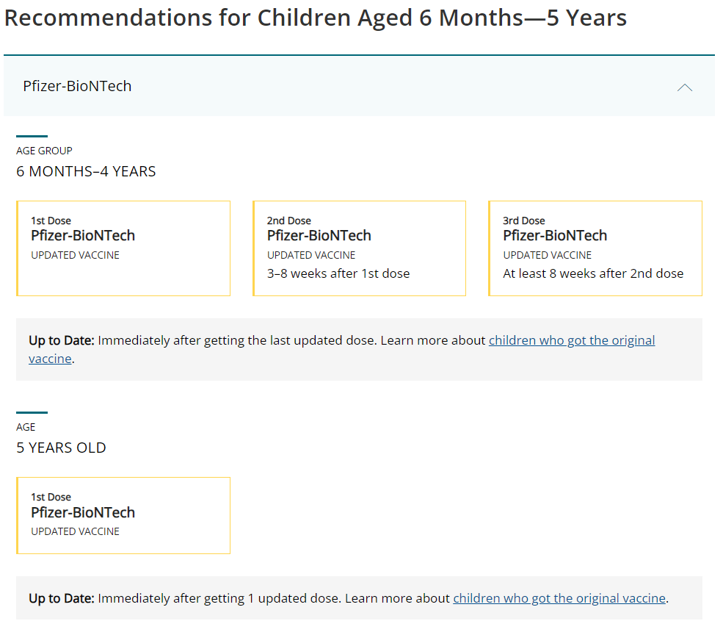

Slide 82
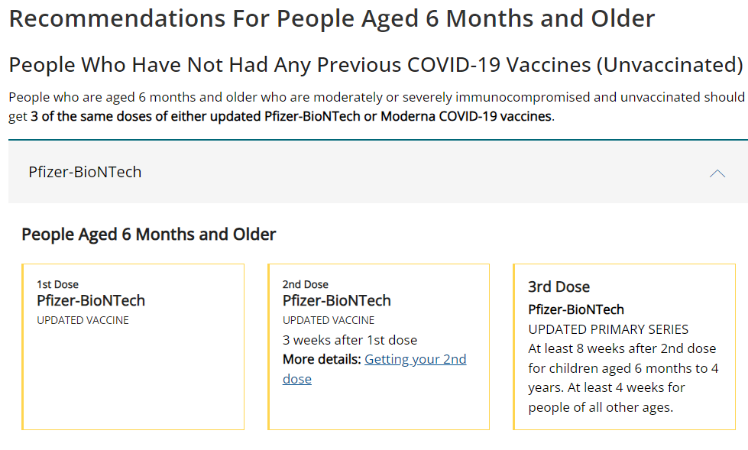
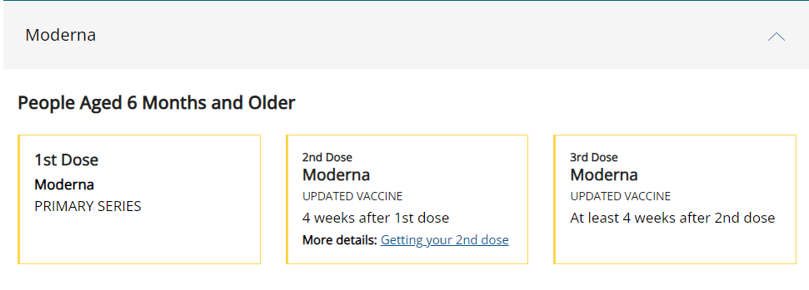

Slide 83
Pre-vaccination counseling: Addressing Concerns
local reactions
systemic reactions
antipyretic or analgesic medications can be taken for treatment but shouldn’t be used prophylactically
localized axillary LAD
myocarditis/pericarditis
anaphylactic reactions

Slide 84
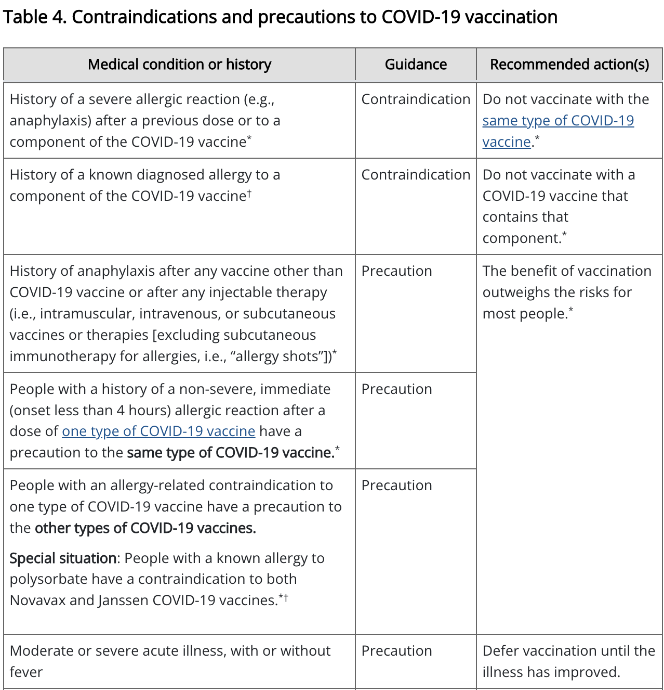
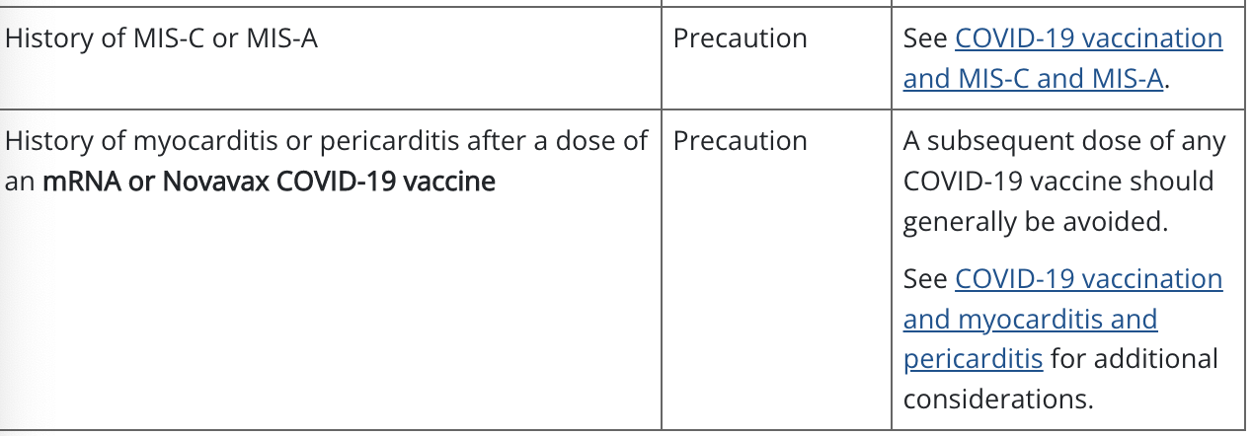

Slide 85
Summary: Vaccine recommendations
Photo credit: History of advertising: No 118: Nike's 'Just do it' tagline (campaignlive.co.uk)

Slide 86
Agenda
Introduction
Therapeutics
Anticoagulation
Cardiac disease
Post-COVID syndrome
Vaccinations
Resources for Patients and Providers

Slide 87
Resources for HCWs and Patients
General Resources | COVID-19 (ohio.gov)
More Resources about COVID-19 | CDC
Coronavirus Disease 2019 (COVID-19) Resources for Patients | FDA
Community Resources During Coronavirus (COVID-19) Outbreak | Columbus OH (cap4kids.org)
Critical Updates on COVID-19 (aap.org)
COVID-19, Pregnancy, Childbirth, and Breastfeeding: Answers From Ob-Gyns | ACOG
Coronavirus (COVID-19): Information for Patient Families (nationwidechildrens.org)
COVID-19 Parental Resources Kit – Adolescence (cdc.gov)
LITFL • Life in the Fast Lane

Slide 88
Works Cited
Khani, Elnaz et al. Current evidence on the use of anakinra in COVID-19. Int Immunopharmacol. Oct 2022.
Chippa, Venu et al. Post Acute Coronavirus (COVID-19) syndrome. StatPearls. 2022.
Patel, Pragna et al. Clinical Characteristics of Multisystem Inflammatory Syndrome in Adults: A systematic review. JAMA. 2021.
Kreuziger, Lisa Baumann et al. COVID-19 and VTE/Anticoagulation: Frequently Asked Questions. ASH. 2022.
Noman, Ali et al. Spike glycoproteins: Their significance for corona viruses and receptor binding activities for pathogenesis and viral survival. Microb Pathog. 2021.
Bradbury, Charlotte A and Zoe McQuilten. Anticoagulation in COVID-19. The Lancet. 2022.
Faroukh, Michael E. et al. Anticoagulation in Patients with COVID-19: JACC Review Topic of the Week. JACC 2022.
Abbasi, Jennifer. The COVID Heart – One Year After SARS-CoV-2 Infection, Patients Have An Array of Increased Cardiovascular Risks. JAMA. 2022.
Labbe, Vincent et al. Effects of Standard-Dose Prophylactic, High-Dose Prophylactic, and Therapeutic Anticoagulation in Patients with Hypoxemic COVID-10 Pneumonia: The ANTICOVID Randomized Clinical Trial. JAMA. 2023
Additional resources: CDC, NIH, WHO, AAFP, JAMA

Slide 89
Thank you! Questions? drasingh@fmchealth.org

